Slide 1
$$\frac{4}{12}=\frac{?}{18}$$
Kathryn earns £$12$ for every $4$ trees she plants. How much does she earn for planting 18 trees?
$$(?, 18)$$
$$(4, 12)$$
Maryse walks $12$ miles in $4$ hours. How long does it take her to walk $18$ miles?
4 yards is equal to $12$ feet.
How many yards are there in $18$ feet?
$4$ cm
 | $12$ cm
$?$ cm
 | $18$ cm

Slide 2
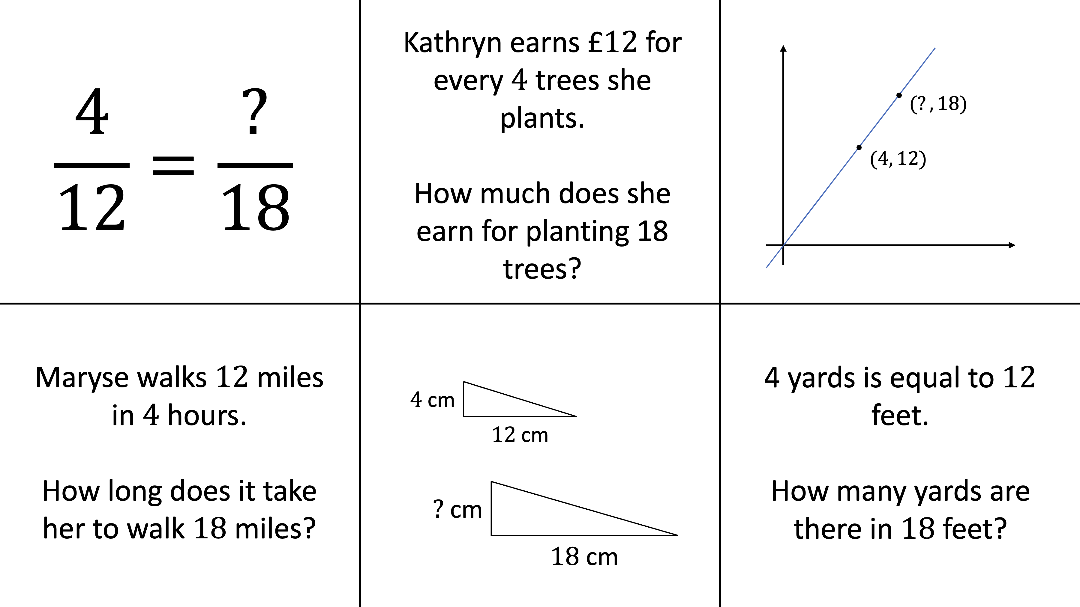
(1) | (2) | (3)
(8) |  | (4)
(7) | (6) | (5)
Which question is the odd one out? Why? | How could you change that question so that it would fit with the others? | What does $3$ represent in each question?
‘Maryse walked 4 miles in 12 hours. How many miles would she walk in 18 hours?’ Can the other questions be adapted in the same way? |  | How could the graph be used to represent each of the other questions?
What extra questions could be added that would fit with the others? | What does $1.5$ represent in each question? | How could a ratio table be used for each question?

Slide 3
Nikki spilled some ink over her maths homework.
Can you still answer the question?
$$3\left(12x+4\right)=2\left(18x+\boxed{} \right)$$
A rectangle has perimeter $12 \text{cm}$ and width $4 \text{cm}$.
An enlargement of that rectangle has perimeter $18 \text{cm}$. What is its width?
David and Amber share money in the ratio $4 :12$.
David Amber
$$£ \boxed{}$$
$$£18$$
Charlotte takes a counter from the box at random $18$ times. Estimate the number of times she will take a blue counter.
$$12x=4y$$
$y$ is equal to $18$. What is the value of $x$?
$12\%$ of a number is $4$. What is $18\%$ of that number?
B
B
G
R
G
G
G
R
B
R
B
G

