Slide 1
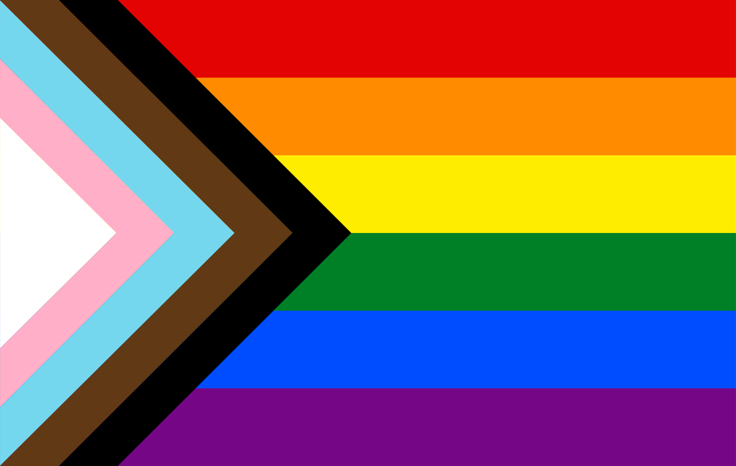
1. If each small square measured $1$ cm by $1$ cm, what would be the total area and perimeter of the flag? a) Area = b) Perimeter = | 2. a) Approximate the area of the orange strip of the flag. b) What shape is the orange stripe? c) Which other stripe has the same area as orange? How do you know? |  | 3. a) Explain why the top length of the yellow strip is exactly $7\frac{1}{3}$ cm. b) Calculate the area of yellow. |  | 4. a) Use Pythagoras’ Theorem to calculate the length of the diagonal side of the green strip. b) Calculate the perimeter of green.
Background Information Shown to the right is the ‘Progress Pride Flag’ designed by Daniel Quasar in 2018. It shows the traditional six colours of the rainbow pride flag used by LGBTQIA+ communities since the 1970s, with added triangular ‘chevrons’ representing additional groups such as transgender people and people of colour. |  |  |  | 5. a) What are the gradients of the edges of the black chevron? Are any parallel? Perpendicular? b) Calculate the length of each of those edges.
6. What percentage of the total area of the flag is dark blue? | 7. If the origin was in the bottom-left corner of the flag, what would be the equation of the edge between violet and black? |  | 8. a) What is the area of white? b) What is the area of pink? |  | 9. What fraction of the total area of the flag is light blue?
 |  |  |  |  |  | interwovenmaths.com

Slide 2
1. If each small square measured $1$ cm by $1$ cm, what would be the total area and perimeter of the flag? a) Area = $6 × 12=72$ cm² b) Perimeter = $2\left(6+12\right)=36$ cm | 2. a) Approximate the area of the orange strip of the flag. $\sim 8$ boxes $→8$cm² b) What shape is the orange stripe? A trapezium c) Which other stripe has the same area as orange? How do you know? Dark blue, by symmetry |  | 3. a) Explain why the top length of the yellow strip is exactly $7\frac{1}{3}$ cm. Each time the black diagonal goes down 1, it goes right by $1\frac{1}{3}$. b) Calculate the area of yellow. $\frac{1}{2} × 1 × \left(6+7\frac{1}{3}\right)=6\frac{2}{3}$ cm² |  | 4. a) Use Pythagoras’ Theorem to calculate the length of the diagonal side of the green strip. $\sqrt{1^{2}+{\left(1\frac{1}{3}\right)}^{2}}=1\frac{2}{3}$ cm b) Calculate the perimeter of green. $6+1+7\frac{1}{3}+1\frac{2}{3}=16$ cm
Solutions Shown to the right is the ‘Progress Pride Flag’ designed by Daniel Quasar in 2018. It shows the traditional six colours of the rainbow pride flag used by LGBTQIA+ communities since the 1970s, with added triangular ‘chevrons’ representing additional groups such as transgender people and people of colour. |  |  |  | 5. a) What are the gradients of the edges of the black chevron? Are any parallel? Perpendicular? The gradients are $\frac{3}{4}$ and $−\frac{3}{4}$. So there are pairs of parallel edges, but not perpendicular edges. b) Calculate the length of each of those edges. $\sqrt{3^{2}+4^{2}}=5$ cm
6. What percentage of the total area of the flag is dark blue? Area = $\frac{1}{2} × 1 ×\left(8\frac{2}{3}+7\frac{1}{3}\right)=8$ cm² So $\frac{8}{72}=11\text{.}\dot{1}\%$ of the flag is dark blue. | 7. If the origin was in the bottom-left corner of the flag, what would be the equation of the edge between violet and black? $$y=\frac{3}{4}x−\frac{3}{2}$$ |  | 8. a) What is the area of white? $\frac{1}{2} × 3 × 2=3$ cm² b) What is the area of pink? $\frac{1}{2}×4\frac{1}{2}×3−3=3\frac{3}{4}$ cm² |  | 9. What fraction of the total area of the flag is light blue? Area = $\frac{1}{2}×6×4−3\frac{1}{4}−3=5\frac{1}{4}$ cm² So $\frac{5.25}{72}=\frac{7}{96}$ of the flag is light blue.
 |  |  |  |  |  | interwovenmaths.com

Slide 3
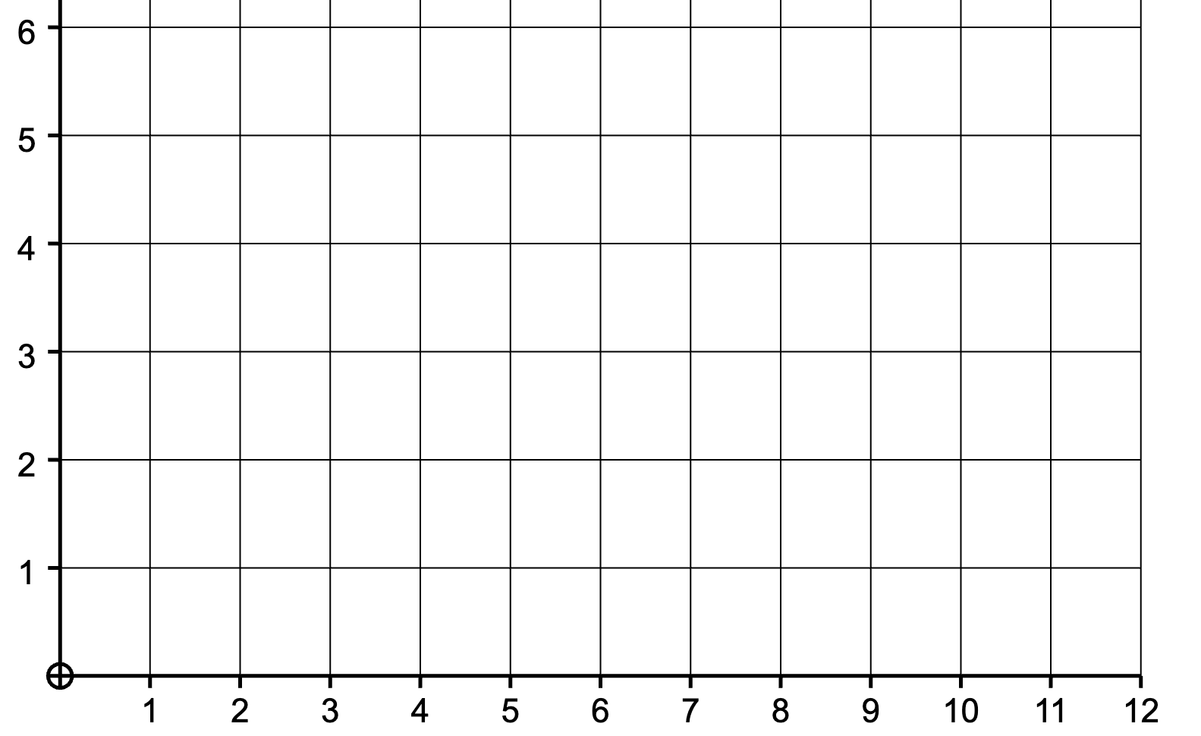
1. What is the colour of the region where each point is located? $\left(2,4\right)$ $\left(5.5, 3.5\right)$ $\left(1.5, 4\right)$ $\left(3.4, 5.1\right)$ | 2. Which colours does each line pass through? a) $y=x$ b) $x=4$ c) $x+y=7$ |  | 3. What is the colour of the region where each pair of lines meet? $y=2x−2$ and $y=x+1$ $y=3x+1$ and $y=5−x$ |  | 4. Find the coordinates of each point where three colours meet.
Background Information Shown to the right is the ‘Progress Pride Flag’ designed by Daniel Quasar in 2018. It shows the traditional six colours of the rainbow pride flag used by LGBTQIA+ communities since the 1970s, with added triangular ‘chevrons’ representing additional groups such as transgender people and people of colour. |  |  |  | 5. a) What are the equations of the four lines that border the green stripe? b) What four inequalities does the green stripe satisfy?
6. Find the coordinates of the point that divides the yellow/green border in the ratio $2 :1$. | 7. Explain using gradients why the white triangle is not right-angled. |  | 8. Find the equation of the straight line connecting the top-left of the flag to the bottom-right of the flag. |  | 9. Create and solve your own question using the Progress Pride Flag!
 |  |  |  |  |  | interwovenmaths.com

Slide 4
1. What is the colour of the region where each point is located? $\left(2,4\right)→$ Light Blue $\left(5.5, 3.5\right)→$ Yellow $\left(1.5, 4\right)→$ Pink $\left(3.4, 5.1\right)→$ Red | 2. Which colours does each line pass through? a) $y=x$ Light Blue, Brown, Black, Orange, Red b) $x=4$ Violet, Blue, Black, Brown, Orange, Red c) $x+y=7$ Brown, Black, Green, Blue, Violet |  | 3. What is the colour of the region where each pair of lines meet? $y=2x−2$ and $y=x+1$ Brown – $\left(3, 4\right)$ $y=3x+1$ and $y=5−x$ Pink – $(1,4)$ |  | 4. Find the coordinates of each point where three colours meet.
Solutions Shown to the right is the ‘Progress Pride Flag’ designed by Daniel Quasar in 2018. It shows the traditional six colours of the rainbow pride flag used by LGBTQIA+ communities since the 1970s, with added triangular ‘chevrons’ representing additional groups such as transgender people and people of colour. |  |  |  | 5. a) What are the equations of the four lines that border the green stripe? $y=2$, $y=3$, $x=12$, $y=\frac{3}{4}x−\frac{3}{2}$ b) What four inequalities does the green stripe satisfy? $y≥2$, $y≤3$, $x≤12$, $y≤\frac{3}{4}x−\frac{3}{2}$
6. Find the coordinates of the point that divides the yellow/green border in the ratio $2 :1$. $(10, 3)$ | 7. Explain using gradients why the white triangle is not right-angled. The gradients of the two non-vertical sides are $\frac{3}{4}$ and $−\frac{3}{4}$, which are not negative reciprocals of one another. |  | 8. Find the equation of the straight line connecting the top-left of the flag to the bottom-right of the flag. $$y=−\frac{1}{2}x+6$$ |  | 9. Create and solve your own question using the Progress Pride Flag!
 |  |  |  |  |  | interwovenmaths.com
$(3\frac{1}{3},1)$ | $(3\frac{1}{3},5)$
$(4\frac{2}{3},2)$ | $(4\frac{2}{3},4)$
$(6, 3)$

