Slide 1
 | Expanded | Factorised | Completed | Roots | $y$-intercept | Vertex | Sketch
a | $y=x^{2}−6x−16$ | $y=(x+2)(x−8)$ | $y={\left(x−3\right)}^{2}−25$ | $x=−2, x=8$ | $(0, −16)$ | $(3, −25)$ | ☑︎
b |  |  | $y={\left(x−5\right)}^{2}−4$
c |  | $y=(x+13)(x−1)$
d |  |  |  |  |  |  | ☑︎
e | $y=x^{2}−8x+16$
f |  |  |  | $x=−3,x=5$ | $(0, −15)$
g |  | $y=3(x+3)(x−5)$
h |  |  |  |  | $(0, 24)$ | $(7, −25)$
i |  |  |  |  |  |  | ☑︎
j |  |  |  |  |  |  | ☑︎
k | $y=−2x^{2}+20x+22$
l |  |  |  | $x=−1,x=10$ | $(0, 20)$

Slide 2
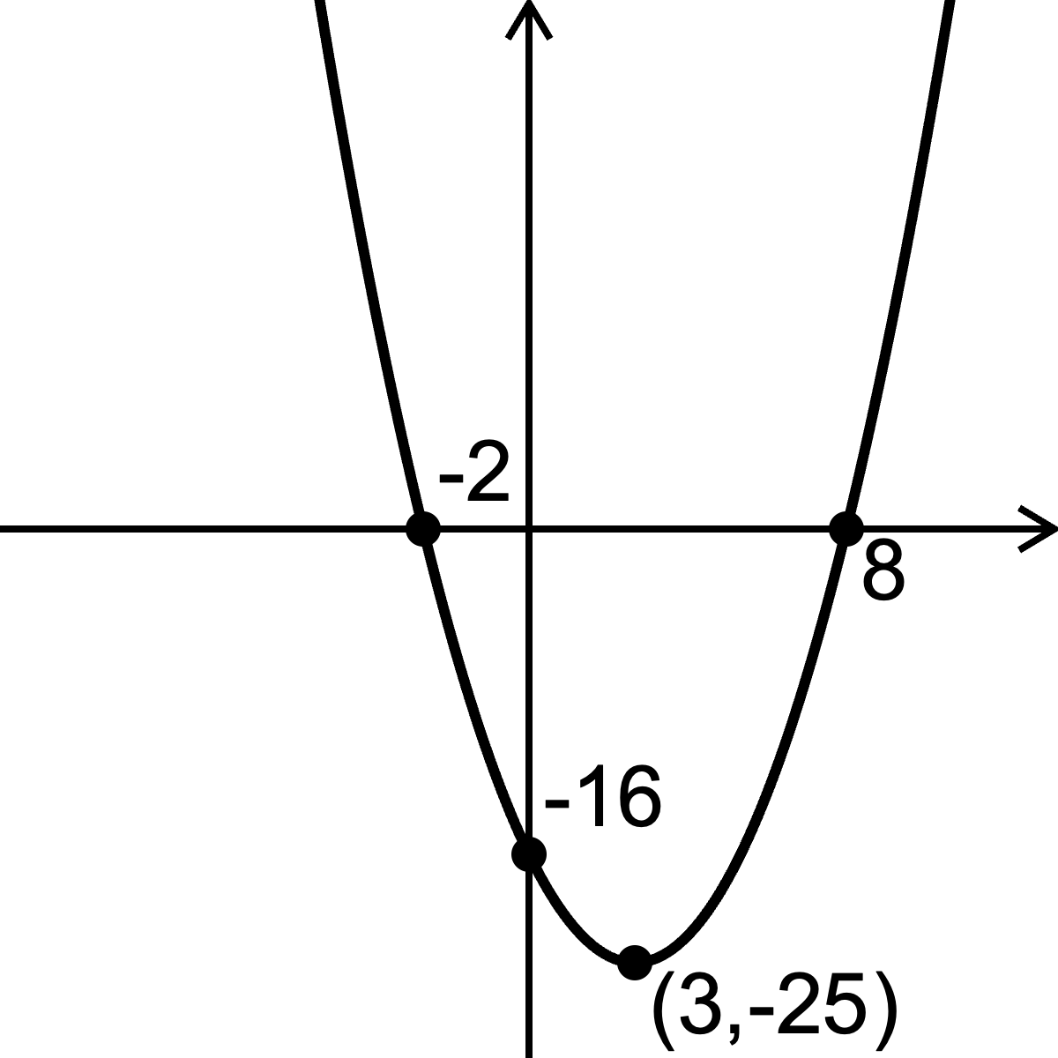
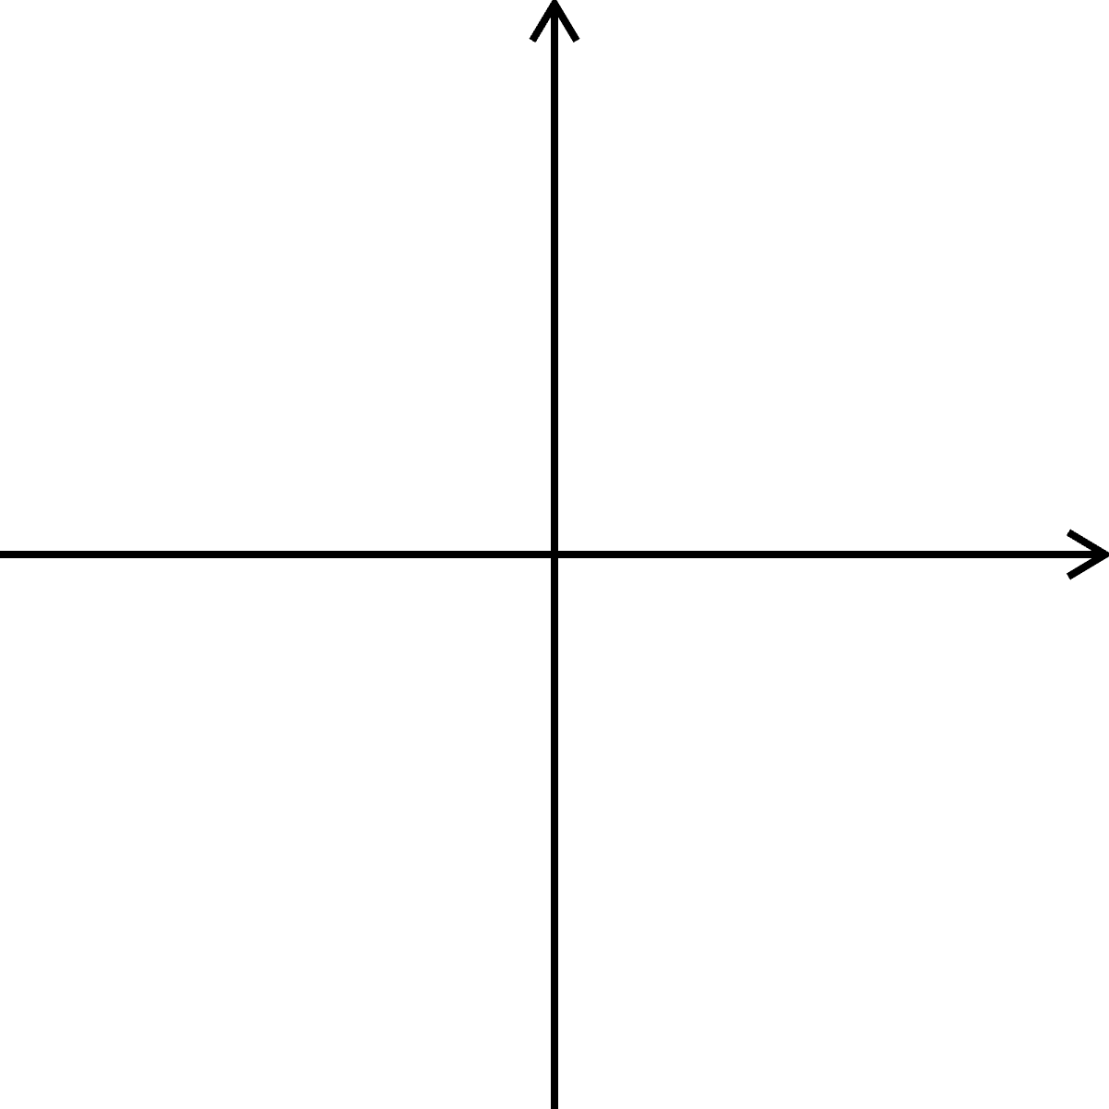
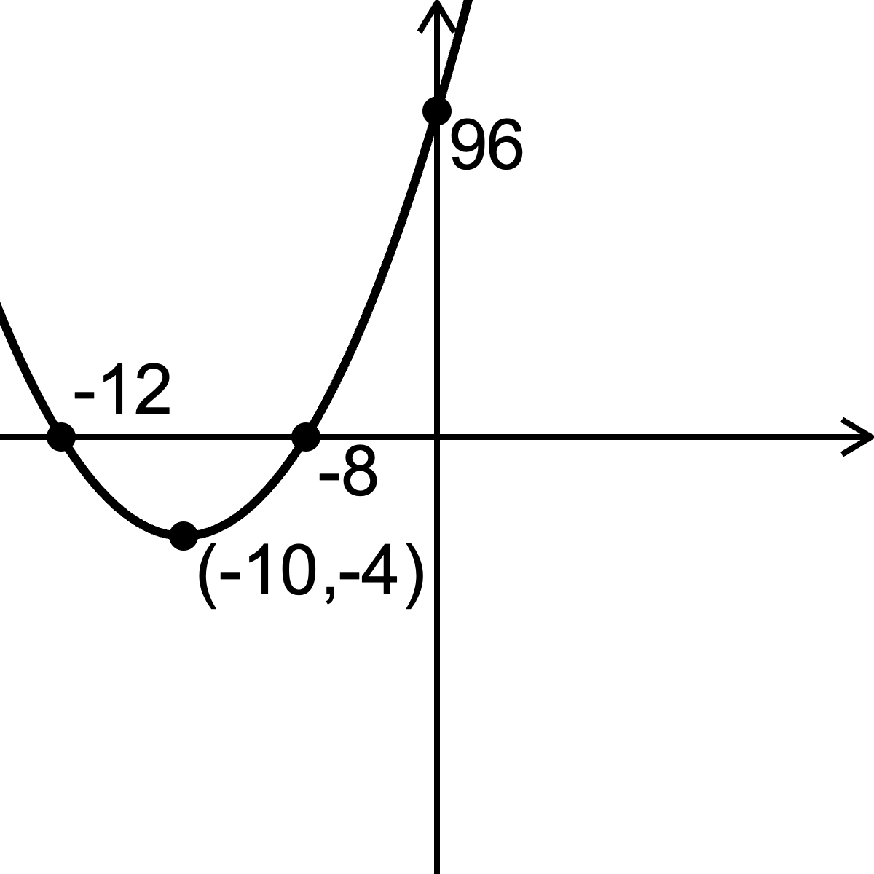
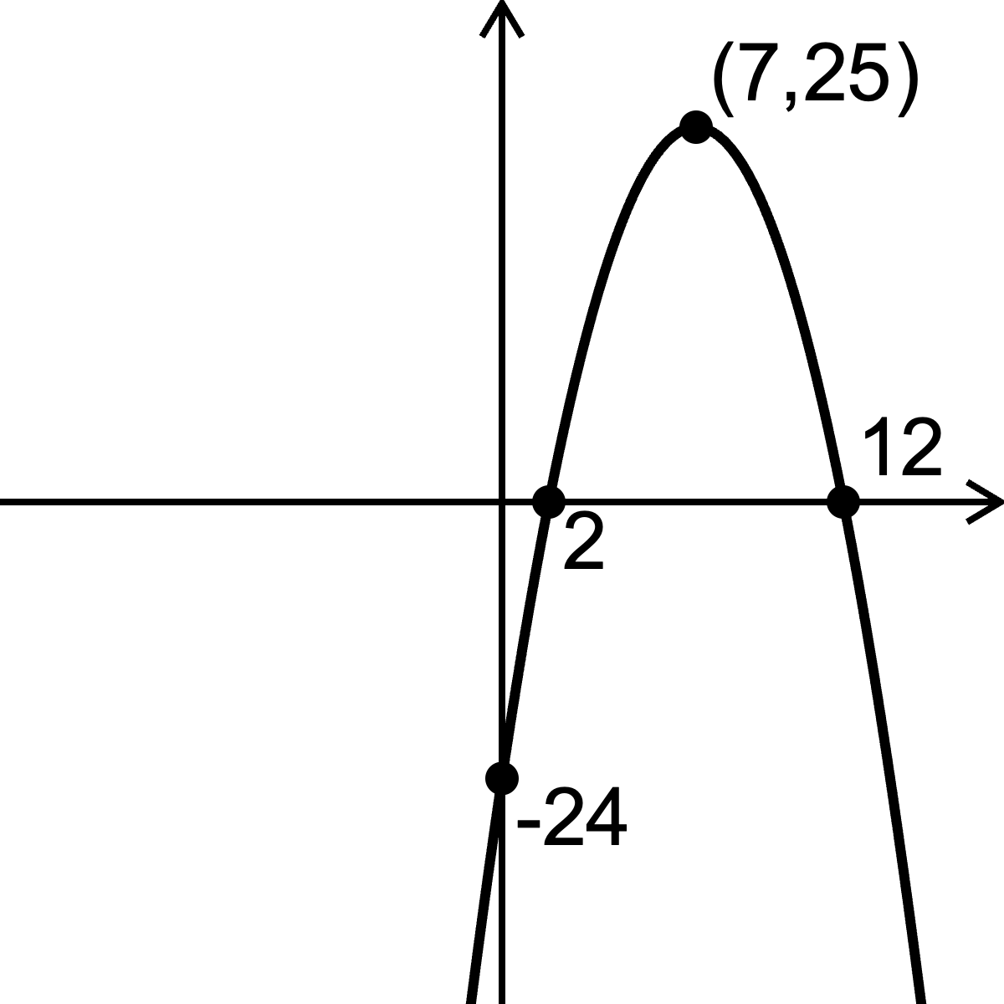
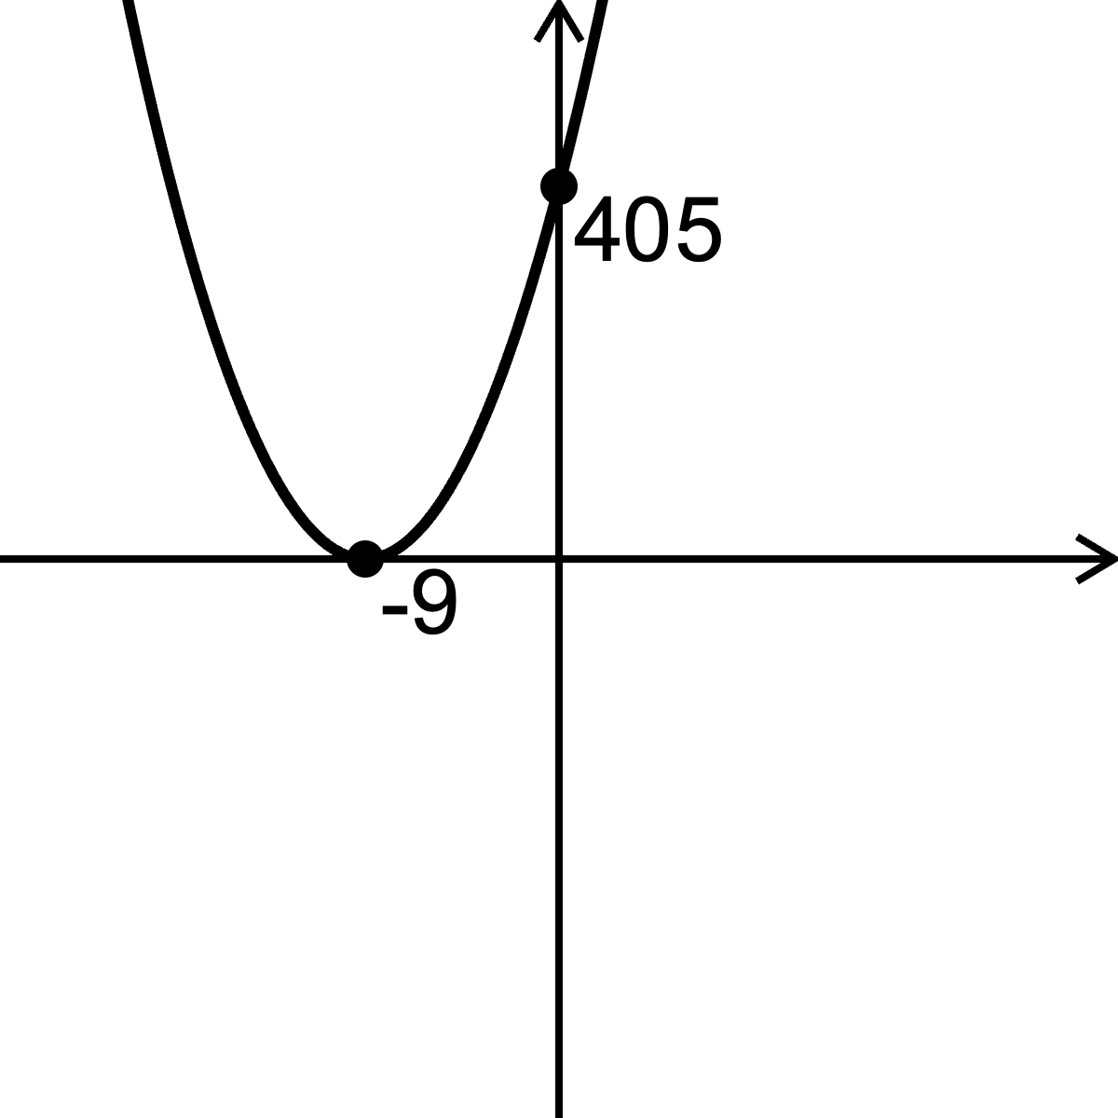
Sketches
a | b | c | d
e | f | g | h
i | j | k | l

Slide 3
 | Expanded | Factorised | Completed | Roots | $y$-intercept | Vertex | Sketch
a | $y=x^{2}−6x−16$ | $y=(x+2)(x−8)$ | $y={\left(x−3\right)}^{2}−25$ | $x=−2, x=8$ | $(0, −16)$ | $(3, −25)$ | ☑︎
b | $y=x^{2}−10x+21$ | $y=(x−3)(x−7)$ | $y={\left(x−5\right)}^{2}−4$ | $x=3, x=7$ | $(0, 21)$ | $(5, −4)$ | ☑︎
c | $y=x^{2}+12x−13$ | $y=(x+13)(x−1)$ | $y={\left(x+6\right)}^{2}−49$ | $x=−13,x=1$ | $(0, −13)$ | $(−6, −49)$ | ☑︎
d | $y=x^{2}+20x+96$ | $y=(x+12)(x+8)$ | $y={\left(x+10\right)}^{2}−4$ | $x=−12, x=−8$ | $(0, 96)$ | $(−10, −4)$ | ☑︎
e | $y=x^{2}−8x+16$ | $y=(x−4)(x−4)$ | $y={\left(x−4\right)}^{2}$ | $x=4$ | $(0, 16)$ | $(4, 0)$ | ☑︎
f | $y=x^{2}−2x−15$ | $y=(x+3)(x−5)$ | $y={\left(x−1\right)}^{2}−16$ | $x=−3,x=5$ | $(0, −15)$ | $(1, −16)$ | ☑︎
g | $y=3x^{2}−6x−45$ | $y=3(x+3)(x−5)$ | $y=3{\left(x−1\right)}^{2}−48$ | $x=−3,x=5$ | $(0, −45)$ | $(1, −48)$ | ☑︎
h | $y=x^{2}−14x+24$ | $y=(x−12)(x−2)$ | $y={\left(x−7\right)}^{2}−25$ | $x=12,x=2$ | $(0, 24)$ | $(7, −25)$ | ☑︎
i | $y=−x^{2}+14x−24$ | $y=−(x−12)(x−2)$ | $y={−\left(x−7\right)}^{2}+25$ | $x=12,x=2$ | $(0,−24)$ | $(7, 25)$ | ☑︎
j | $y=5x^{2}+90x+405$ | $y=5(x+9)(x+9)$ | $y=5{\left(x+9\right)}^{2}$ | $x=−9$ | $(0, 405)$ | $(−9, 0)$ | ☑︎
k | $y=−2x^{2}+20x+22$ | $y=−2(x+1)(x−11)$ | $y=−2{\left(x−5\right)}^{2}+72$ | $x=−1,x=11$ | $(0, 22)$ | $(5, 72)$ | ☑︎
l | $y=−2x^{2}+18x+20$ | $y=−2(x+1)(x−10)$ | $y=−2{\left(x−4.5\right)}^{2}+60.5$ | $x=−1,x=10$ | $(0, 20)$ | $(4.5, 60.5)$ | ☑︎

Slide 4
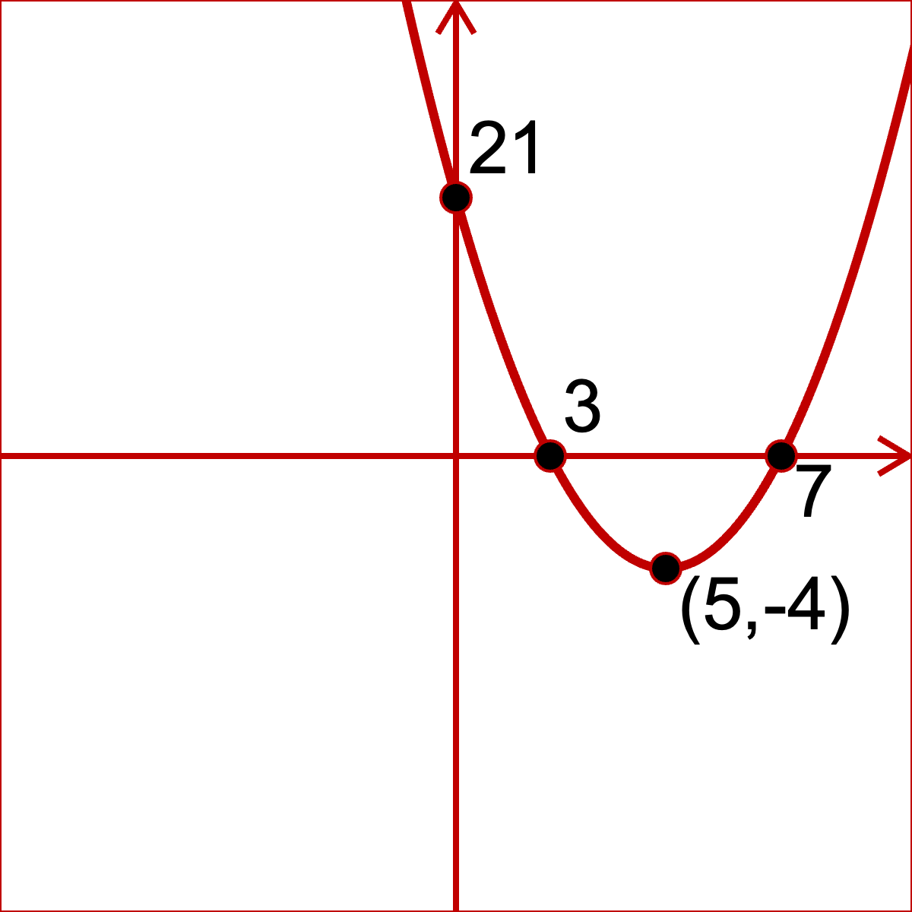
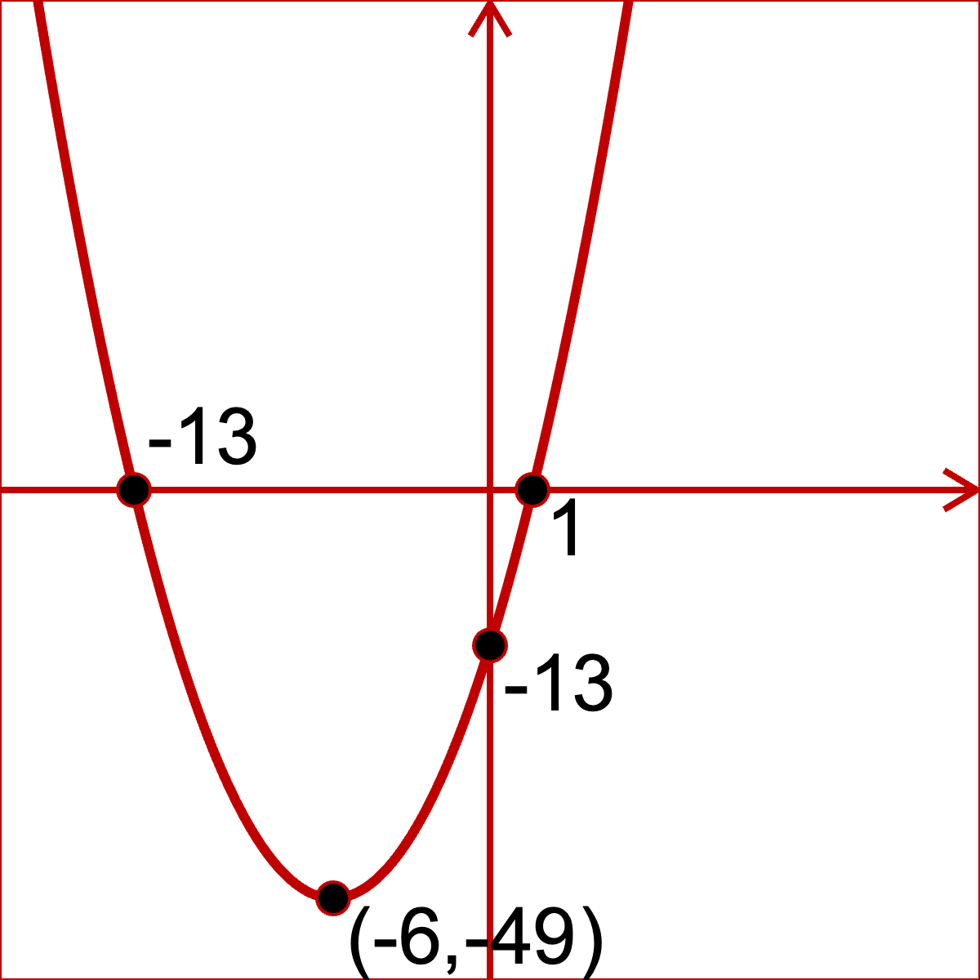
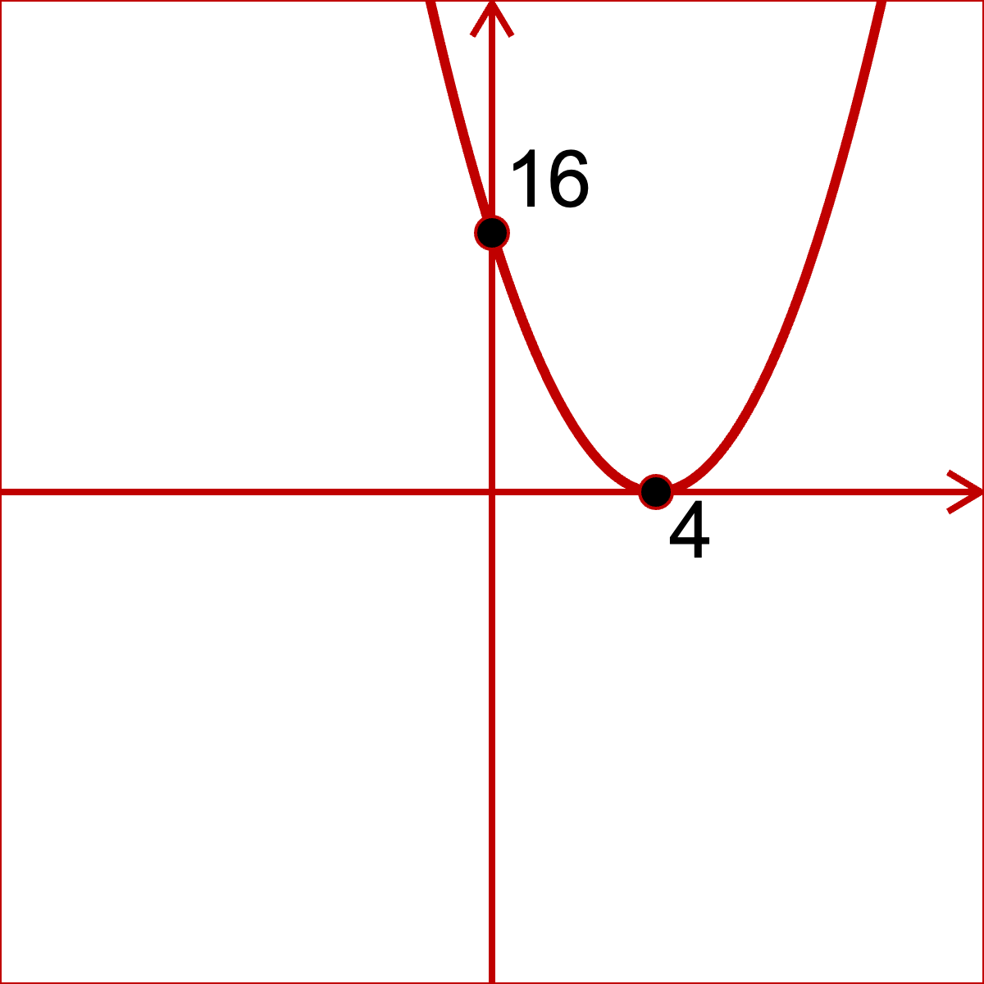
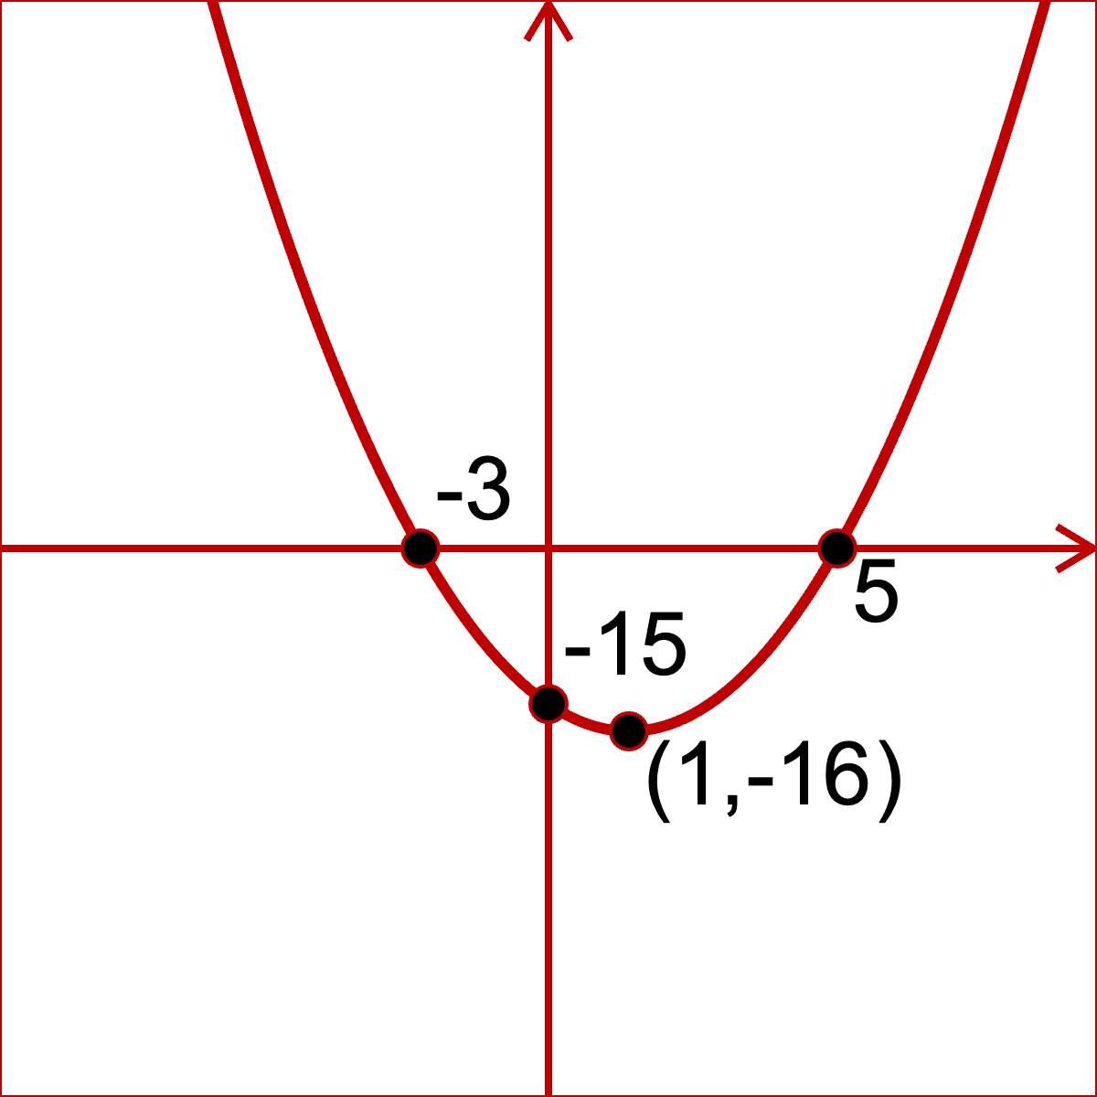
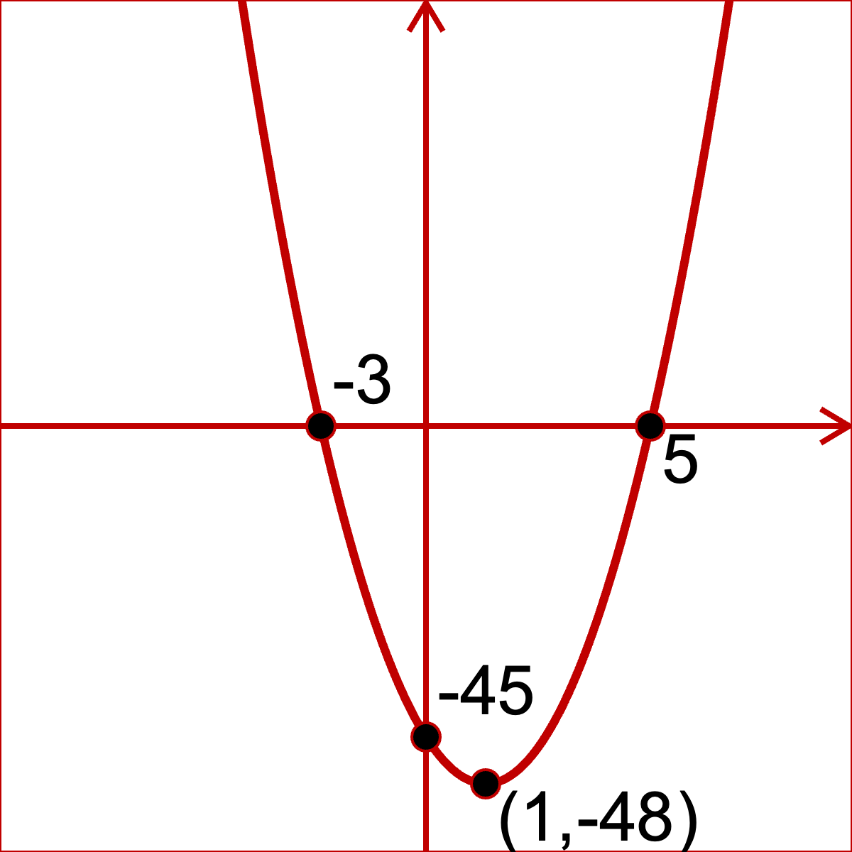
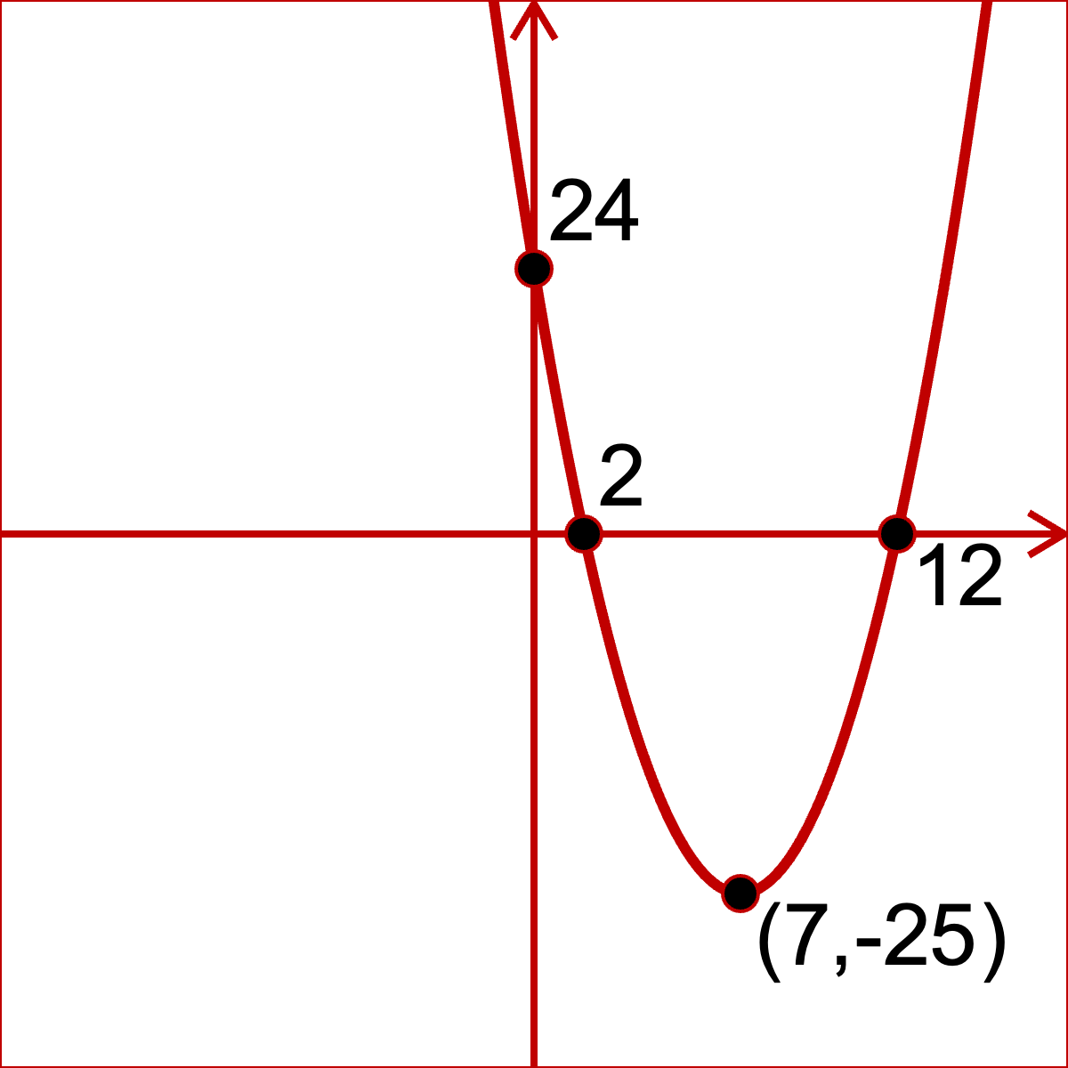
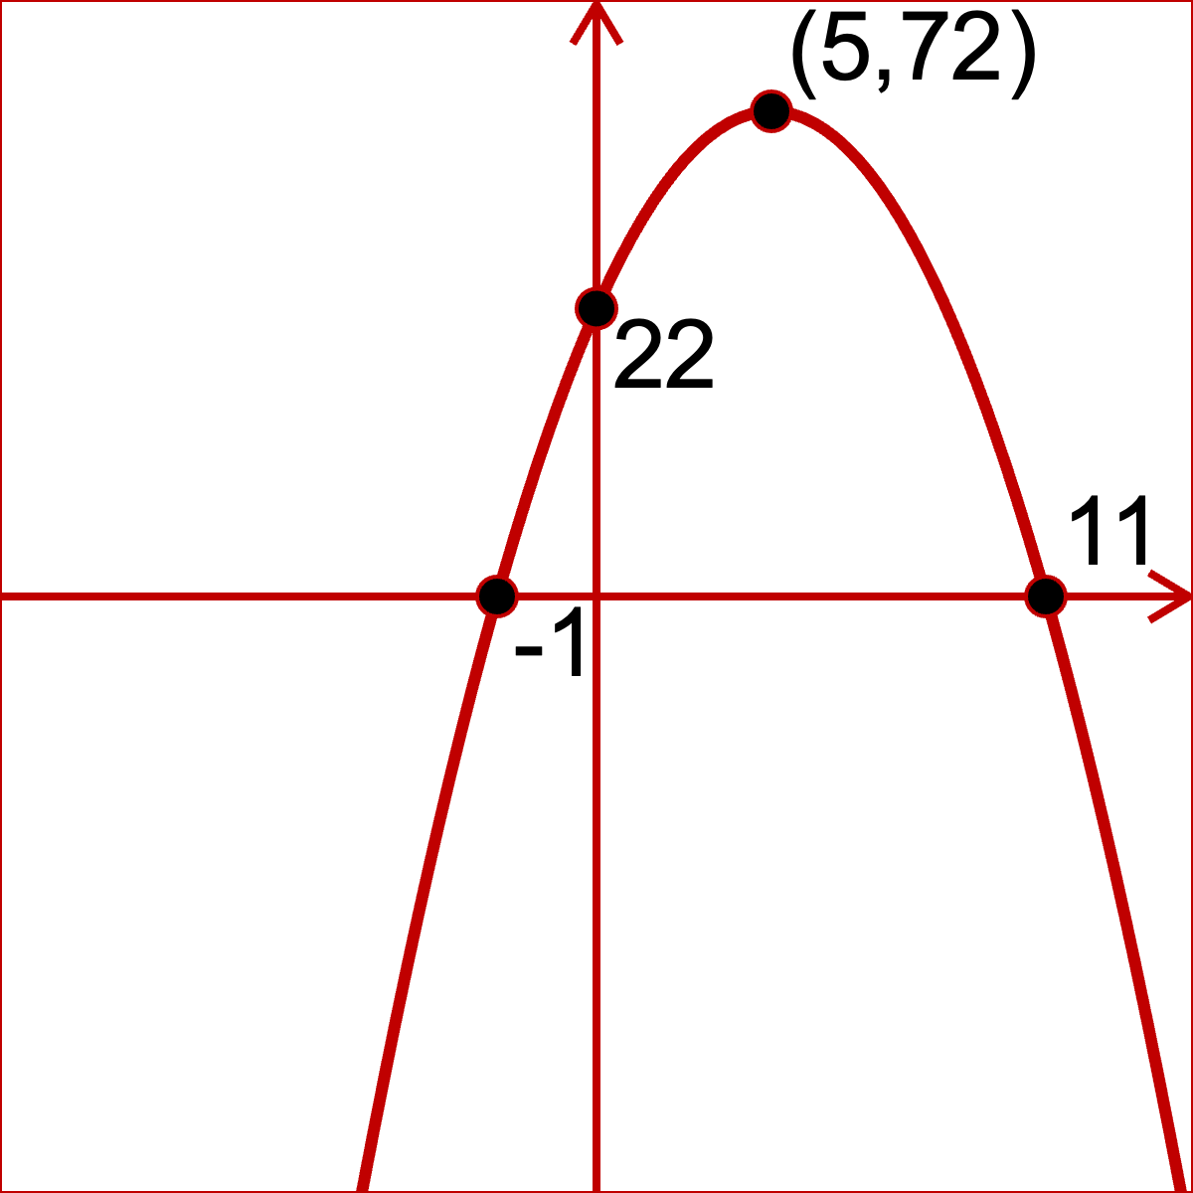
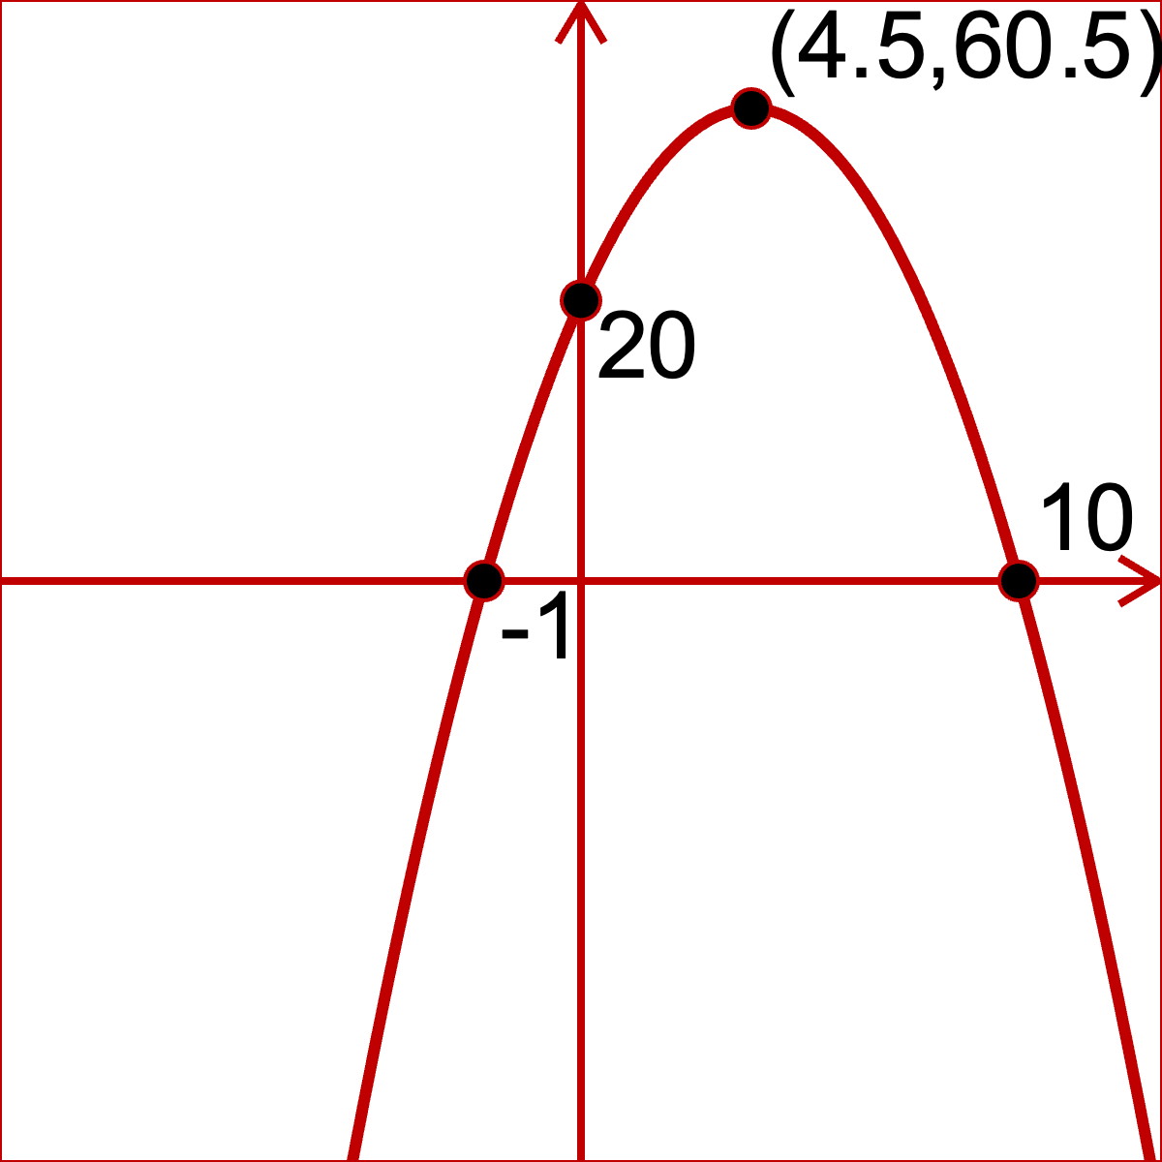
Sketches
a | b | c | d
e | f | g | h
i | j | k | l

