Slide 1
50 Mathematical Quotations

Slide 2
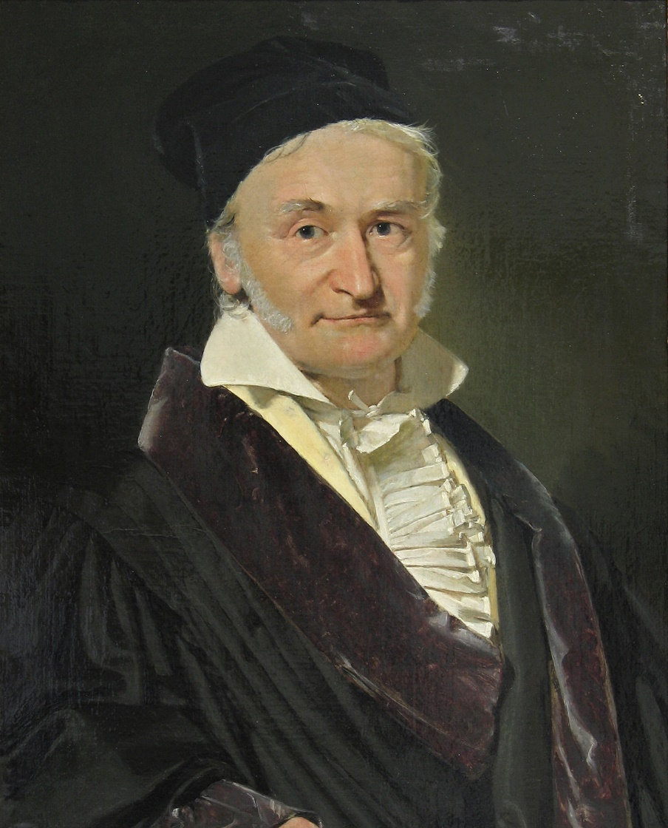
Mathematics is the queen of the
sciences and number theory is the
queen of mathematics.
Carl Friedrich Gauss

Slide 3
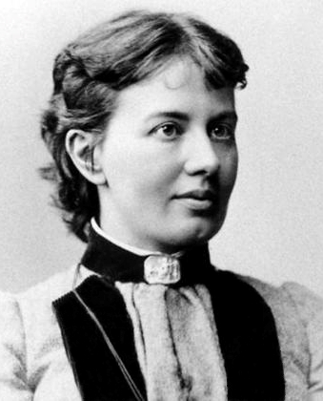
It is impossible to be a
mathematician without being
a poet in soul.
Sofia Kovalevskaya

Slide 4
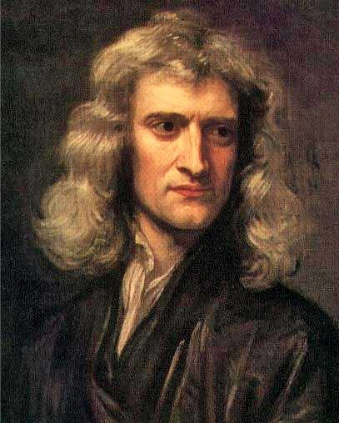
If I have been able to see further,
it was only because I stood on the
shoulders of giants.
Isaac Newton

Slide 5
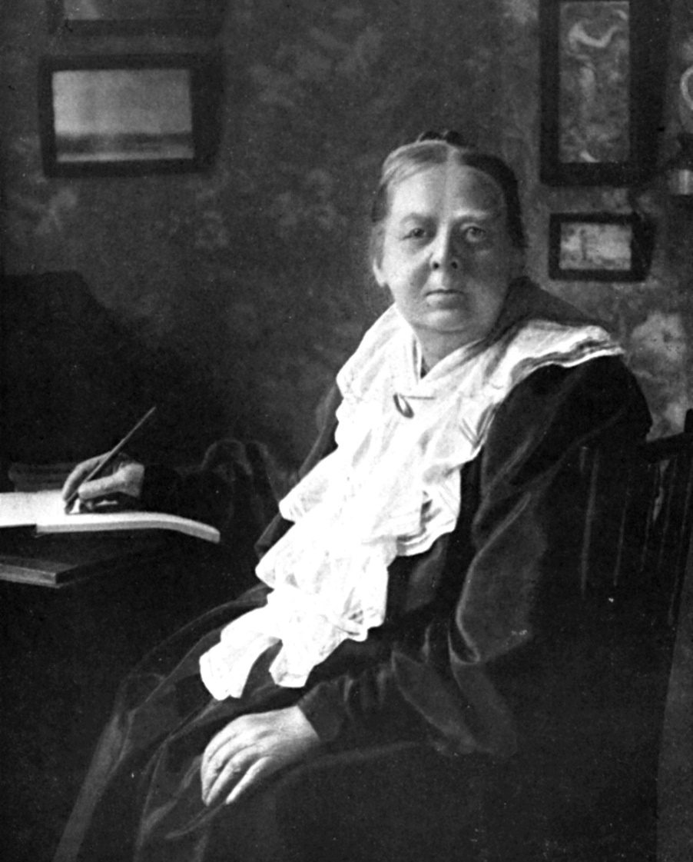
Only dead mathematics can be taught where the attitude of competition prevails; living mathematics must always be a communal possession.
Mary Everest Boole

Slide 6
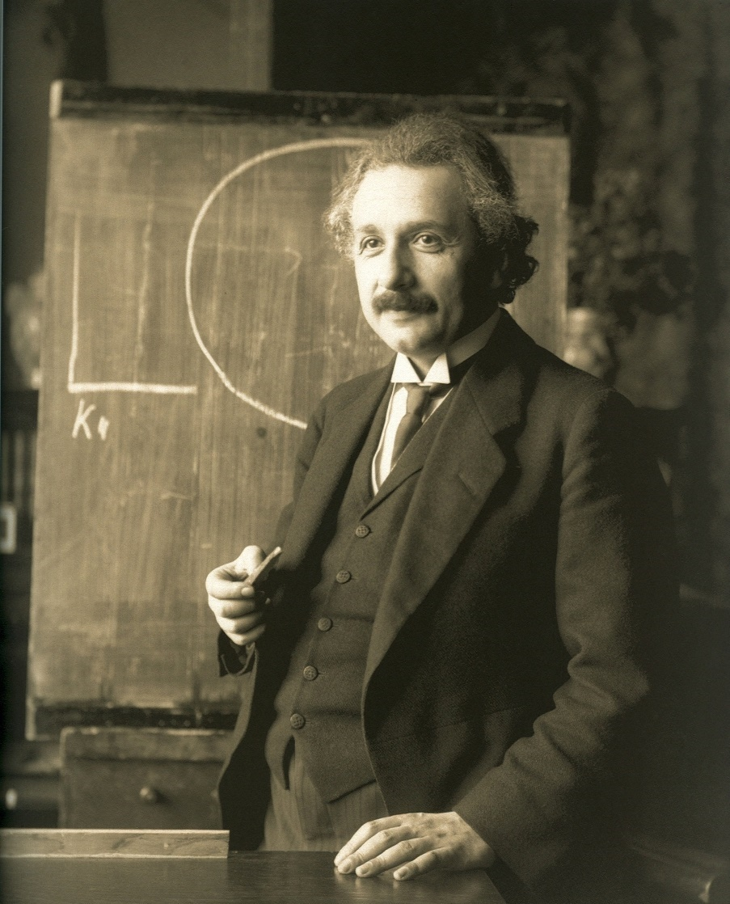
Do not worry about your difficulties in Mathematics.
I can assure you mine are still
greater.
Albert Einstein

Slide 7
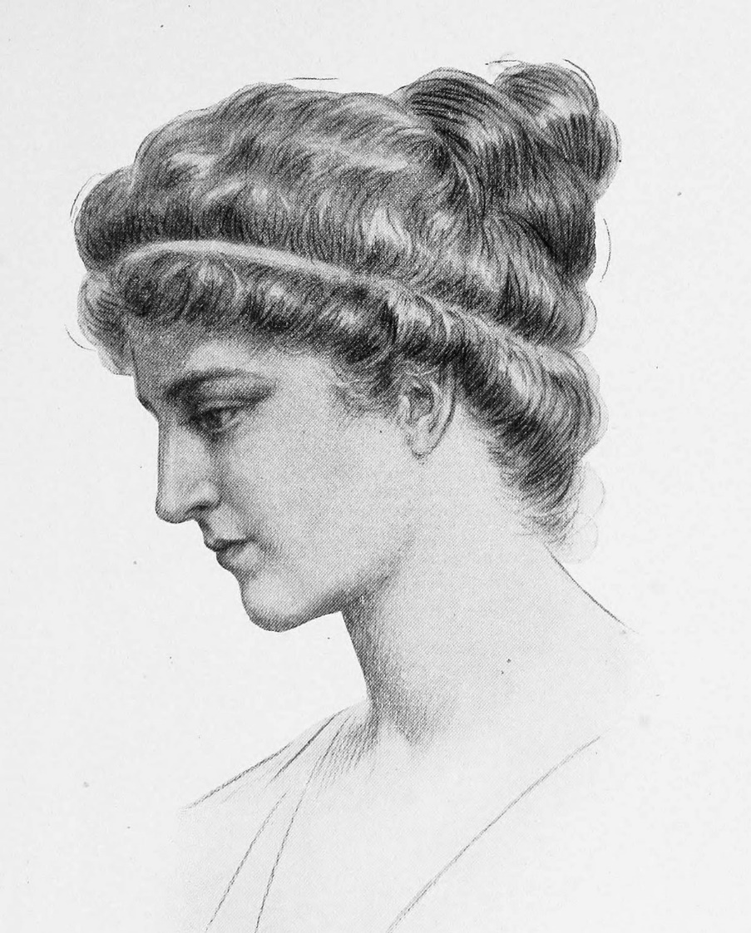
Reserve your right to think,
for even to think wrongly is better than not to think at all.
Hypatia of Alexandria

Slide 8
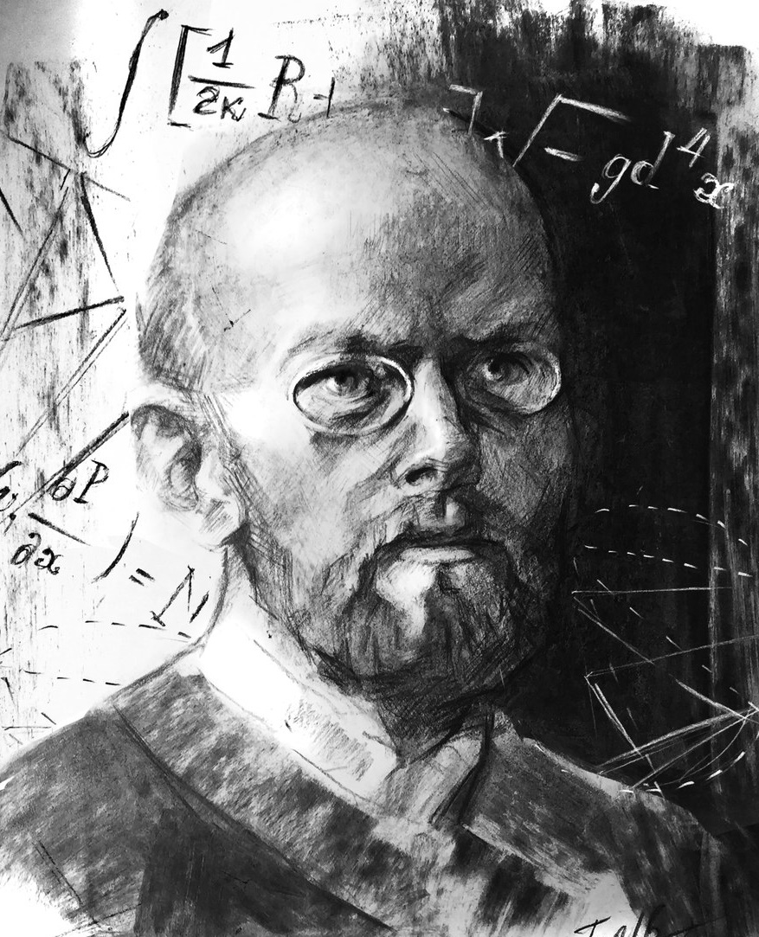
That I have been able to accomplish anything in mathematics is really due to the fact that I have always found it so difficult.
David Hilbert

Slide 9
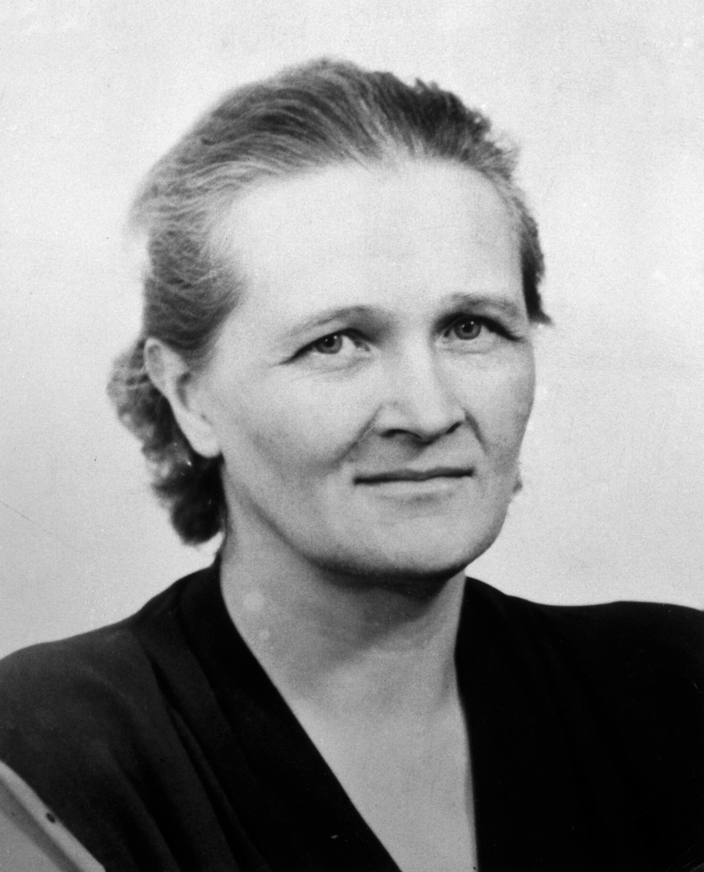
Your reward will be the widening of the horizon as you climb. And if you achieve that reward, you will ask no other.
Cecilia Payne-Gaposchkin

Slide 10
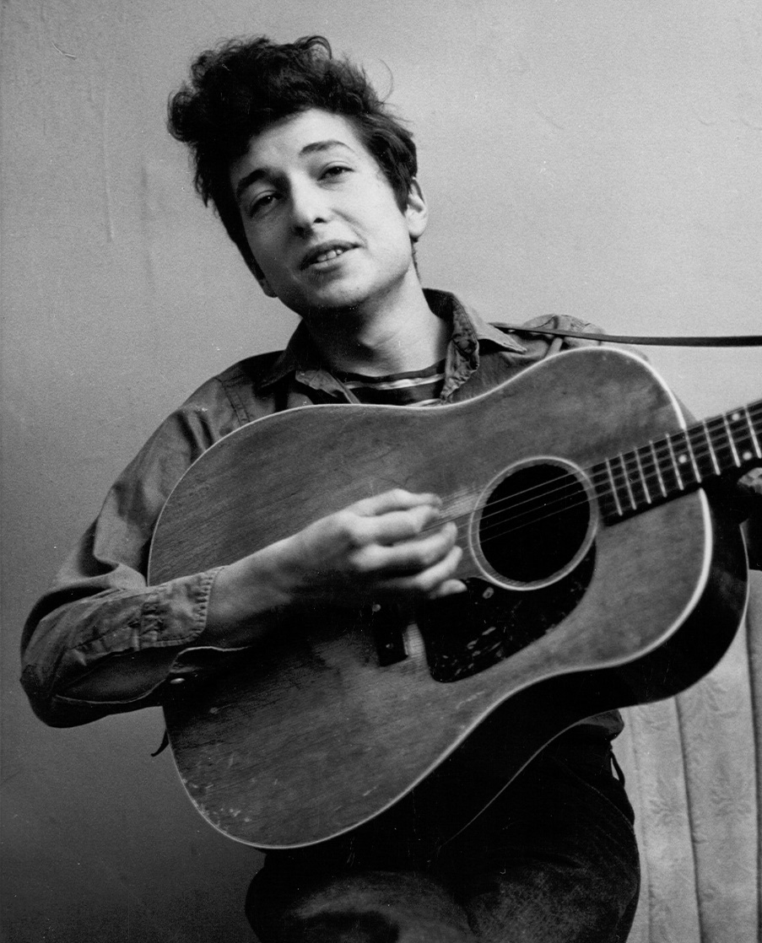
I wouldn't even think about playing music if I was born in these times, I'd probably turn to something like mathematics. That would interest me.
Bob Dylan

Slide 11
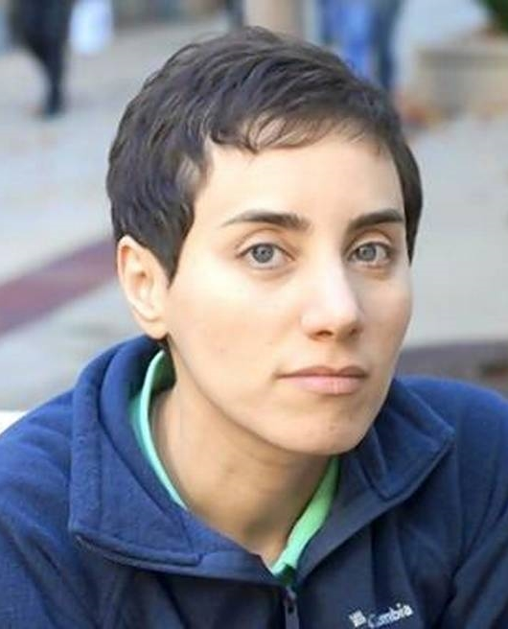
It's not only the question, but the way you try to solve it.
Maryam Mirzakhani

Slide 12
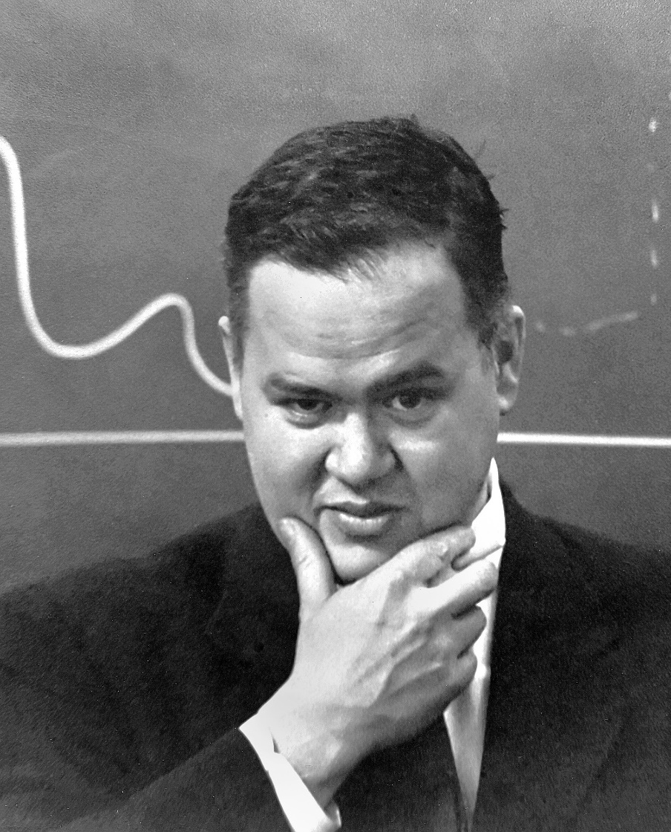
There is no data that can be displayed in a pie chart, that cannot be displayed better in some other type of chart.
John Tukey

Slide 13
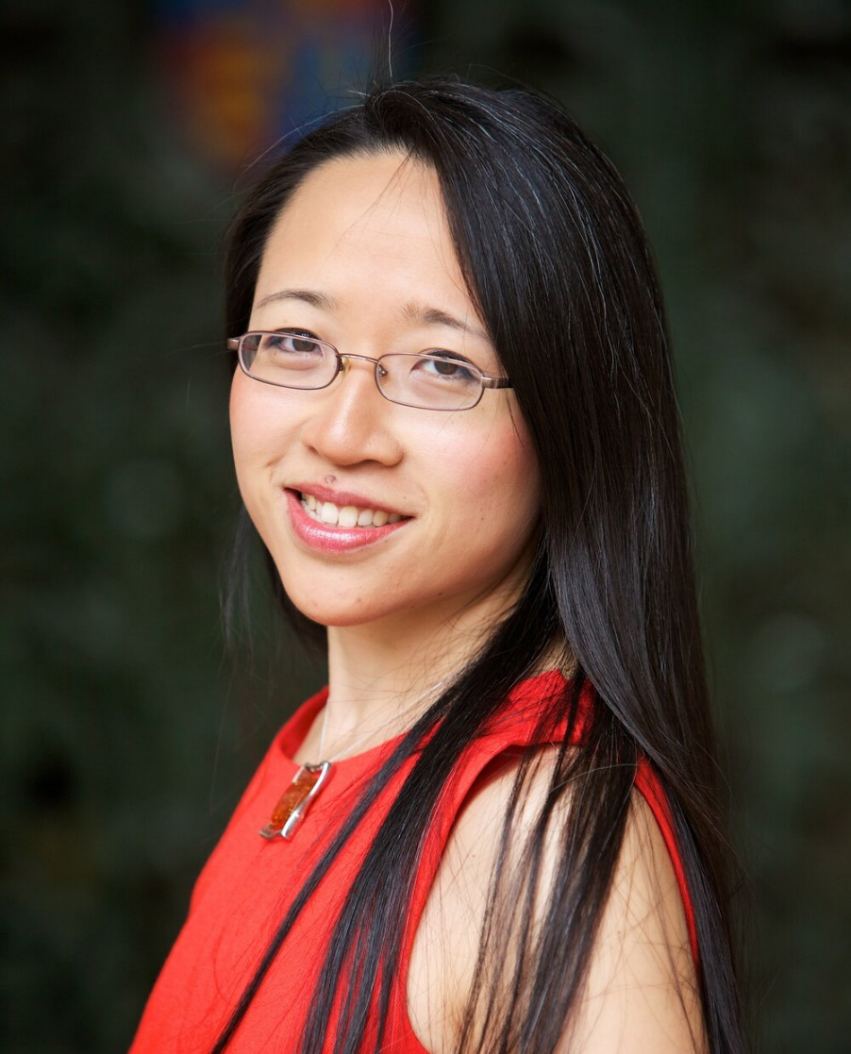
Some people think maths is all about getting the right answers, when it’s actually about asking the right questions.
Eugenia Cheng

Slide 14
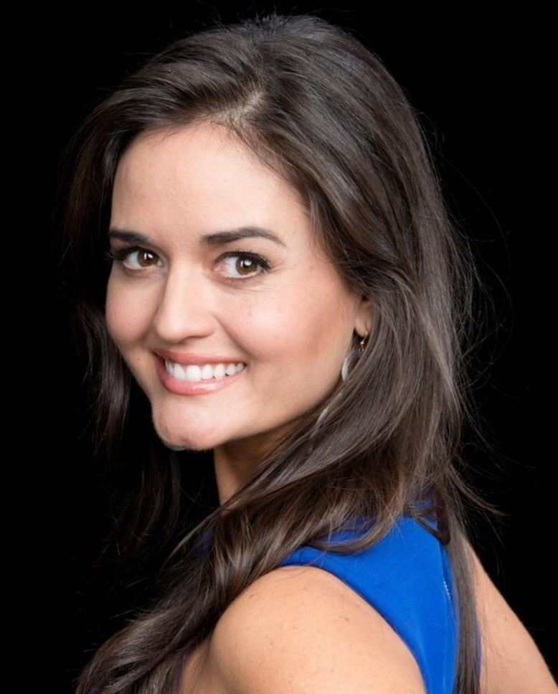
Maths is the only place where truth and beauty mean the same thing.
Danica McKellar

Slide 15
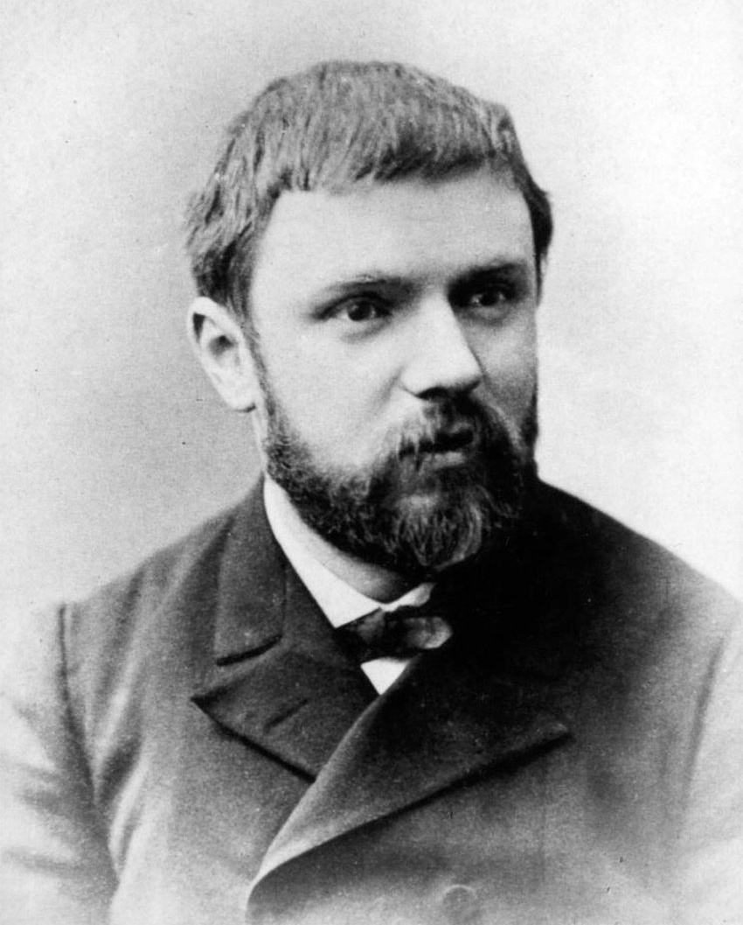
It is by logic we prove, it is by intuition that we invent.
Henri Poincaré

Slide 16
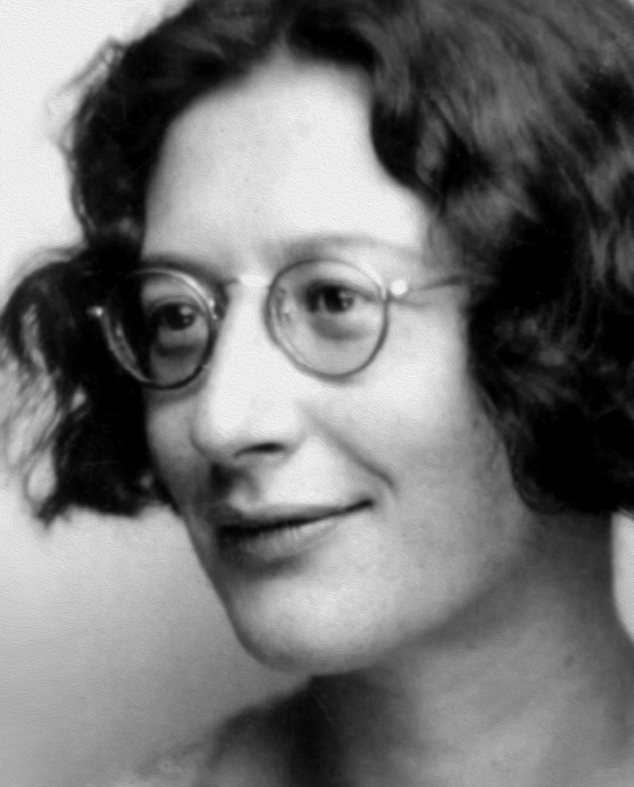
What is beautiful in mathematics is that which makes abundantly clear to us that they are not something which we have manufactured ourselves.
That thing is contradiction. ...The beauty of mathematics lies in contradiction.
Simone Weil

Slide 17
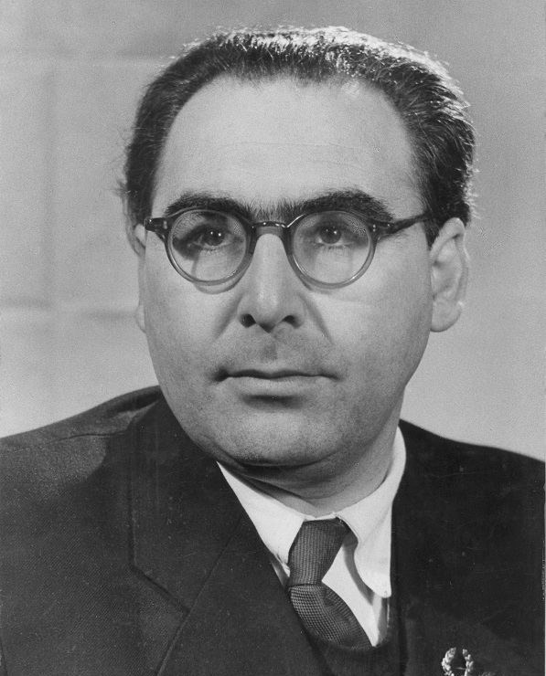
If I feel unhappy, I do mathematics to become happy. If I am happy, I do mathematics to keep happy.
Alfred Rényi

Slide 18
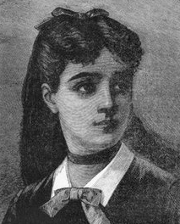
Algebra is nothing more than geometry, in words.
Geometry is nothing more than algebra, in pictures.
Sophie Germain

Slide 19
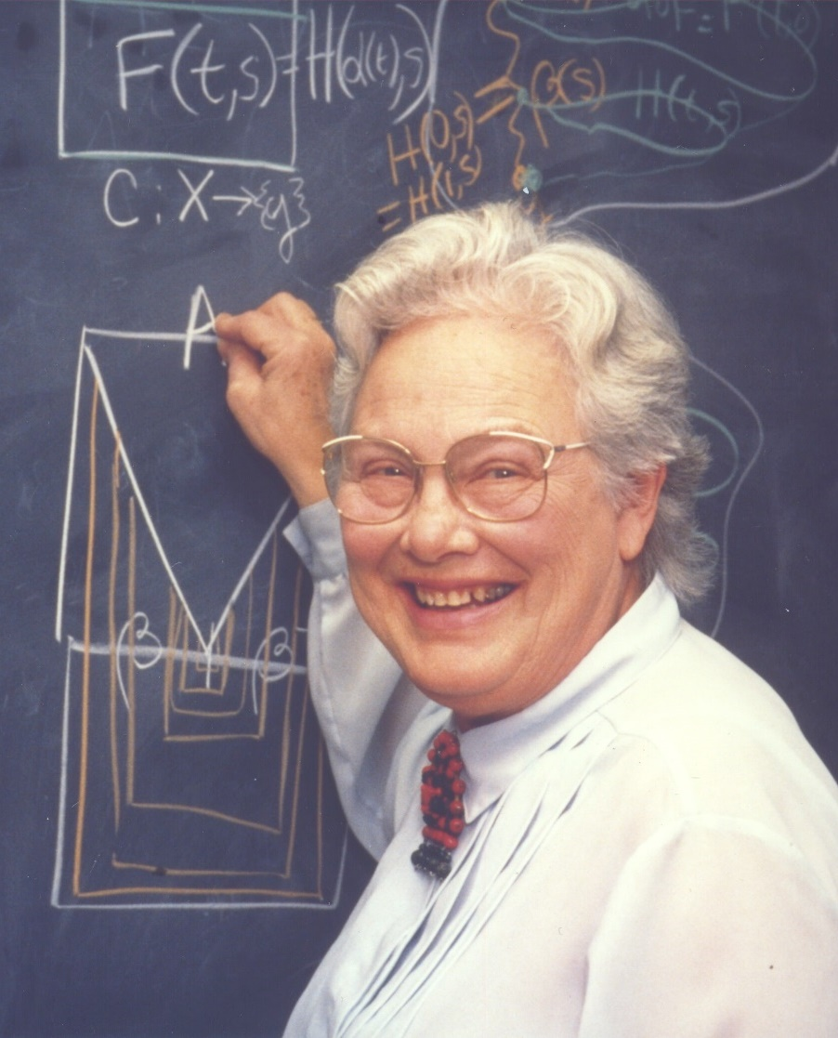
I draw little pictures and try this thing and that thing. I'm interested in how ideas fit together. Actually, I'm very geometric in my thinking. I'm not really interested in numbers.
Mary Ellen Rudin

Slide 20
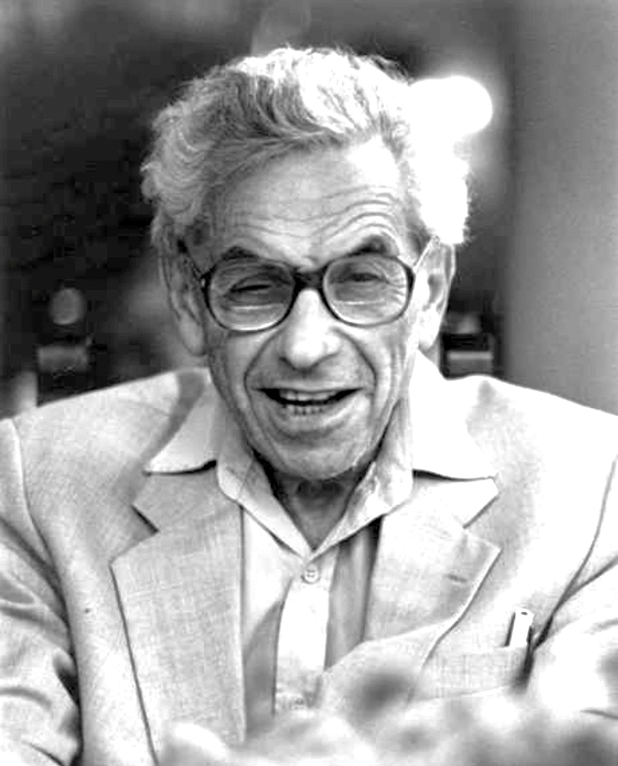
I rarely go any place where there is no mathematics.
Paul Erdös

Slide 21
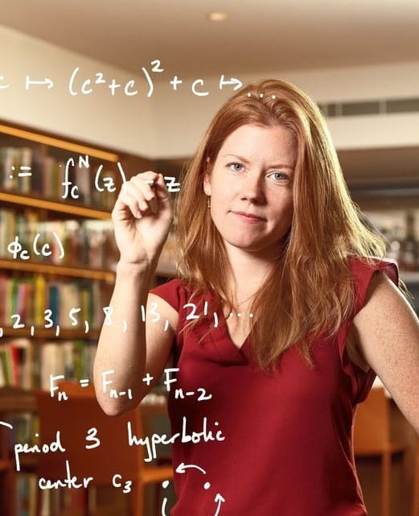
Just as learning the historical context of a painting or a novel can significantly and permanently change your perception of and personal attachment to it, learning mathematics changes the way you view nature, art, and music.
Holly Krieger

Slide 22
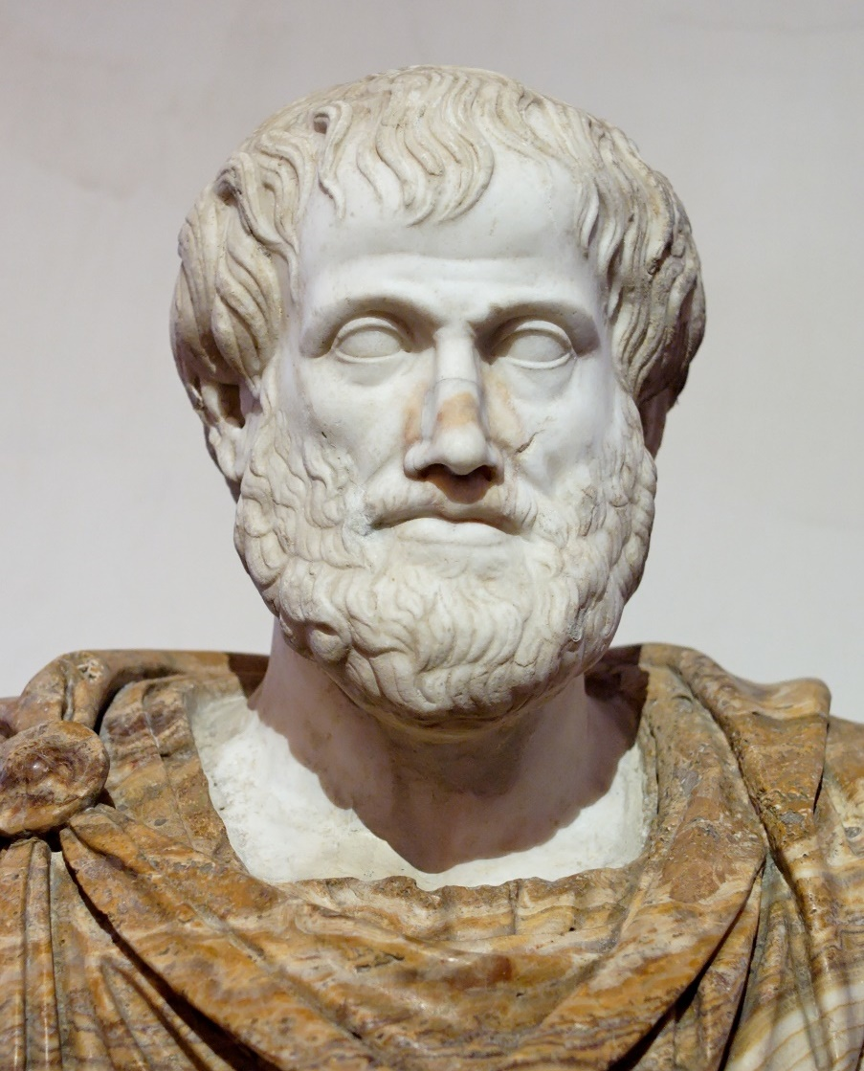
The qualities of numbers exist in a musical scale, in the heavens, and in many other things.
Aristotle

Slide 23
It matters little who first arrives
at an idea, rather what is significant is how far that idea can go.
Sophie Germain

Slide 24
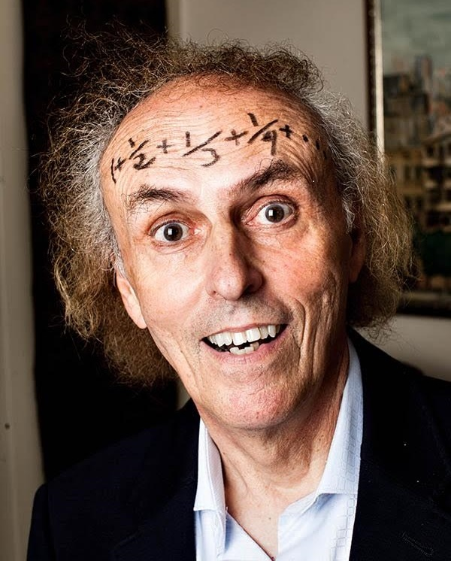
Mathematics is no more computation than typing is literature.
John Allen Paulos

Slide 25
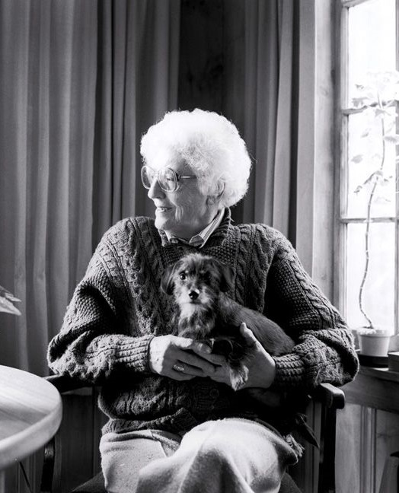
I see a certain order in the universe, and maths is one way of making it visible.
May Sarton

Slide 26
A mathematician is a machine for turning coffee into theorems.
Alfred Rényi

Slide 27
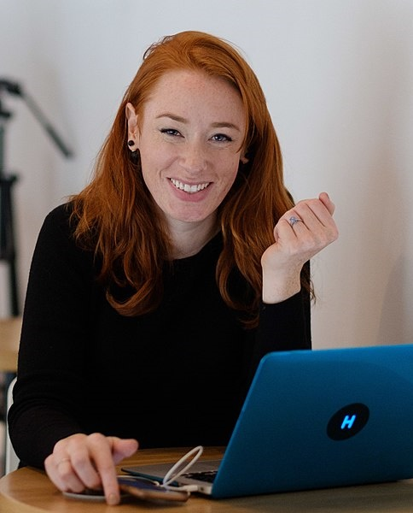
There’s barely any aspect of our modern lives that hasn’t had a mathematical contribution at some point; everything from politics to films, to everyday decision-making, to animals making football predictions.
Hannah Fry

Slide 28
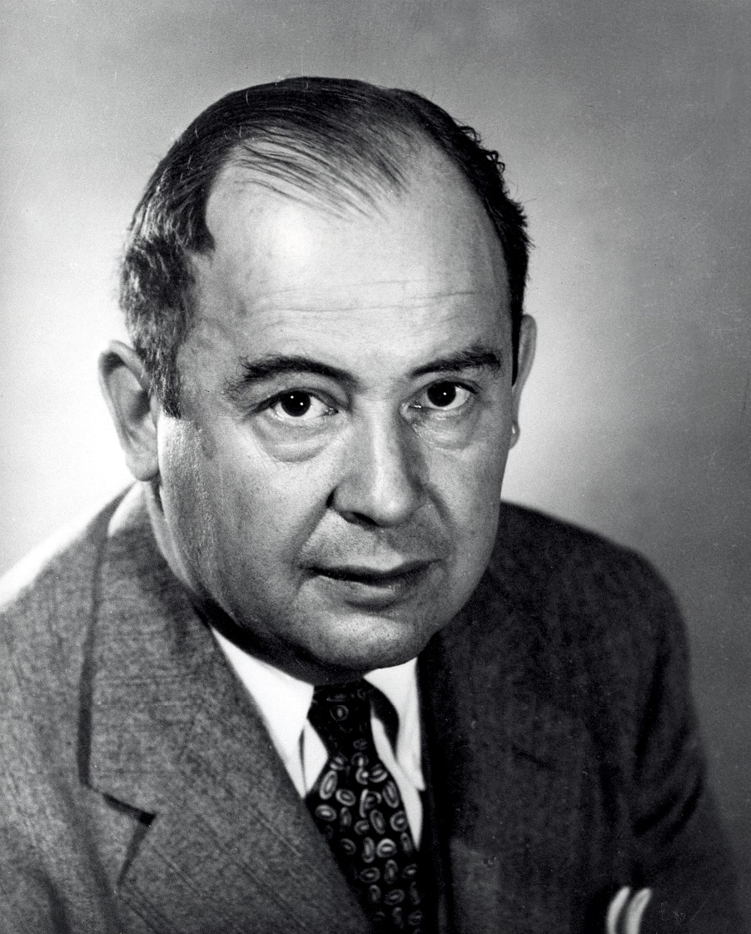
Young man, in Mathematics you don't understand things. You just get used to them.
John von Neumann

Slide 29
The beauty of mathematics only shows itself to more patient followers.
Maryam Mirzakhani

Slide 30
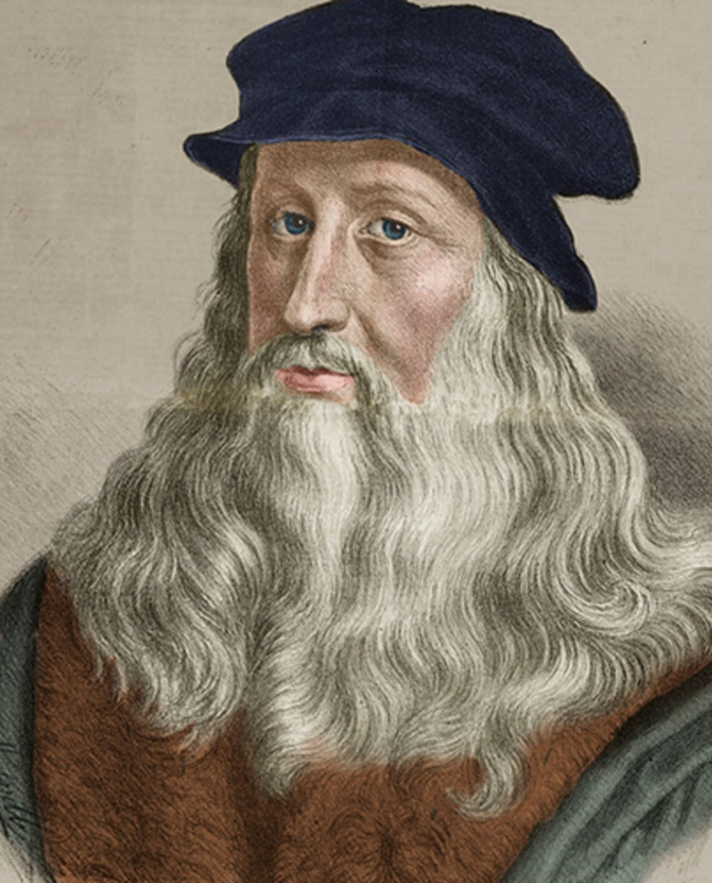
No human investigation can
be called real science if it cannot be demonstrated mathematically.
Leonardo da Vinci

Slide 31
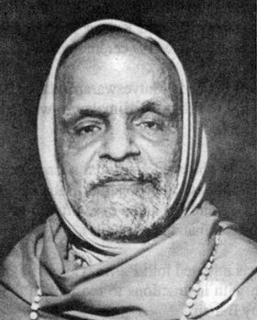
It is magic until you understand it, and mathematics thereafter.
Bharati Krishna Tirtha

Slide 32
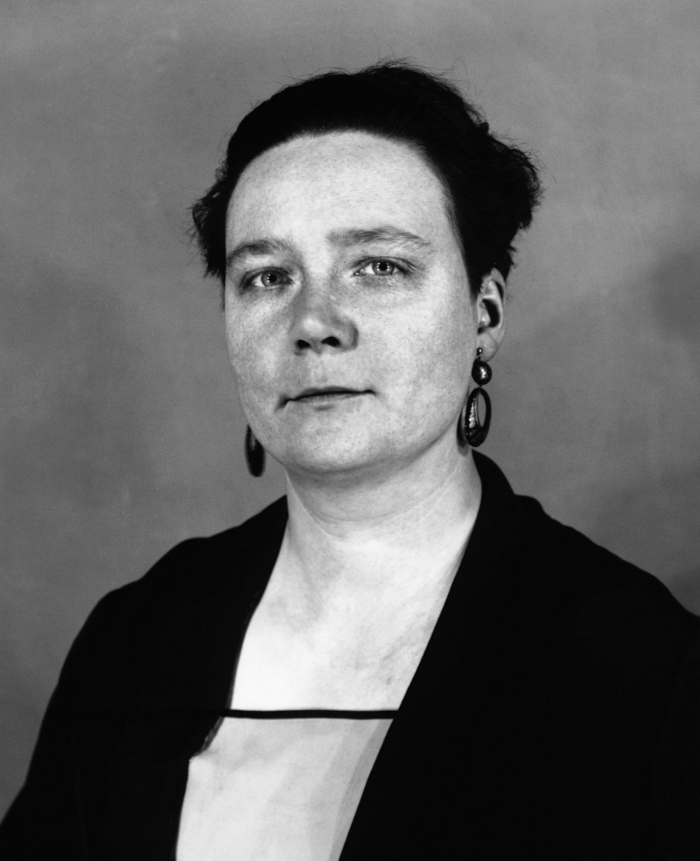
Have you noticed that the astronomers and mathematicians are much the most cheerful people of the lot?
Dorothy L. Sayers

Slide 33
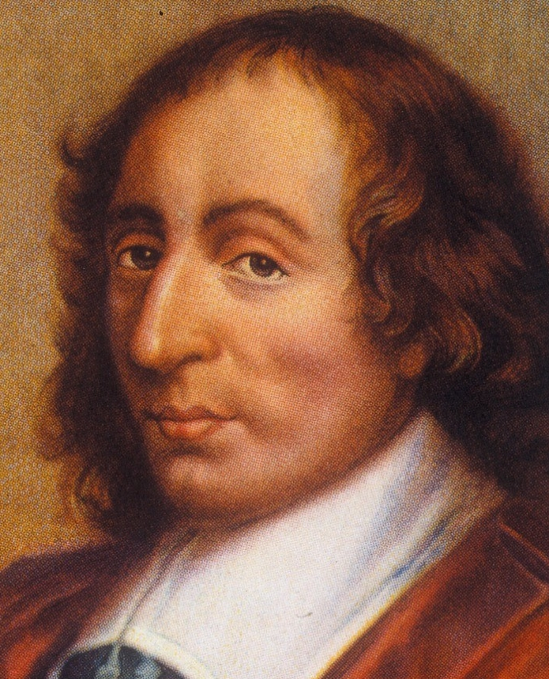
Reason is the slow and tortuous method by which those who do not understand the truth discover it.
Blaise Pascal

Slide 34
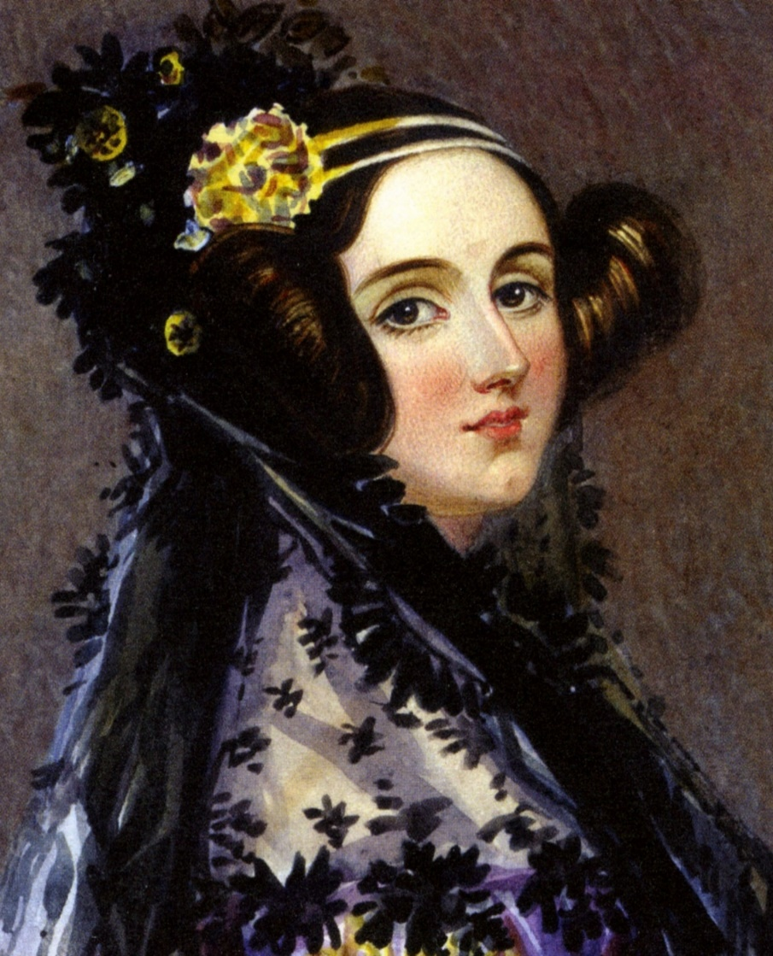
Maths shows what is. It is the language of unseen relations between things. But to use and apply that language, we must be able to fully to appreciate, to feel, to seize the unseen, the unconscious.
Ada Lovelace

Slide 35
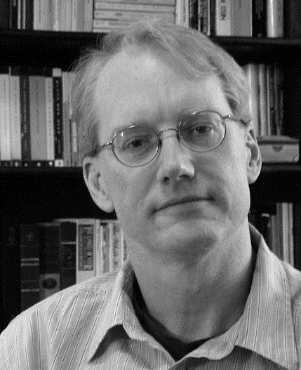
There is nothing as dreamy and poetic, nothing as radical, subversive, and psychedelic, as mathematics. It is every bit as mind blowing as cosmology or physics and allows more freedom of expression than poetry, art, or music.
Paul Lockhart

Slide 36
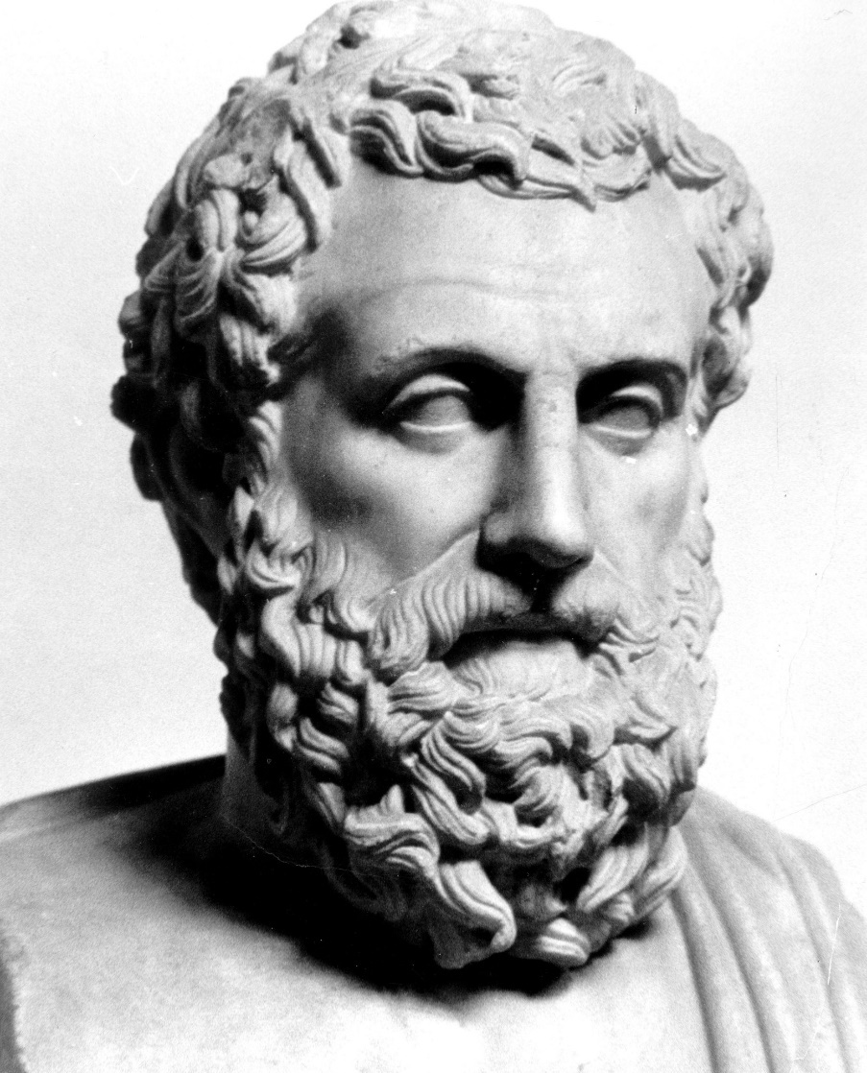
To Thales the primary question was not 'What do we know?' but 'How do we know it?'
Aristotle

Slide 37
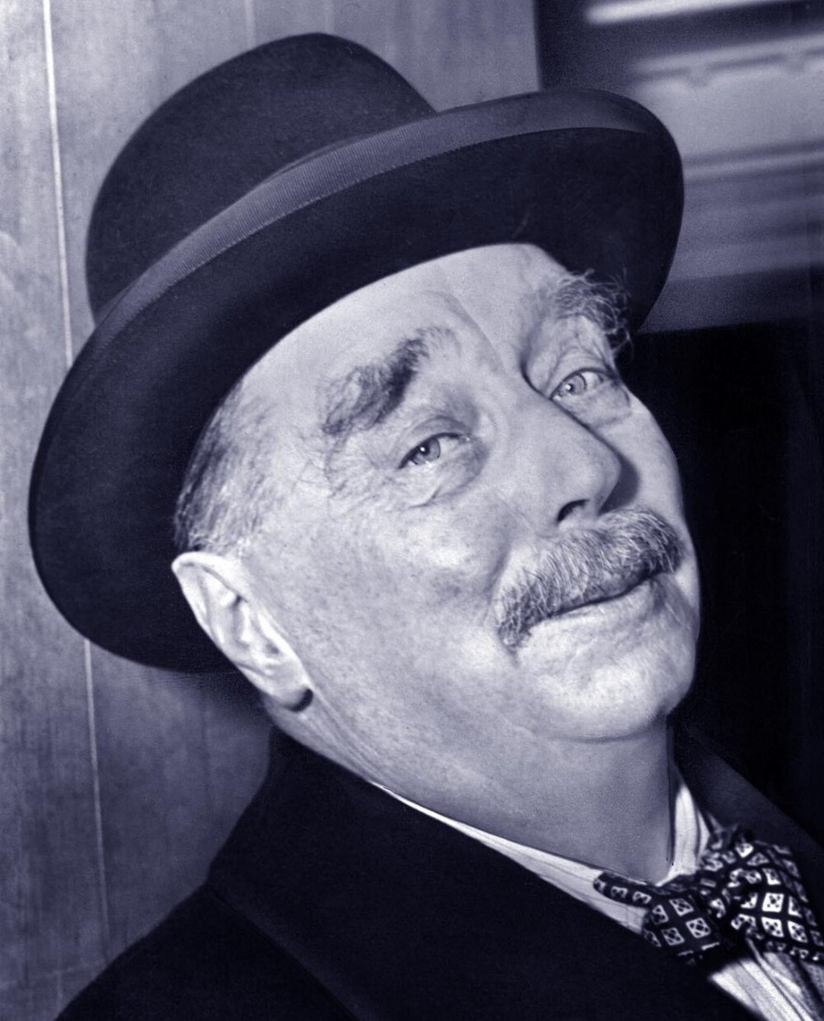
Statistical thinking will one day be as necessary for efficient citizenship as the ability to read or write.
H. G. Wells

Slide 38
Let's face it; by and large maths is not easy, but that's what makes it so rewarding when you conquer a problem and reach new heights of understanding.
Danica McKellar

Slide 39
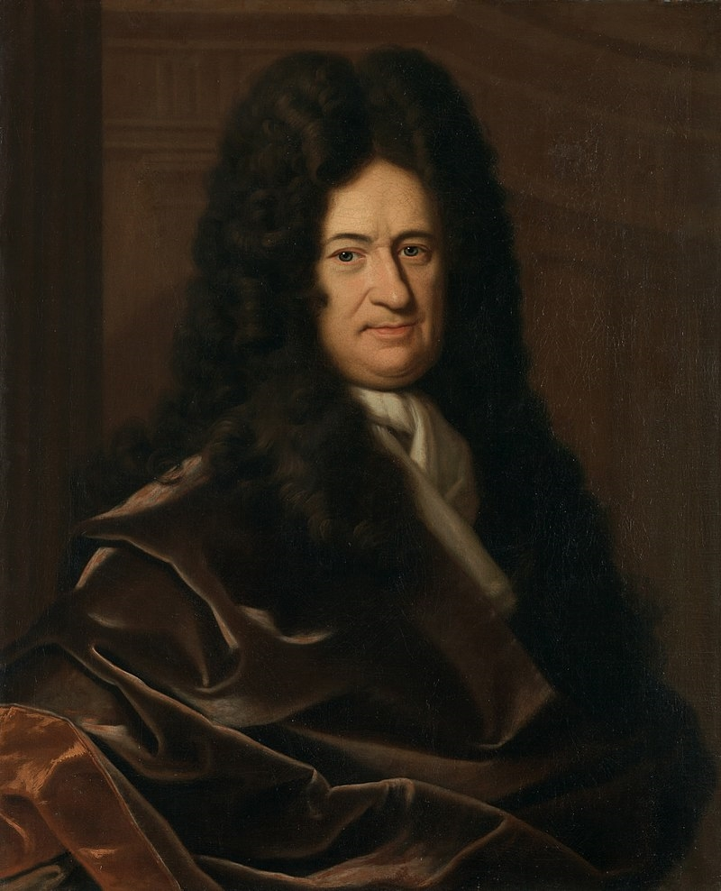
Imaginary numbers are a fine and wonderful refuge of the divine spirit almost an amphibian between being and non-being.
Gottfried Leibniz

Slide 40
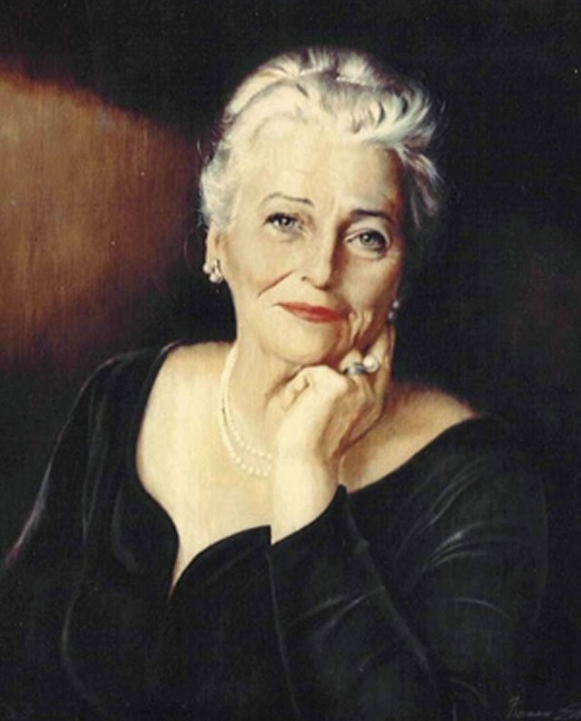
She had not understood mathematics until he explained to her that it was the symbolic language of relationships. "And relationships," he had told her, "contained the essential meaning of life."
Pearl S. Buck

Slide 41
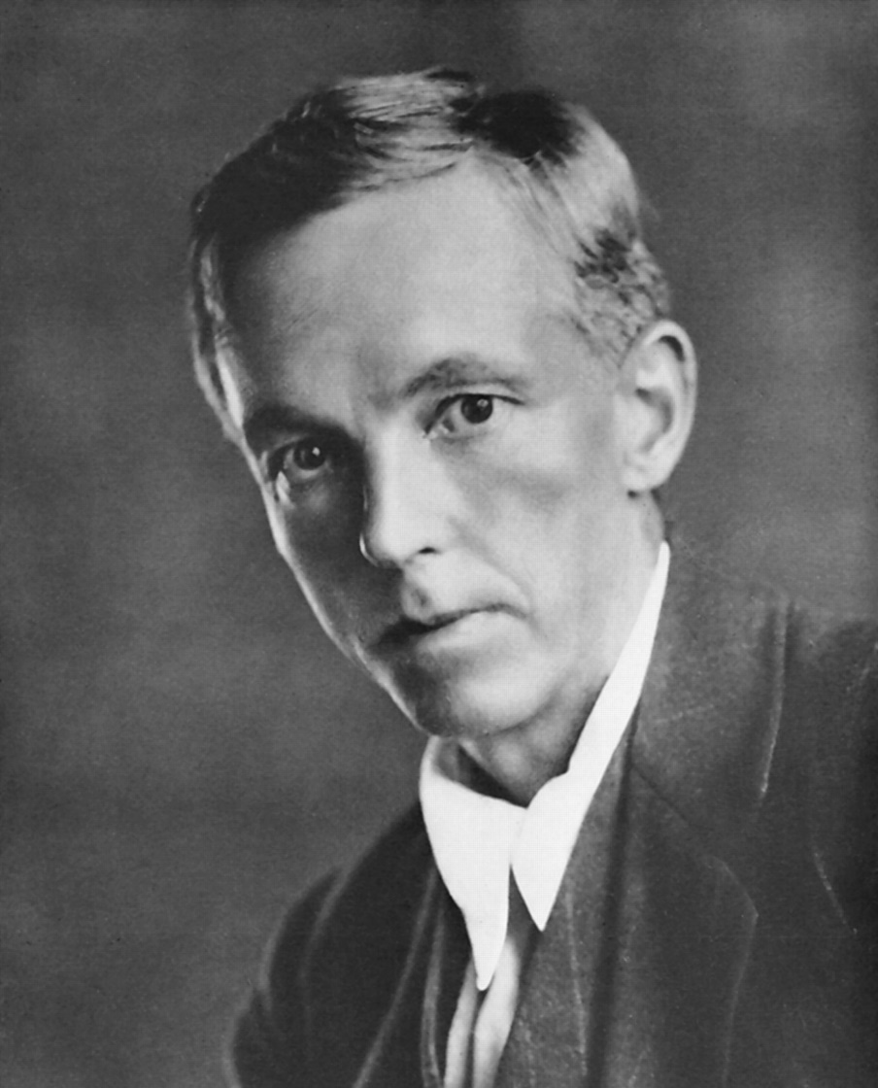
Beauty is the first test: there is no permanent place in the world for ugly mathematics.
G. H. Hardy

Slide 42
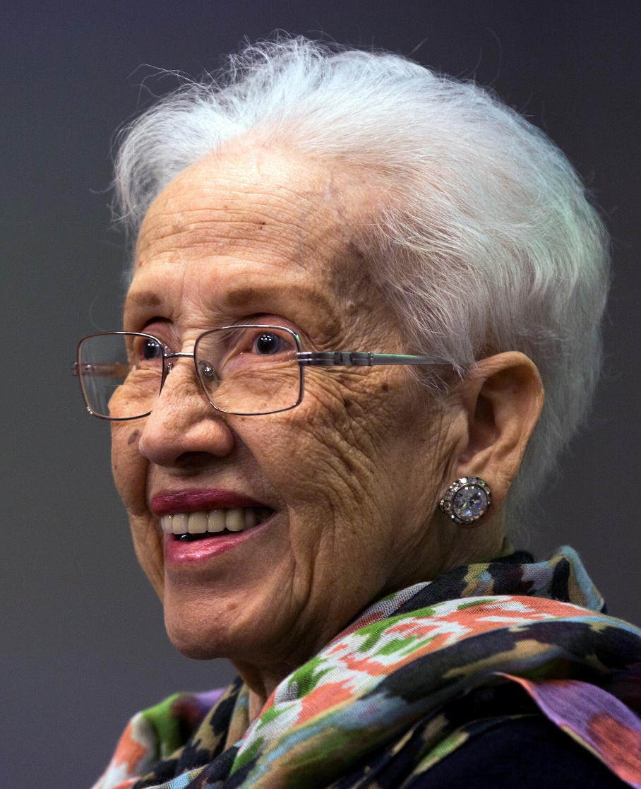
Some things will drop out of the public eye and go away, but there will always be science, engineering and technology. And there will always, always be mathematics.
Katherine Johnson

Slide 43
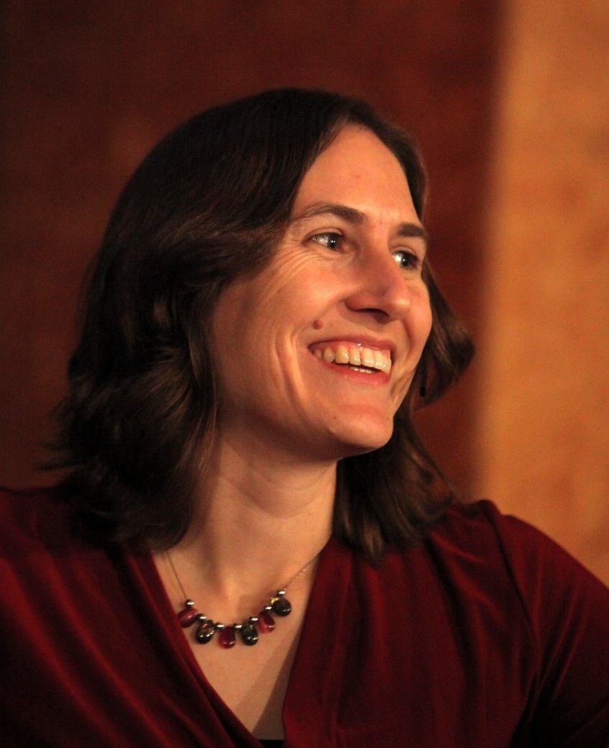
So far, all of reality seems to be described by exquisite, elegant mathematical equations. We can't stop now - it's got to be beautiful all the way down.
Katie Mack

Slide 44
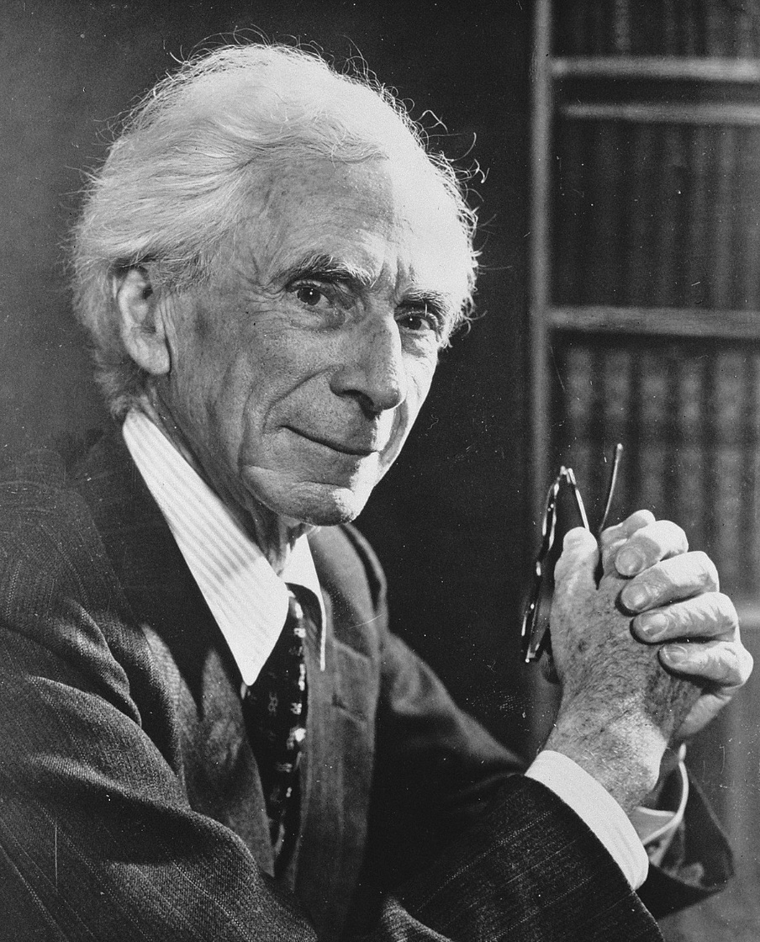
The greatest challenge to any thinker is stating the problem in a way that will allow a solution.
Bertrand Russell

Slide 45
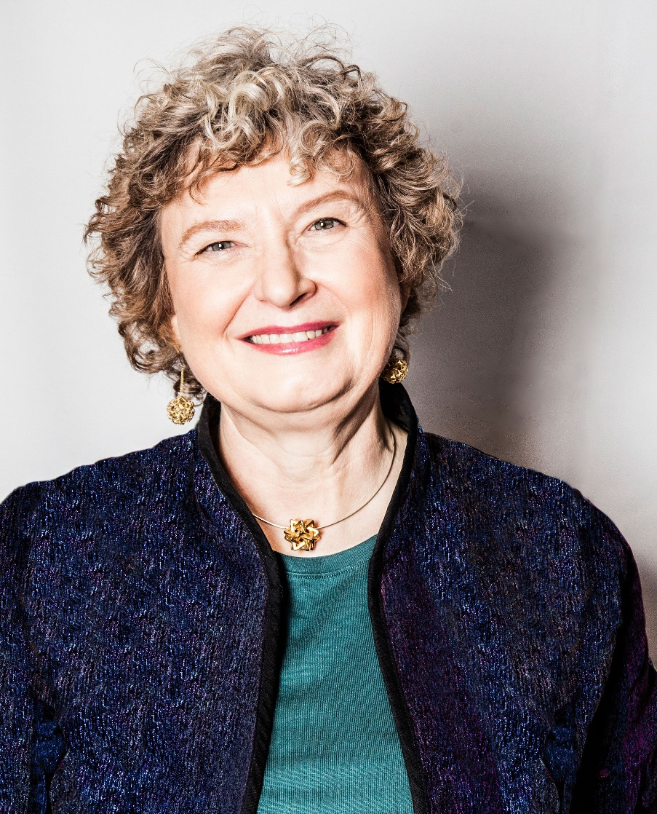
Think about what it means to find something beautiful. For me, it’s feeling of joy, awe, and reverence. It gladdens the heart and lights up the eye.
Mathematics is beautiful as it elicits the same emotions in us. It is awe-inspiring and joy-inspiring at the same time.
Ingrid Daubechies

Slide 46
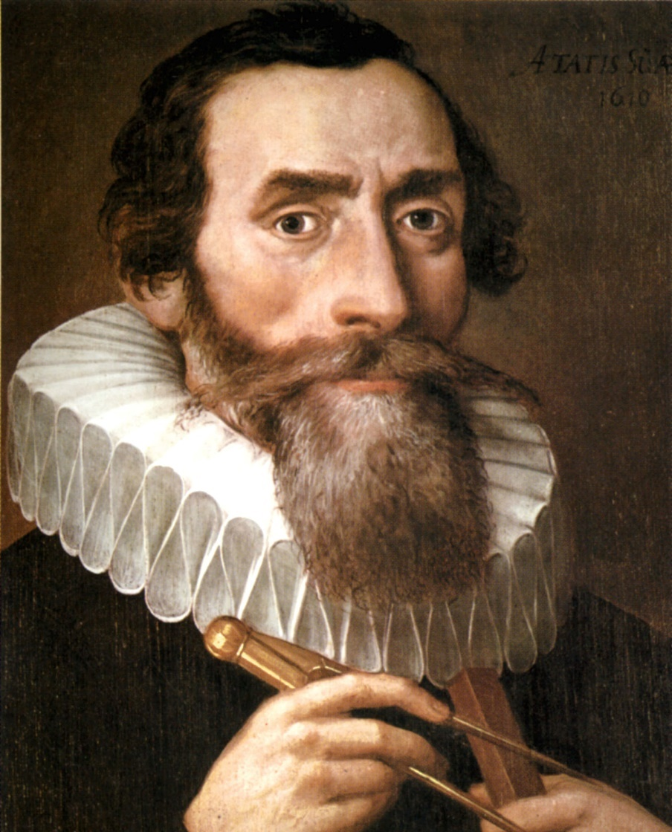
Where there is matter, there is geometry.
Johannes Kepler

Slide 47
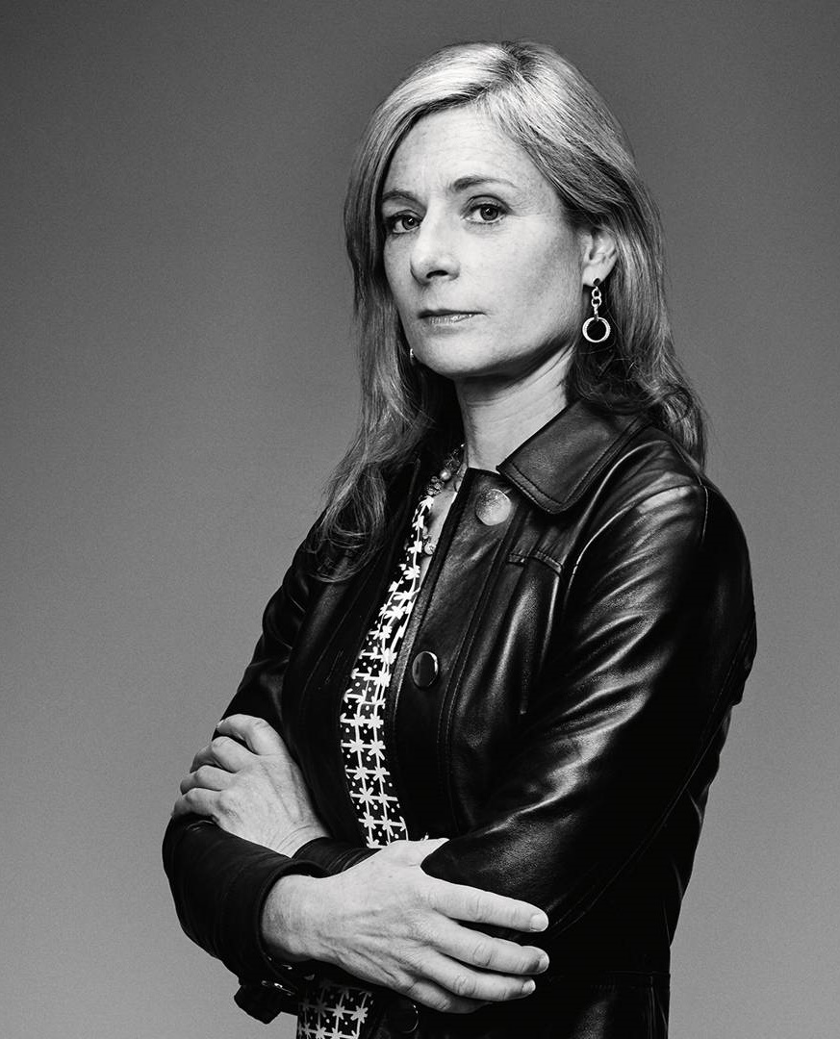
Although I was first drawn to maths by the certainty it promised, today I find the unanswered questions and the unexpected connections at least as attractive.
Lisa Randall

Slide 48
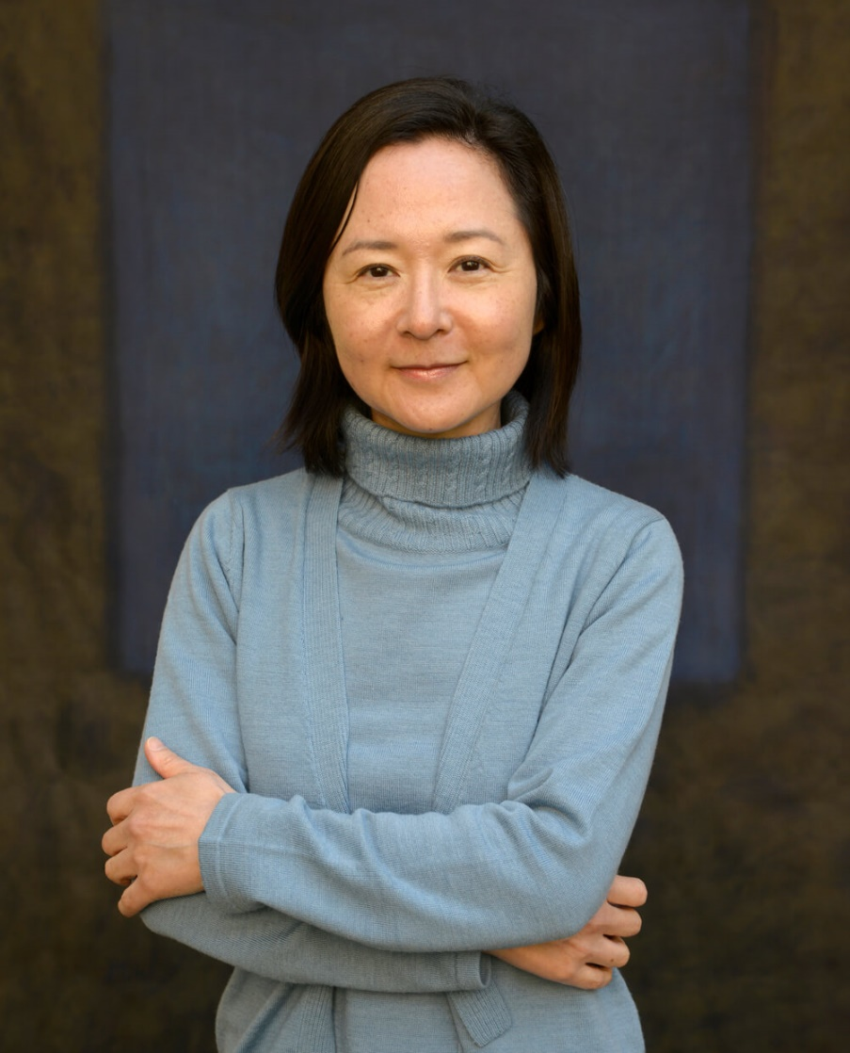
In mathematics, the truth is somewhere out there in a place no one knows, beyond all the beaten paths. And it's not always at the top of the mountain. It might be in a crack on the smoothest cliff or somewhere deep in the valley.
Yōko Ogawa

Slide 49
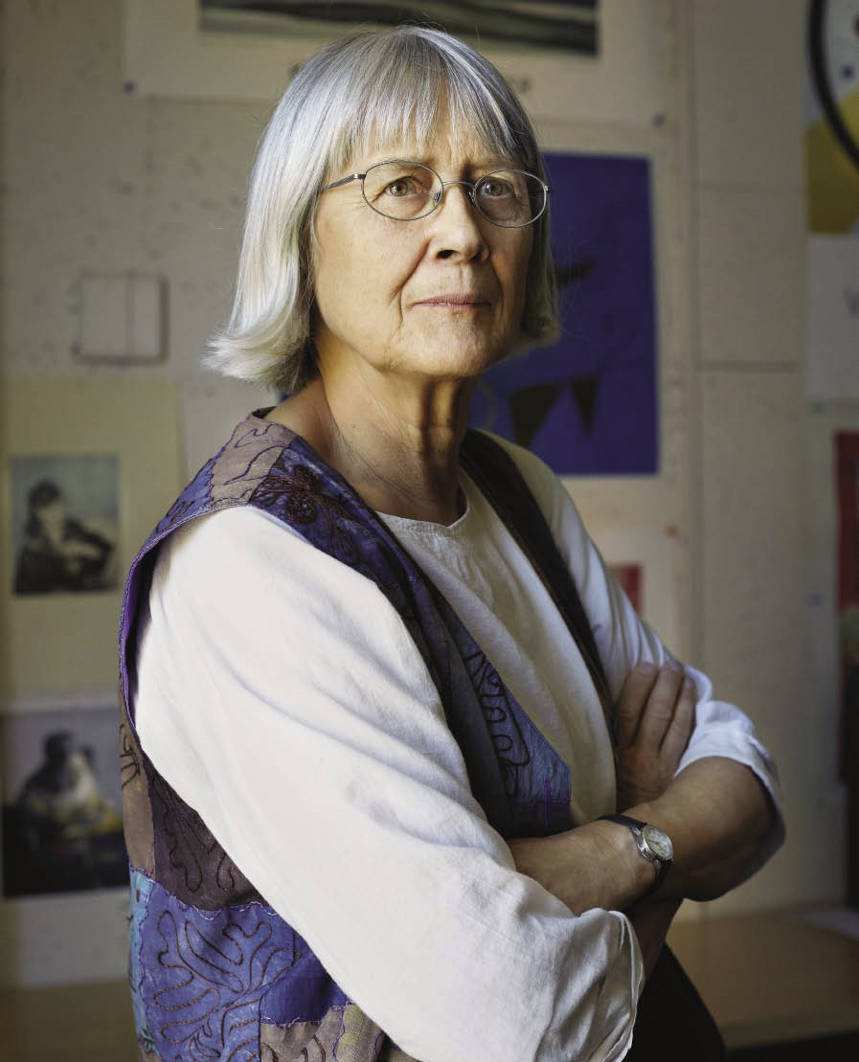
Gel’fand amazed me by talking of mathematics as though it were poetry. I had always thought of mathematics as being much more straightforward: a formula is a formula, and an algebra is an algebra, but Gel’fand found hedgehogs lurking in the rows of his spectral sequences!
Dusa McDuff

Slide 50
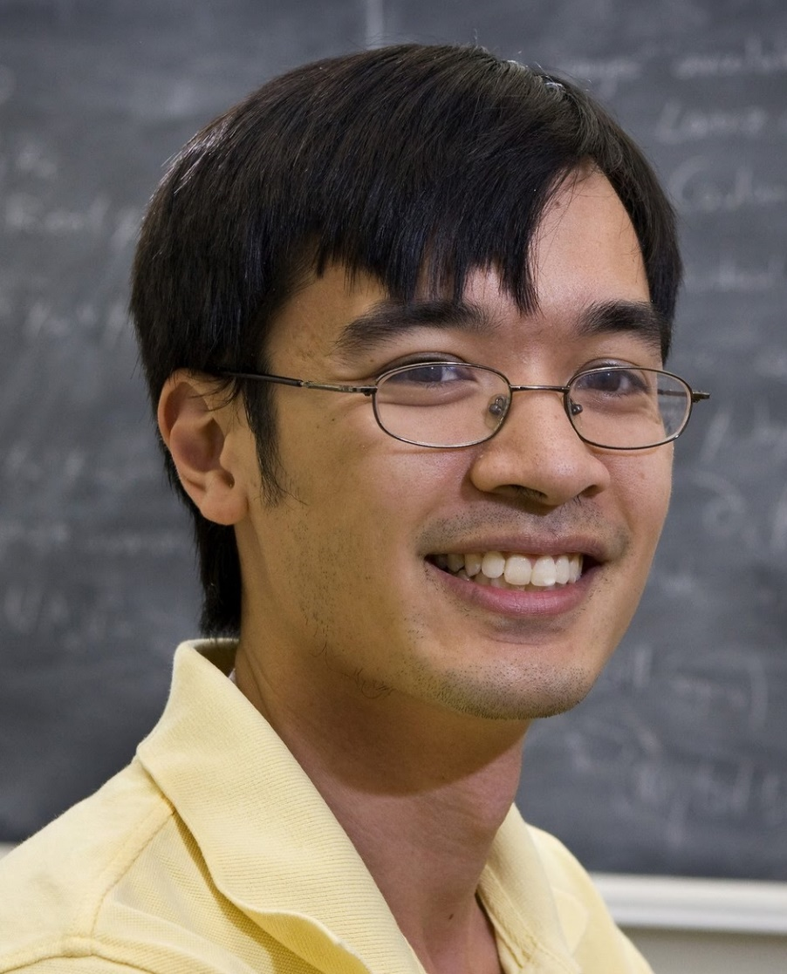
Ask yourself dumb questions - and answer them.
Terry Tao

Slide 51
One moment, you have no clue what some piece of mathematics is saying, and suddenly there’s this neurological shift and it clicks into place. Then, not only do you understand it, but it’s almost incomprehensible that you didn’t understand it five seconds ago. I find that really satisfying.
Holly Krieger

Slide 52
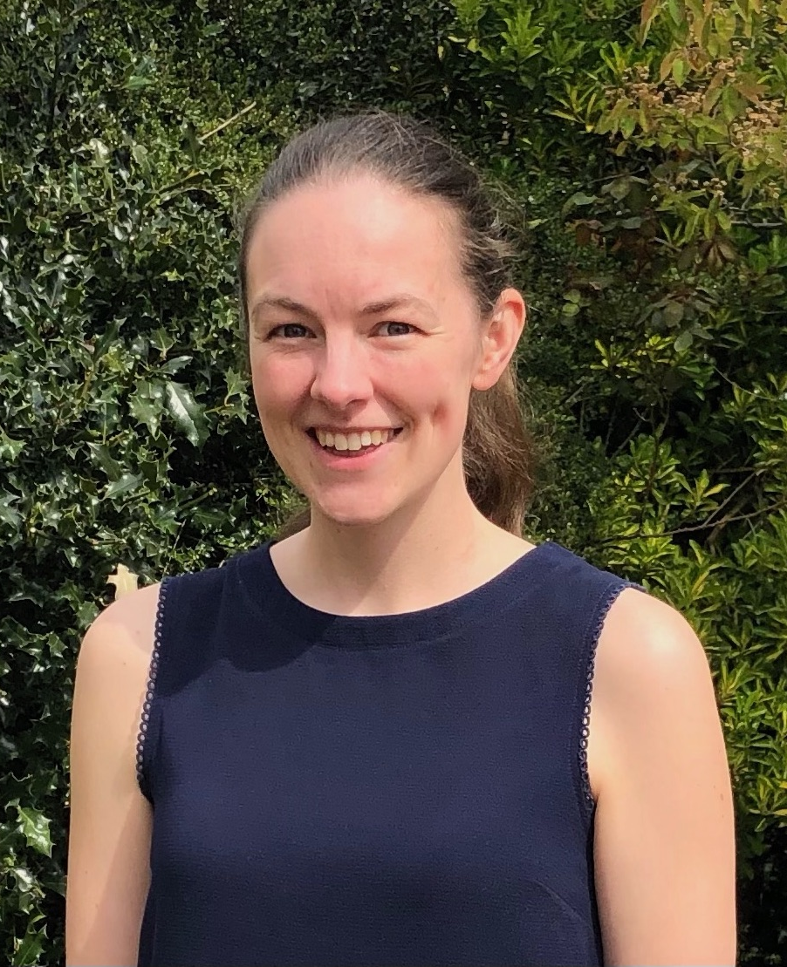
The point of statistics: Using data to uncover the truth.
Catriona Agg

