Slide 1
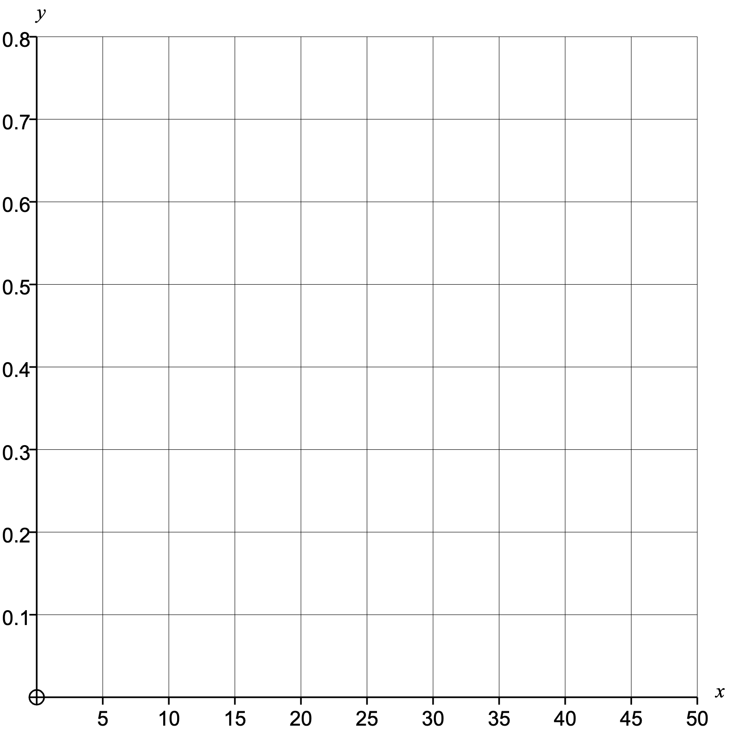
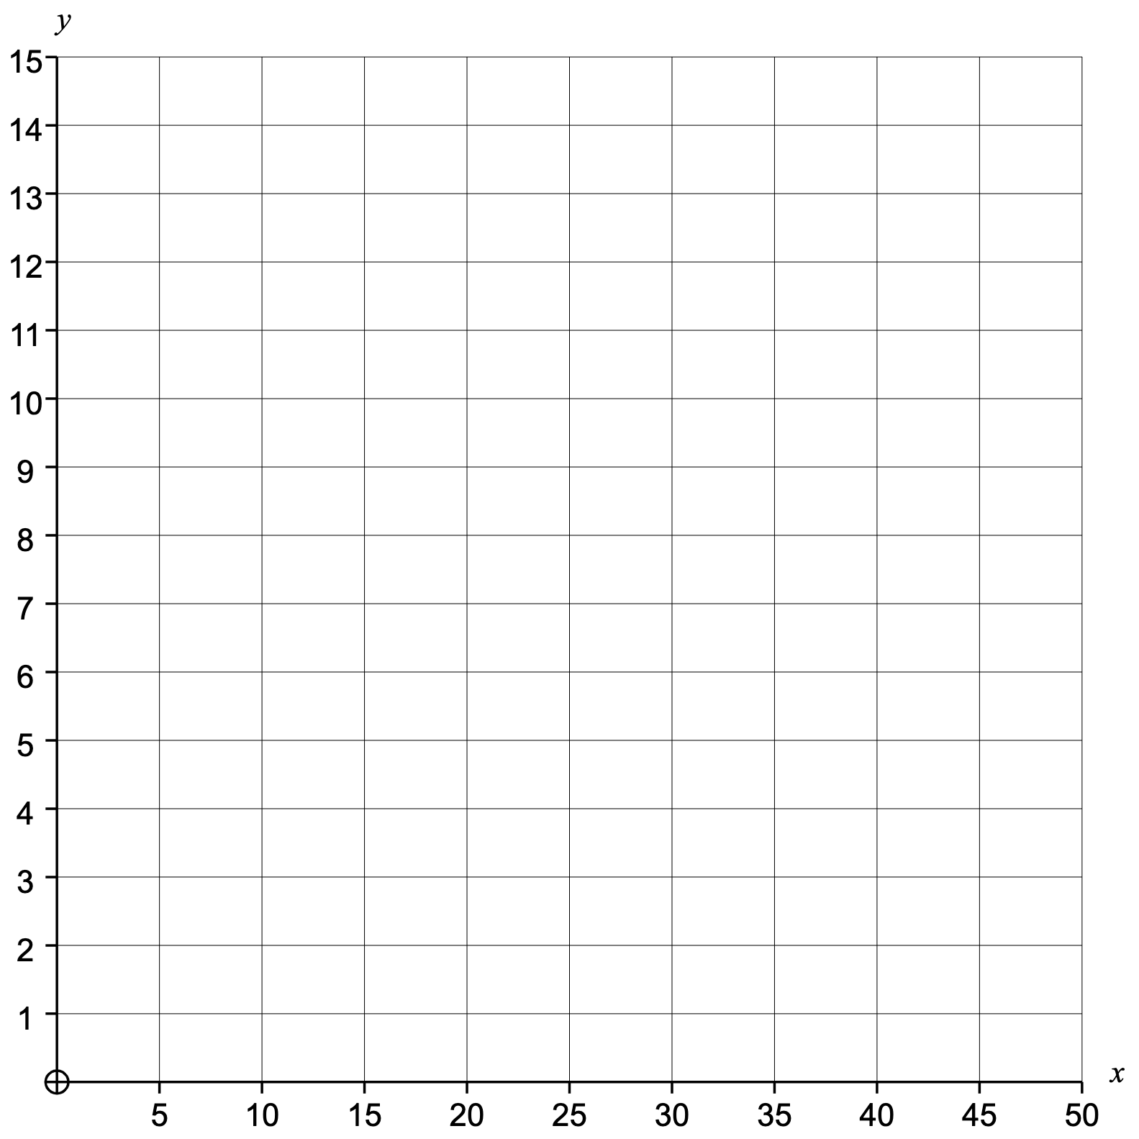
Prime numbers less than $50$
2 | 3 |  |  |  |  |  |  |  |  |  |  |  |  | 47
Group | Frequency |  | Cumulative Frequency |  | Class Width | Frequency Density |  | Midpoint | F $×$ M
$0≤n<5$ | 2
$5≤n<10$
$10≤n<20$
$20≤n<30$
$30≤n<50$
Mean
Median
Range
Lower Quartile
Upper Quartile
Interquartile Range
Estimated Mean
Modal Class
Median Class
Histogram
Cumulative Frequency
Actual Box Plot
Estimated Box Plot

Slide 2
Prime numbers less than $50$
2 | 3 | 5 | 7 | 11 | 13 | 17 | 19 | 23 | 29 | 31 | 37 | 41 | 43 | 47
Group | Frequency |  | Cumulative Frequency |  | Class Width | Frequency Density |  | Midpoint | F $×$ M
$0≤n<5$ | 2 |  | 2 |  | 5 | 0.4 |  | 2.5 | 5
$5≤n<10$ | 2 |  | 4 |  | 5 | 0.4 |  | 7.5 | 15
$10≤n<20$ | 4 |  | 8 |  | 10 | 0.4 |  | 15 | 60
$20≤n<30$ | 2 |  | 10 |  | 10 | 0.2 |  | 25 | 50
$30≤n<50$ | 5 |  | 15 |  | 20 | 0.25 |  | 40 | 200
 | 15 |  |  |  |  |  |  |  | 330
Mean | 21.87
Median | 19
Range | 45
Lower Quartile | 7
Upper Quartile | 37
Interquartile Range | 30
Estimated Mean | 22
Modal Class | $30≤n<50$
Median Class | $10≤n<20$
Histogram
Cumulative Frequency
Actual Box Plot
Estimated Box Plot

Slide 3
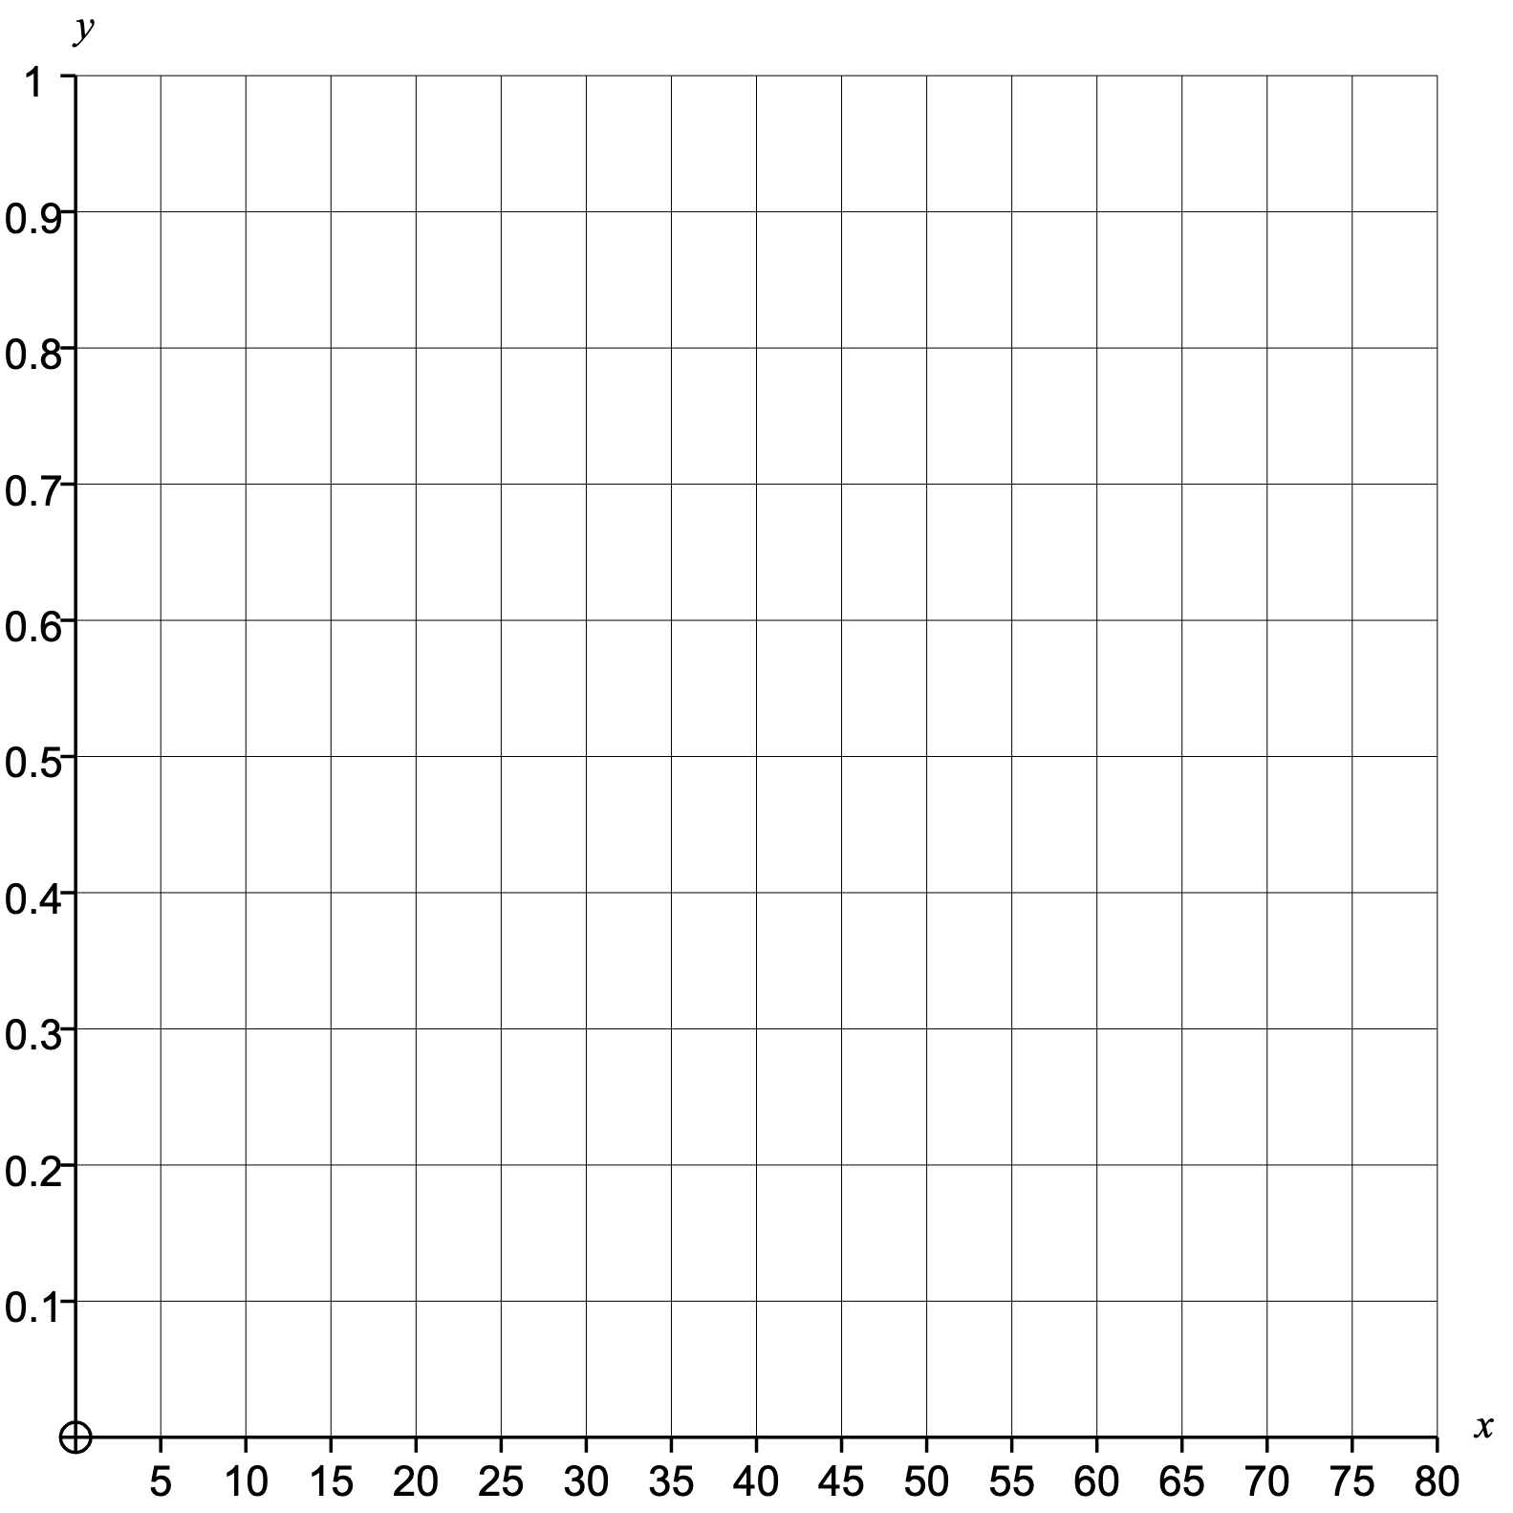
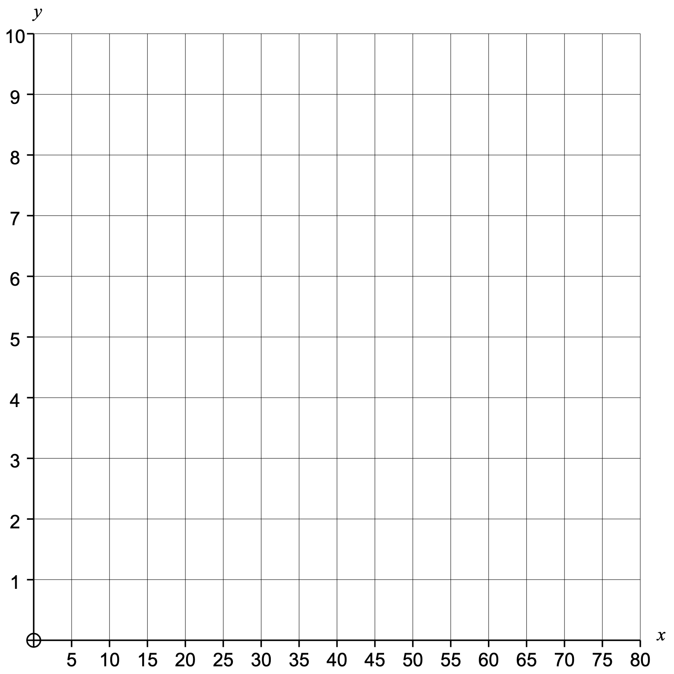
First $10$ Fibonacci numbers
1 | 1 | 2 |  |  |  |  |  |  | 55
Group | Frequency |  | Cumulative Frequency |  | Class Width | Frequency Density |  | Midpoint | F $×$ M
$0≤n<5$
$5≤n<10$
$10≤n<20$
$20≤n<40$
$40≤n<80$
Mean
Median
Range
Lower Quartile
Upper Quartile
Interquartile Range
Estimated Mean
Modal Class
Median Class
Histogram
Cumulative Frequency
Actual Box Plot
Estimated Box Plot

Slide 4
First $10$ Fibonacci numbers
1 | 1 | 2 | 3 | 5 | 8 | 13 | 21 | 34 | 55
Group | Frequency |  | Cumulative Frequency |  | Class Width | Frequency Density |  | Midpoint | F $×$ M
$0≤n<5$ | 4 |  | 4 |  | 5 | 0.8 |  | 2.5 | 10
$5≤n<10$ | 2 |  | 6 |  | 5 | 0.4 |  | 7.5 | 15
$10≤n<20$ | 1 |  | 7 |  | 10 | 0.1 |  | 15 | 15
$20≤n<40$ | 2 |  | 9 |  | 20 | 0.1 |  | 30 | 60
$40≤n<80$ | 1 |  | 10 |  | 40 | 0.025 |  | 60 | 60
 | 10 |  |  |  |  |  |  |  | 160
Mean | 14.3
Median | 6.5
Range | 54
Lower Quartile | 2
Upper Quartile | 21
Interquartile Range | 19
Estimated Mean | 16
Modal Class | $0≤n<5$
Median Class | $5≤n<10$
Histogram
Cumulative Frequency
Actual Box Plot
Estimated Box Plot

Slide 5
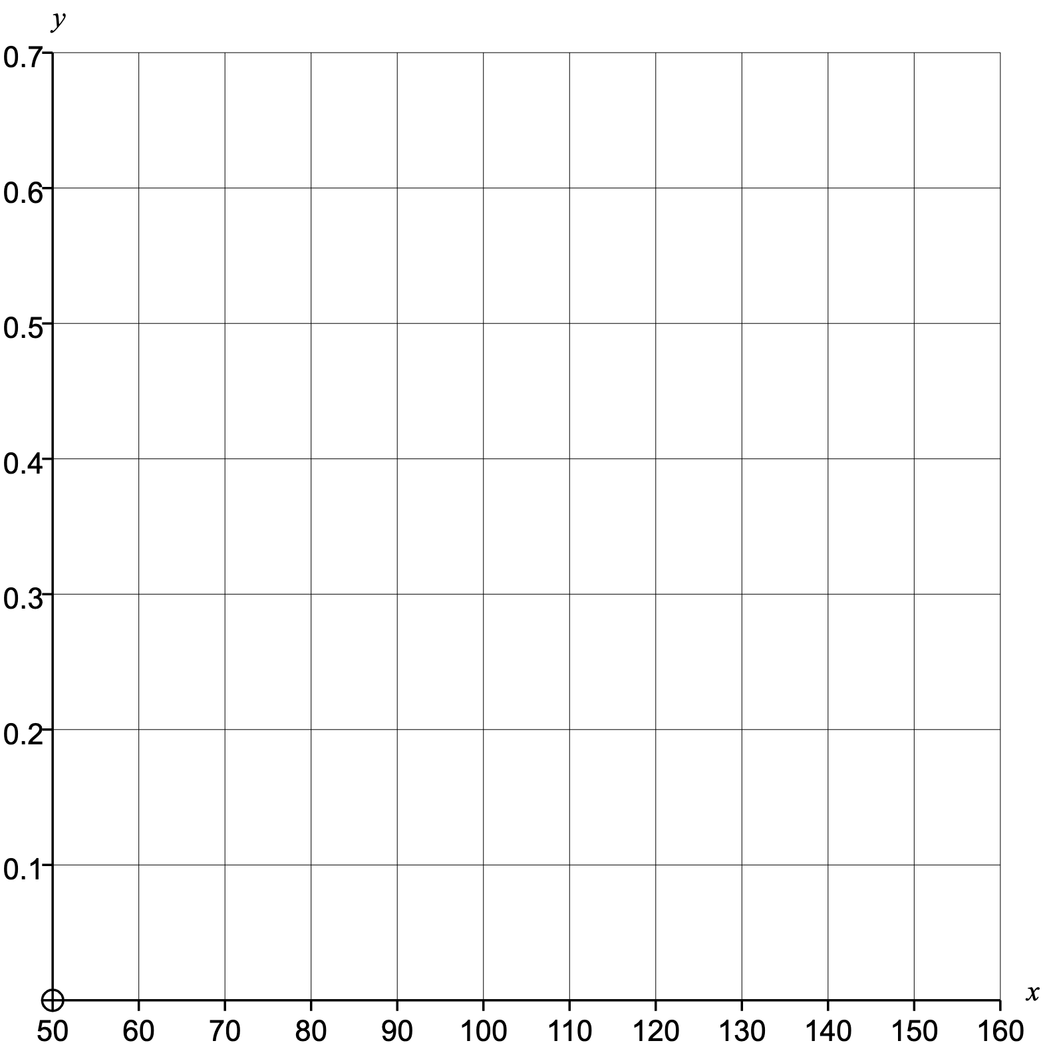
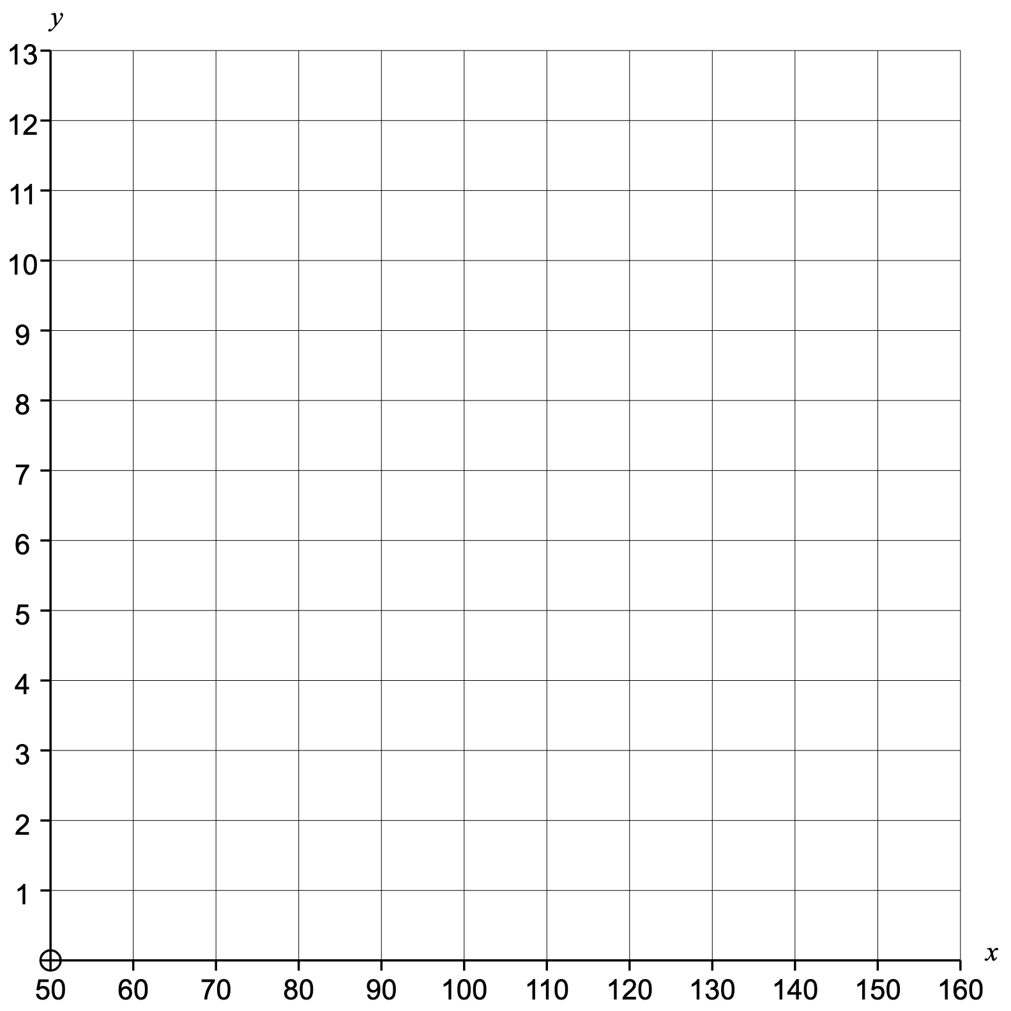
Interior angles of regular polygons from triangles to pentadecagons ($15$ sides)
$60°$ |  |  |  |  |  |  |  |  |  |  |  | $156°$
Group | Frequency |  | Cumulative Frequency |  | Class Width | Frequency Density |  | Midpoint | F $×$ M
$50°≤x<100°$
$100°≤x<125°$
$125°≤x<145°$
$145°≤x<155°$
$155°≤x<160°$
Mean
Median
Range
Lower Quartile
Upper Quartile
Interquartile Range
Estimated Mean
Modal Class
Median Class
Histogram
Cumulative Frequency
Actual Box Plot
Estimated Box Plot

Slide 6
Interior angles of regular polygons from triangles – pentadecagons ($15$ sides)
$60°$ | $90°$ | $108°$ | $120°$ | $128.6°$ | $135°$ | $140°$ | $144°$ | $147.3°$ | $150°$ | $152.3°$ | $154.3°$ | $156°$
Group | Frequency |  | Cumulative Frequency |  | Class Width | Frequency Density |  | Midpoint | F $×$ M
$50°≤x<100°$ | 2 |  | 2 |  | 50 | 0.04 |  | 75 | 150
$100°≤x<125°$ | 2 |  | 4 |  | 25 | 0.08 |  | 112.5 | 225
$125°≤x<145°$ | 4 |  | 8 |  | 20 | 0.2 |  | 135 | 540
$145°≤x<155°$ | 4 |  | 12 |  | 10 | 0.4 |  | 150 | 600
$155°≤x<160°$ | 1 |  | 13 |  | 5 | 0.2 |  | 157.5 | 157.5
 | 13 |  |  |  |  |  |  |  | 1672.5
Mean | $129.7°$
Median | $140°$
Range | $$96°$$
Lower Quartile | $114°$
Upper Quartile | $151.2°$
Interquartile Range | $$37.2°$$
Estimated Mean | $128.7°$
Modal Class | $−$
Median Class | $125°≤x<145°$
Histogram
Cumulative Frequency
Actual Box Plot
Estimated Box Plot

Slide 7
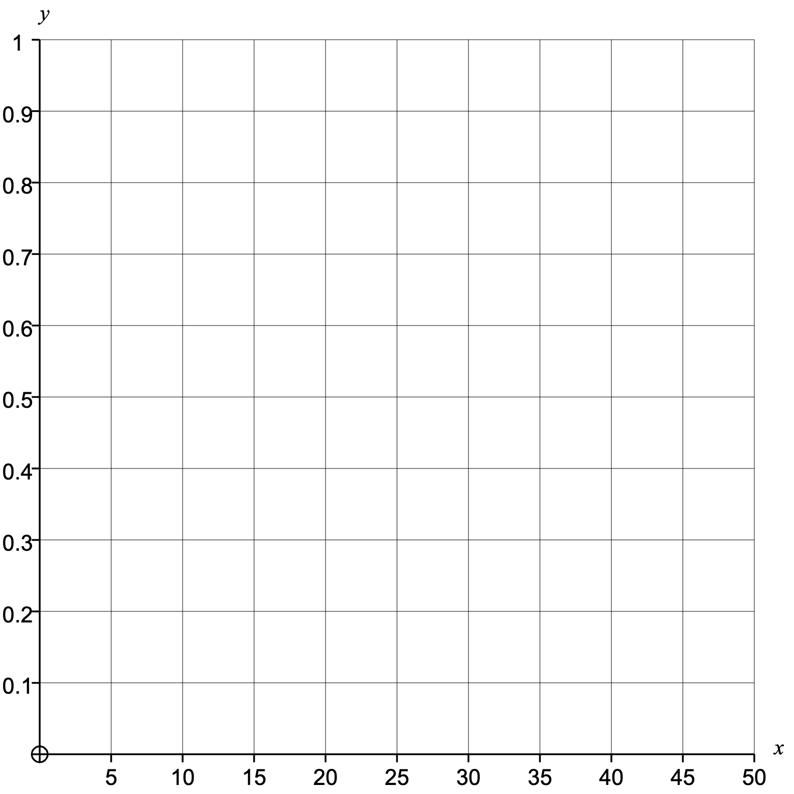
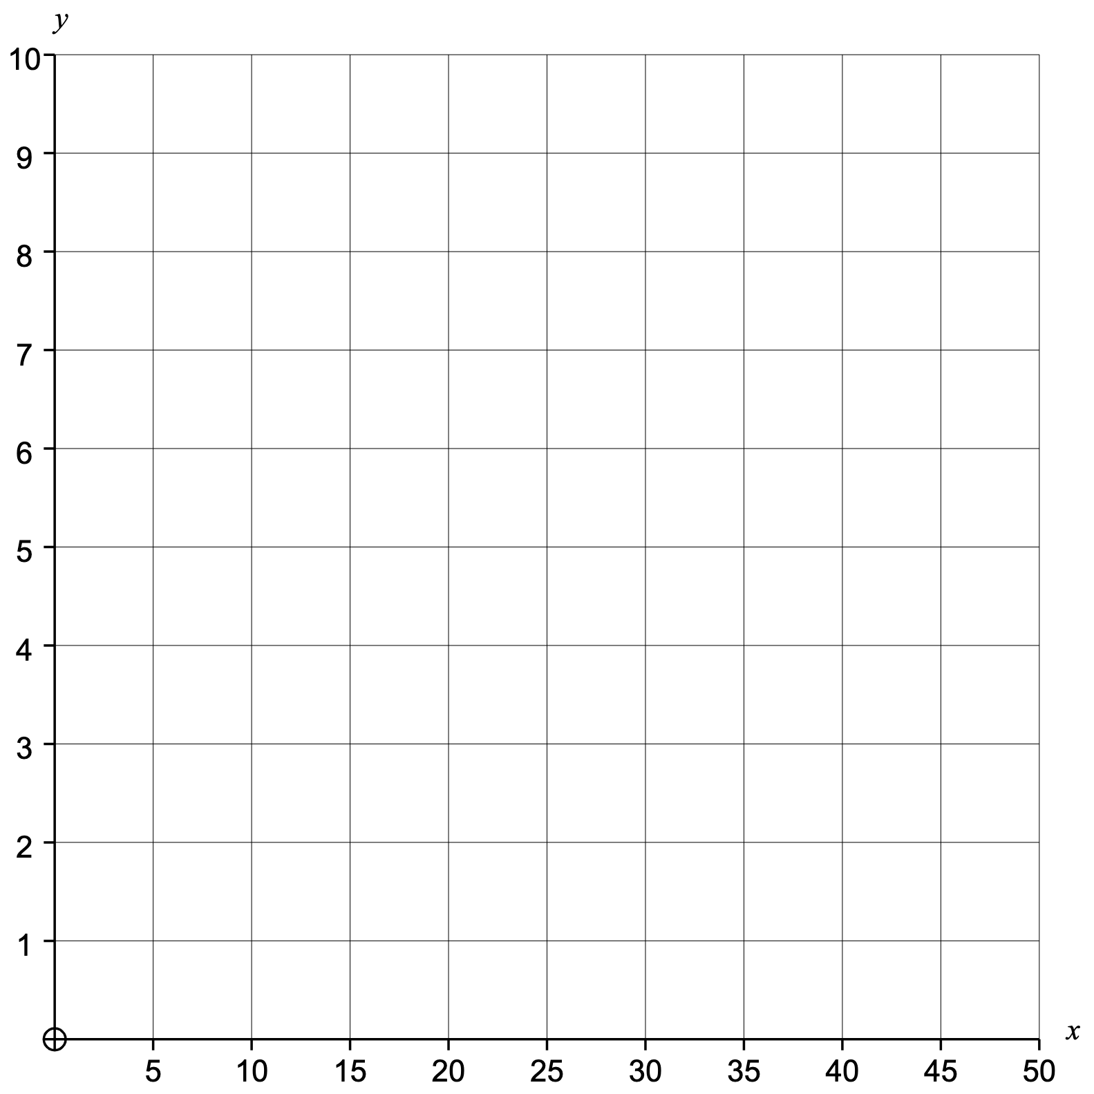
Factors of $48$
1 |  |  |  |  |  |  |  |  | 48
Group | Frequency |  | Cumulative Frequency |  | Class Width | Frequency Density |  | Midpoint | F $×$ M
$0≤n<5$
$5≤n<10$
$10≤n<20$
$20≤n<30$
$30≤n<50$
Mean
Median
Range
Lower Quartile
Upper Quartile
Interquartile Range
Estimated Mean
Modal Class
Median Class
Histogram
Cumulative Frequency
Actual Box Plot
Estimated Box Plot

Slide 8
Factors of $48$
1 | 2 | 3 | 4 | 6 | 8 | 12 | 16 | 24 | 48
Group | Frequency |  | Cumulative Frequency |  | Class Width | Frequency Density |  | Midpoint | F $×$ M
$0≤n<5$ | 4 |  | 4 |  | 5 | 0.8 |  | 2.5 | 10
$5≤n<10$ | 2 |  | 6 |  | 5 | 0.4 |  | 7.5 | 15
$10≤n<20$ | 2 |  | 8 |  | 10 | 0.2 |  | 15 | 30
$20≤n<30$ | 1 |  | 9 |  | 10 | 0.1 |  | 25 | 25
$30≤n<50$ | 1 |  | 10 |  | 20 | 0.05 |  | 40 | 40
 | 10 |  |  |  |  |  |  |  | 120
Mean | 12.4
Median | 7
Range | 47
Lower Quartile | 3
Upper Quartile | 16
Interquartile Range | 13
Estimated Mean | 12
Modal Class | $0≤n<5$
Median Class | $5≤n<10$
Histogram
Cumulative Frequency
Actual Box Plot
Estimated Box Plot

Slide 9
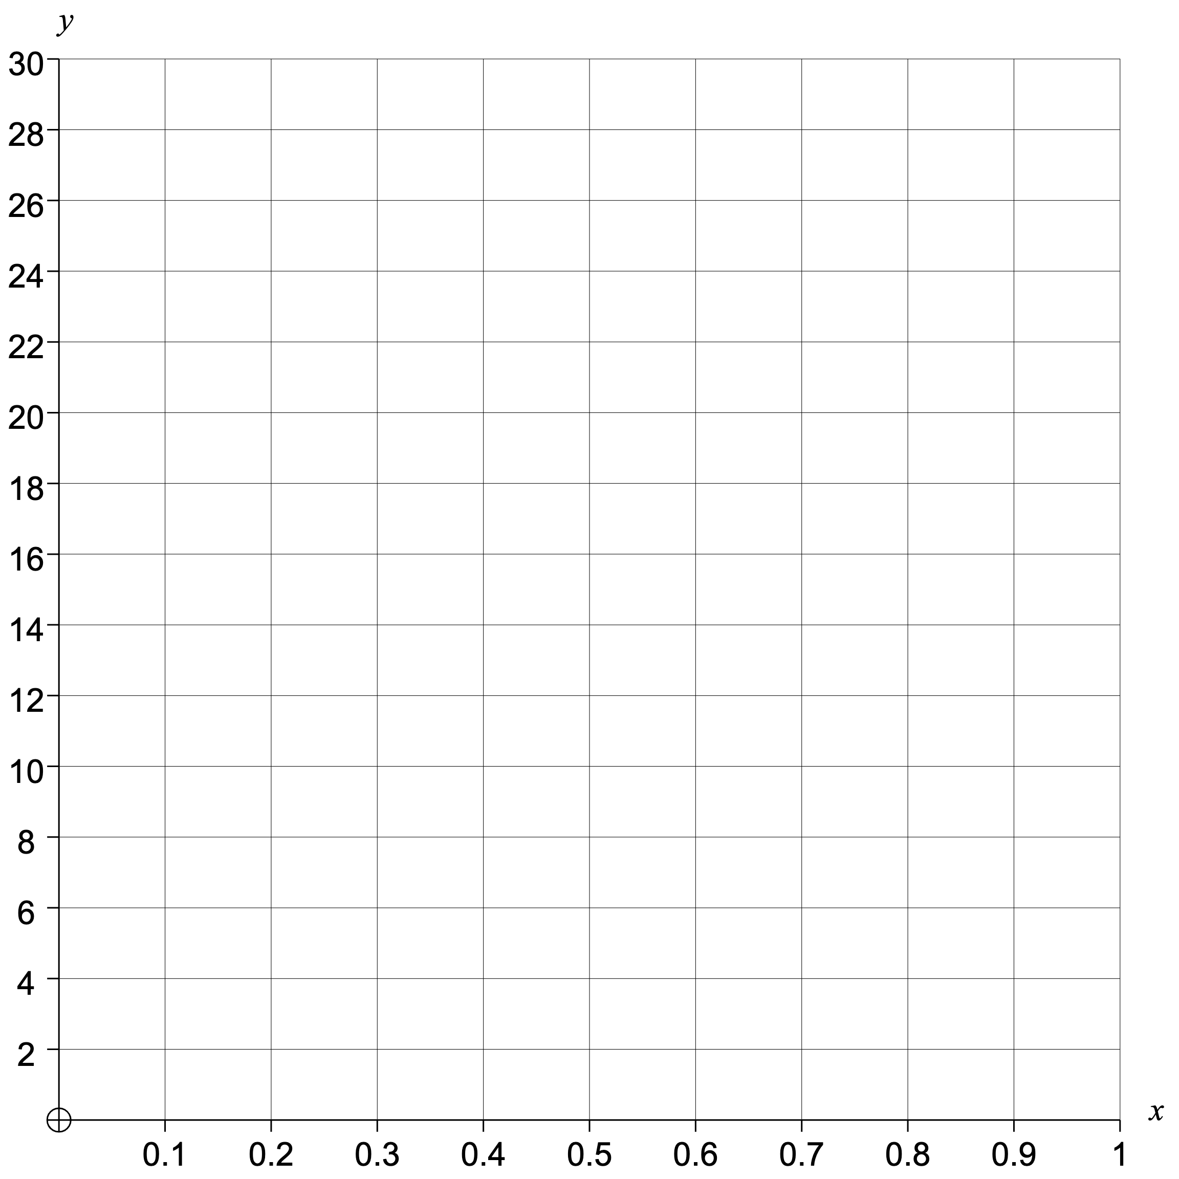
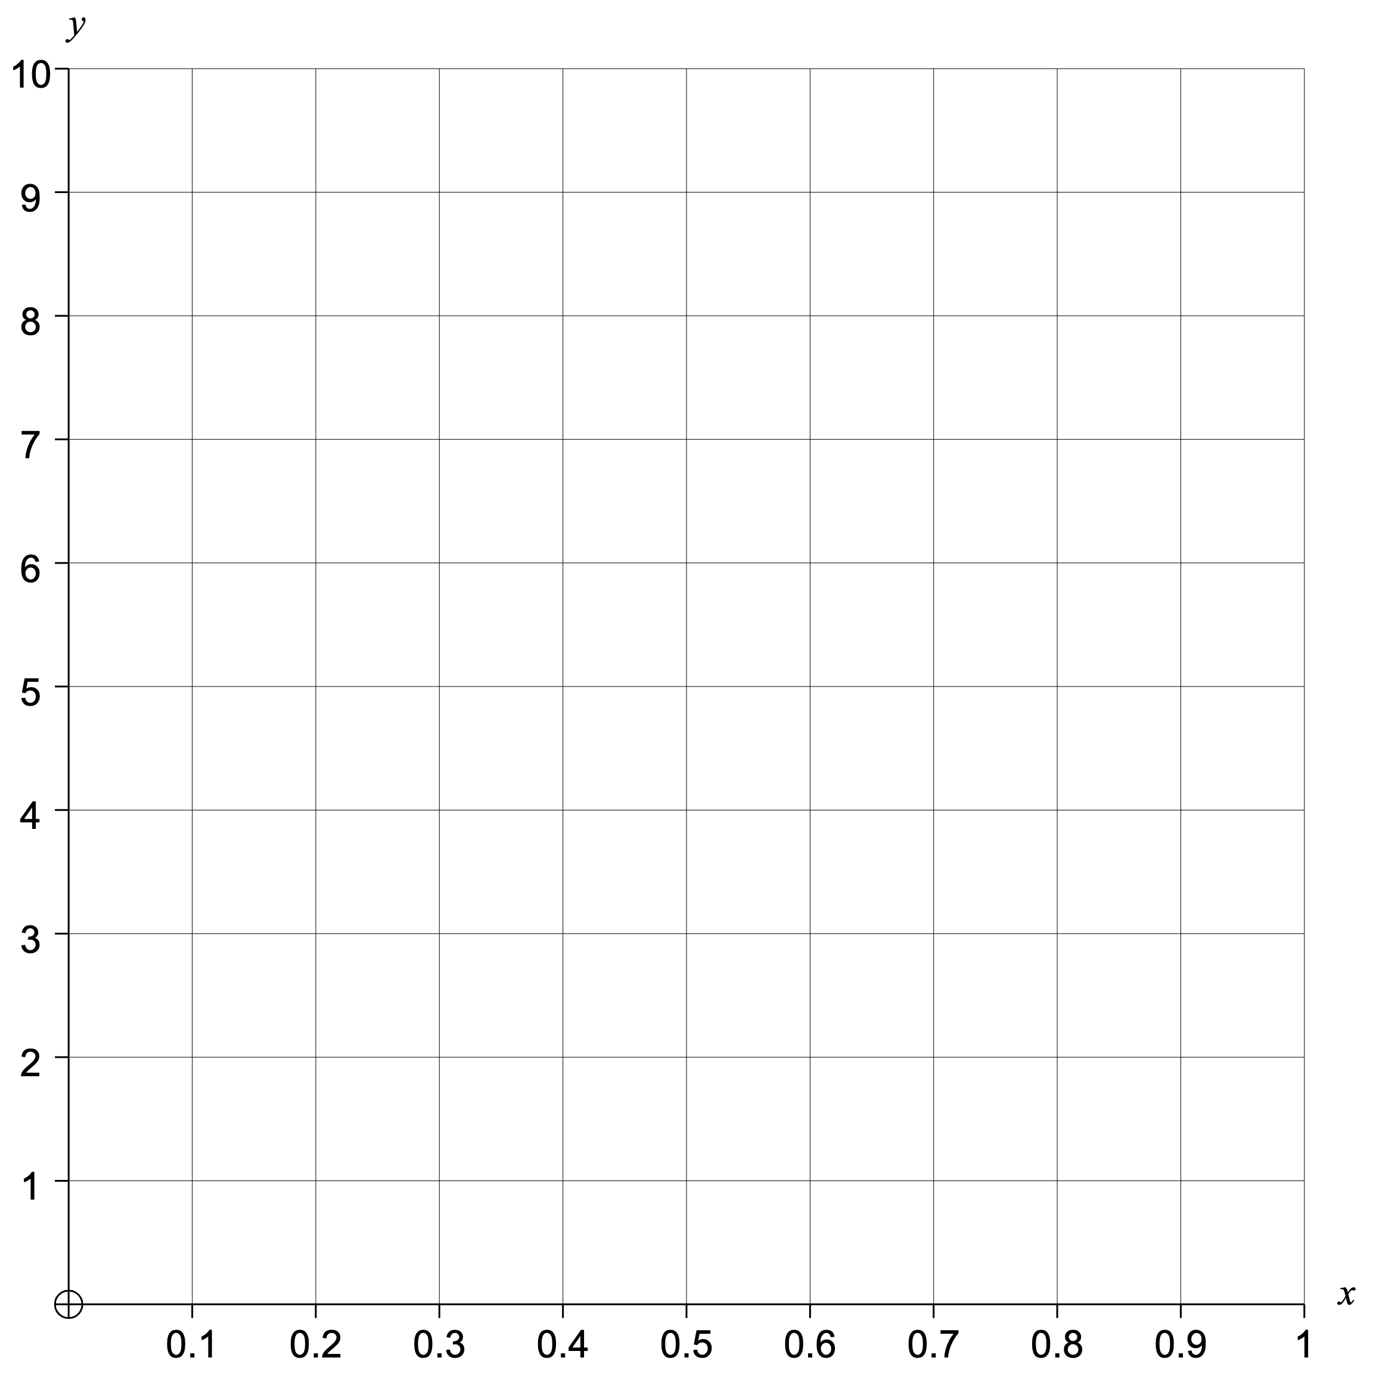
$\sin{0°}$, $\sin{10°}$, …, $\sin{90°}$
0 | 0.17
Group | Frequency |  | Cumulative Frequency |  | Class Width | Frequency Density |  | Midpoint | F $×$ M
$0≤n<0.25$
$0.25≤n<0.5$
$0.5≤n<0.7$
$0.7≤n<0.9$
$0.9≤n≤1$
Mean
Median
Range
Lower Quartile
Upper Quartile
Interquartile Range
Estimated Mean
Modal Class
Median Class
Histogram
Cumulative Frequency
Actual Box Plot
Estimated Box Plot

Slide 10
$\sin{0°}$, $\sin{10°}$, …, $\sin{90°}$
0 | 0.17 | 0.34 | 0.5 | 0.64 | 0.77 | 0.87 | 0.94 | 0.98 | 1
Group | Frequency |  | Cumulative Frequency |  | Class Width | Frequency Density |  | Midpoint | F $×$ M
$0≤n<0.25$ | 2 |  | 2 |  | 0.25 | 8 |  | 0.125 | 0.25
$0.25≤n<0.5$ | 1 |  | 3 |  | 0.25 | 4 |  | 0.375 | 0.375
$0.5≤n<0.7$ | 2 |  | 5 |  | 0.2 | 10 |  | 0.6 | 1.2
$0.7≤n<0.9$ | 2 |  | 7 |  | 0.2 | 10 |  | 0.8 | 1.6
$0.9≤n≤1$ | 3 |  | 10 |  | 0.1 | 30 |  | 0.95 | 2.85
 | 10 |  |  |  |  |  |  |  | 6.275
Mean | 0.62
Median | 0.70
Range | 1
Lower Quartile | 0.34
Upper Quartile | 0.94
Interquartile Range | 0.60
Estimated Mean | 0.6275
Modal Class | $0.9≤n≤1$
Median Class | $0.7≤n<0.9$
Histogram
Cumulative Frequency
Actual Box Plot
Estimated Box Plot

Slide 11
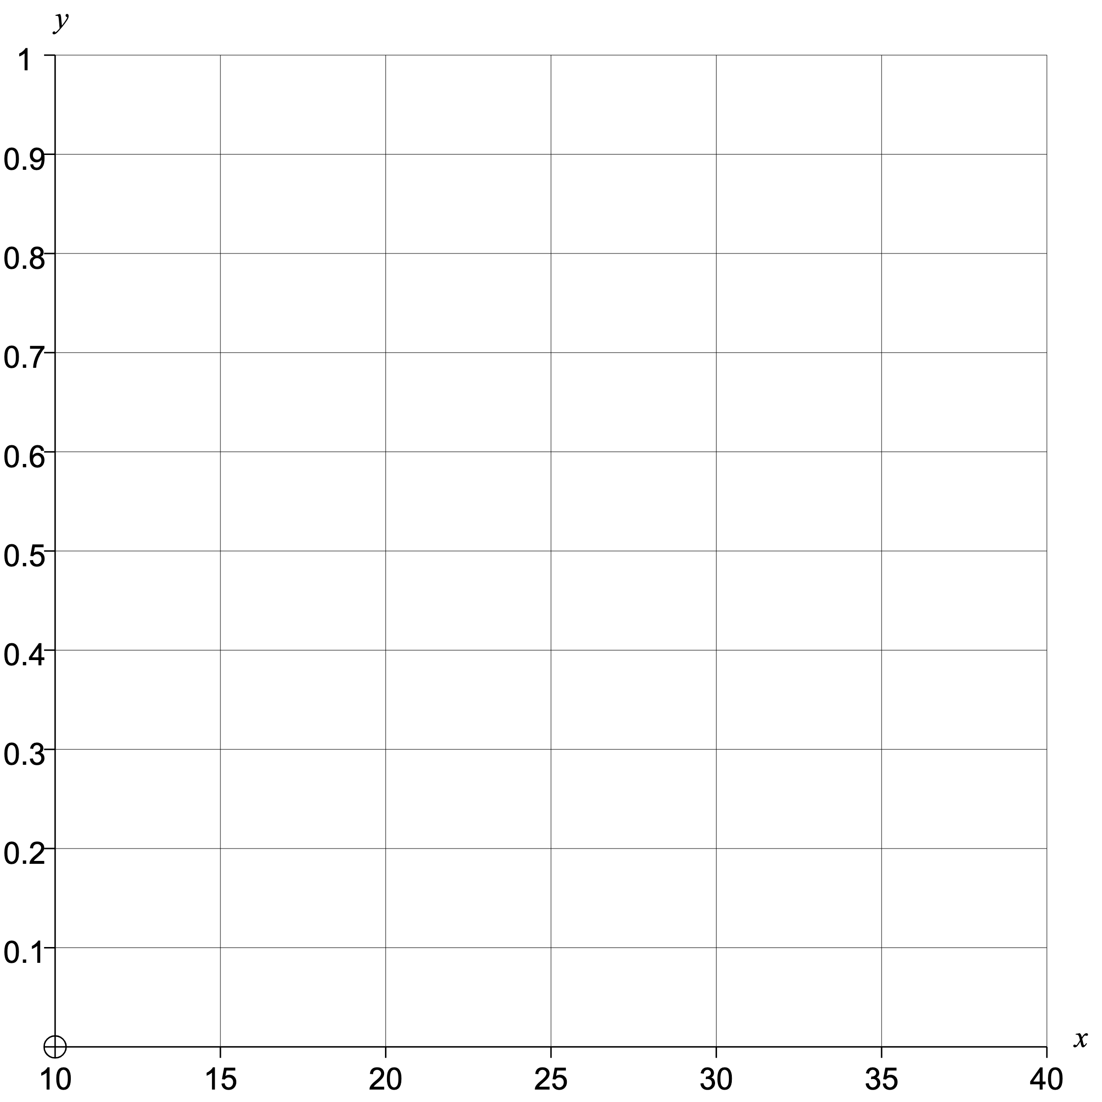
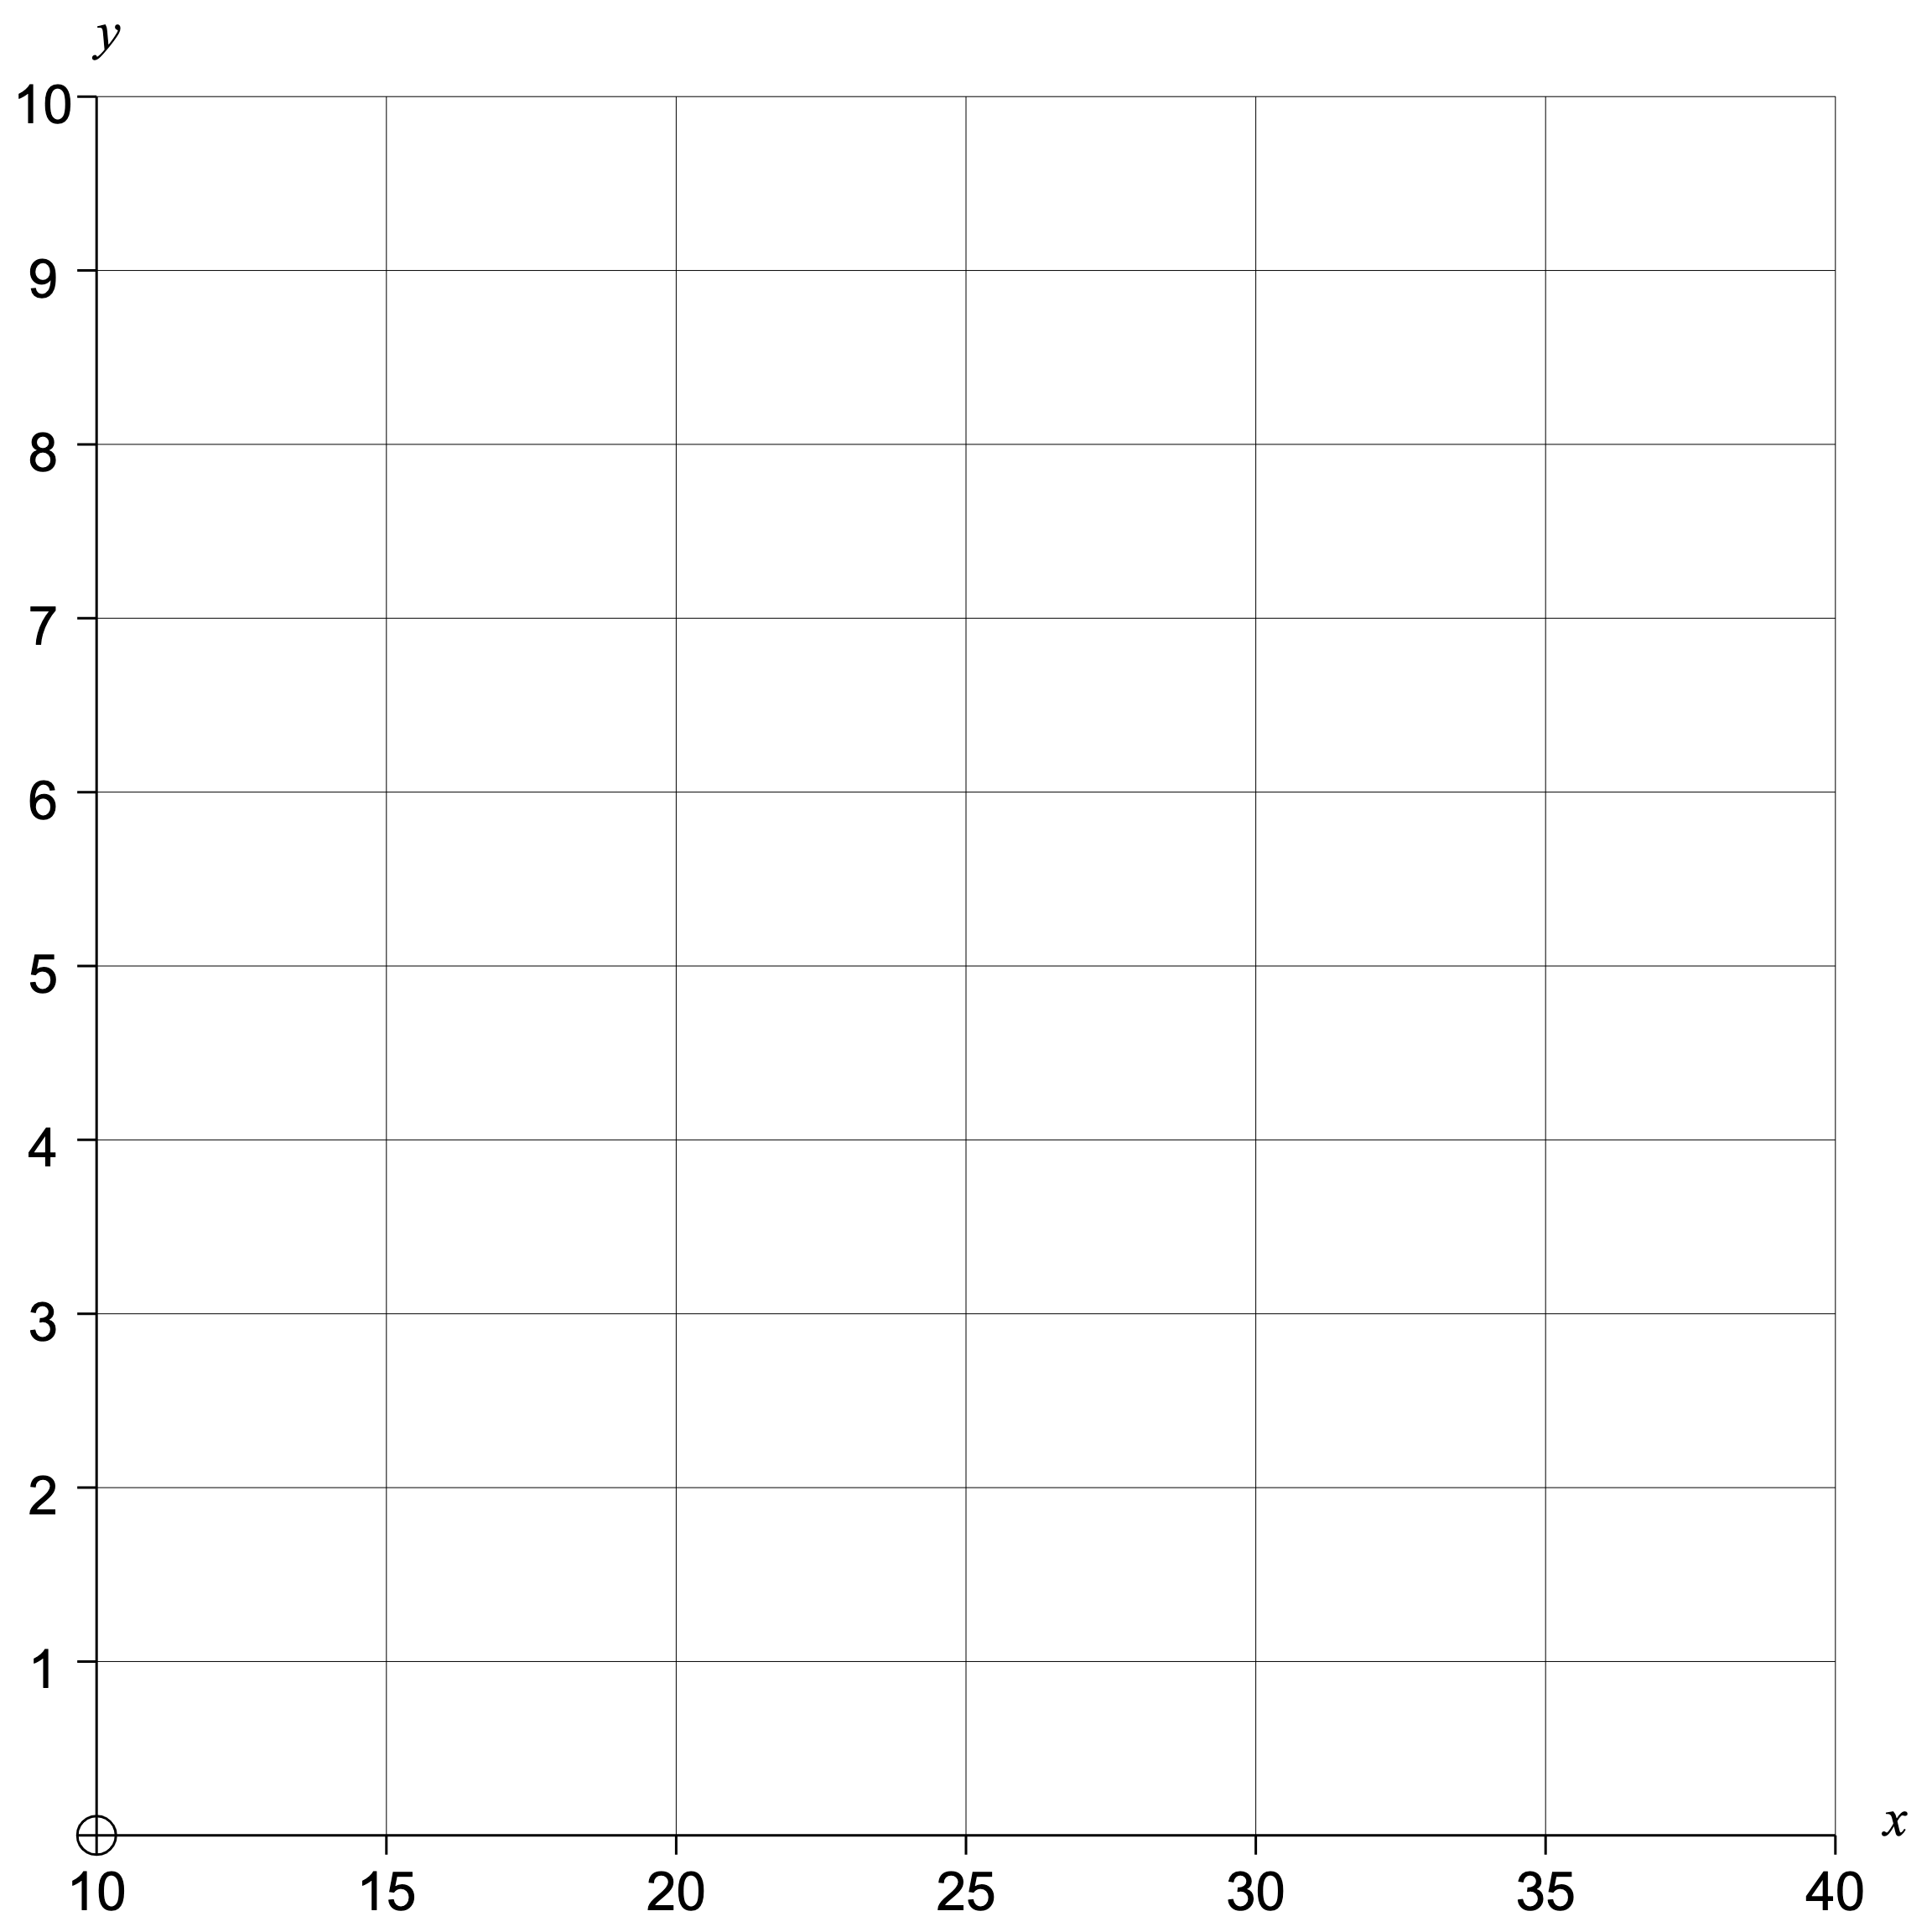
$£10$, with $14\%$ compound interest after $1$-$10$ years
£11.40 |  |  |  |  |  |  |  |  | £37.07
Group | Frequency |  | Cumulative Frequency |  | Class Width | Frequency Density |  | Midpoint | F $×$ M
$£10≤n<£15$
$£15≤n<£20$
$£20≤n<£25$
$£25≤n<£30$
$£30≤n<£40$
Mean
Median
Range
Lower Quartile
Upper Quartile
Interquartile Range
Estimated Mean
Modal Class
Median Class
Histogram
Cumulative Frequency
Actual Box Plot
Estimated Box Plot

Slide 12
$£10$, with $14\%$ compound interest after $1$-$10$ years
£11.40 | £13.00 | £14.82 | £16.89 | £19.25 | £21.95 | £25.02 | £28.53 | £32.52 | £37.07
Group | Frequency |  | Cumulative Frequency |  | Class Width | Frequency Density |  | Midpoint | F $×$ M
$£10≤n<£15$ | 3 |  | 3 |  | 5 | 0.6 |  | 12.5 | 37.5
$£15≤n<£20$ | 2 |  | 5 |  | 5 | 0.4 |  | 17.5 | 35
$£20≤n<£25$ | 1 |  | 6 |  | 5 | 0.2 |  | 22.5 | 22.5
$£25≤n<£30$ | 2 |  | 8 |  | 5 | 0.4 |  | 27.5 | 55
$£30≤n<£40$ | 2 |  | 10 |  | 10 | 0.2 |  | 35 | 70
 | 10 |  |  |  |  |  |  |  | 220
Mean | £22.04
Median | £20.60
Range | £25.67
Lower Quartile | £14.82
Upper Quartile | £28.53
Interquartile Range | £13.71
Estimated Mean | £22
Modal Class | $£10≤n<£15$
Median Class | $£20≤n<£25$
Histogram
Cumulative Frequency
Actual Box Plot
Estimated Box Plot

