Slide 1
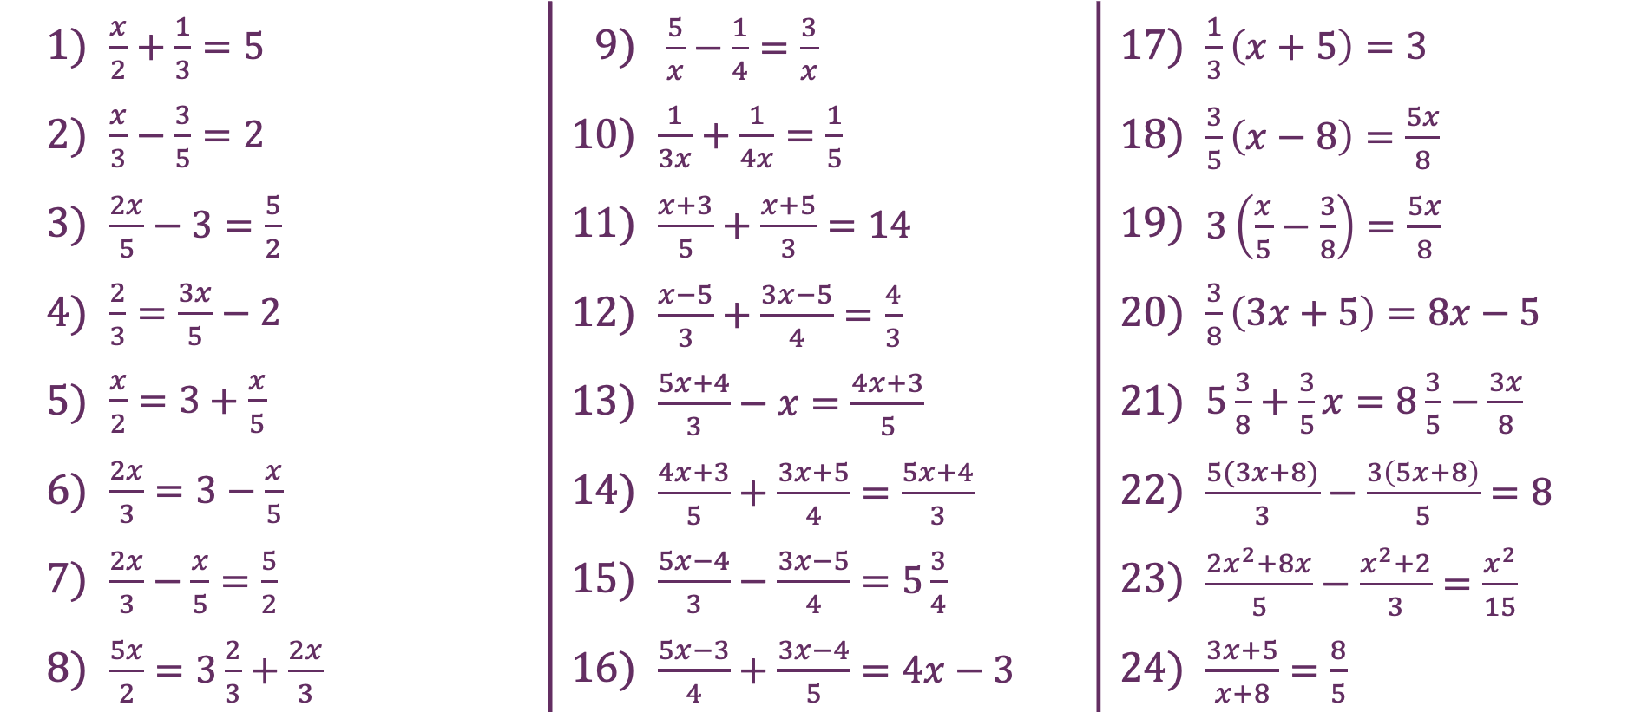
Fractions
1) | $\frac{x}{2}+\frac{1}{3}=5$ | 9) | $\frac{5}{x}−\frac{1}{4}=\frac{3}{x}$ | 17) | $\frac{1}{3}\left(x+5\right)=3$
2) | $\frac{x}{3}−\frac{3}{5}=2$ | 10) | $\frac{1}{3x}+\frac{1}{4x}=\frac{1}{5}$ | 18) | $\frac{3}{5}\left(x−8\right)=\frac{5x}{8}$
3) | $\frac{2x}{5}−3=\frac{5}{2}$ | 11) | $\frac{x+3}{5}+\frac{x+5}{3}=14$ | 19) | $3\left(\frac{x}{5}−\frac{3}{8}\right)=\frac{5x}{8}$
4) | $\frac{2}{3}=\frac{3x}{5}−2$ | 12) | $\frac{x−5}{3}+\frac{3x−5}{4}=\frac{4}{3}$ | 20) | $\frac{3}{8}\left(3x+5\right)=8x−5$
5) | $\frac{x}{2}=3+\frac{x}{5}$ | 13) | $\frac{5x+4}{3}−x=\frac{4x+3}{5}$ | 21) | $5\frac{3}{8}+\frac{3}{5}x=8\frac{3}{5}−\frac{3x}{8}$
6) | $\frac{2x}{3}=3−\frac{x}{5}$ | 14) | $\frac{4x+3}{5}+\frac{3x+5}{4}=\frac{5x+4}{3}$ | 22) | $\frac{5(3x+8)}{3}−\frac{3\left(5x+8\right)}{5}=8$
7) | $\frac{2x}{3}−\frac{x}{5}=\frac{5}{2}$ | 15) | $\frac{5x−4}{3}−\frac{3x−5}{4}=5\frac{3}{4}$ | 23) | $\frac{{2x}^{2}+8x}{5}−\frac{x^{2}+2}{3}=\frac{x^{2}}{15}$
8) | $\frac{5x}{2}=3\frac{2}{3}+\frac{2x}{3}$ | 16) | $\frac{5x−3}{4}+\frac{3x−4}{5}=4x−3$ | 24) | $\frac{3x+5}{x+8}=\frac{8}{5}$

Slide 2
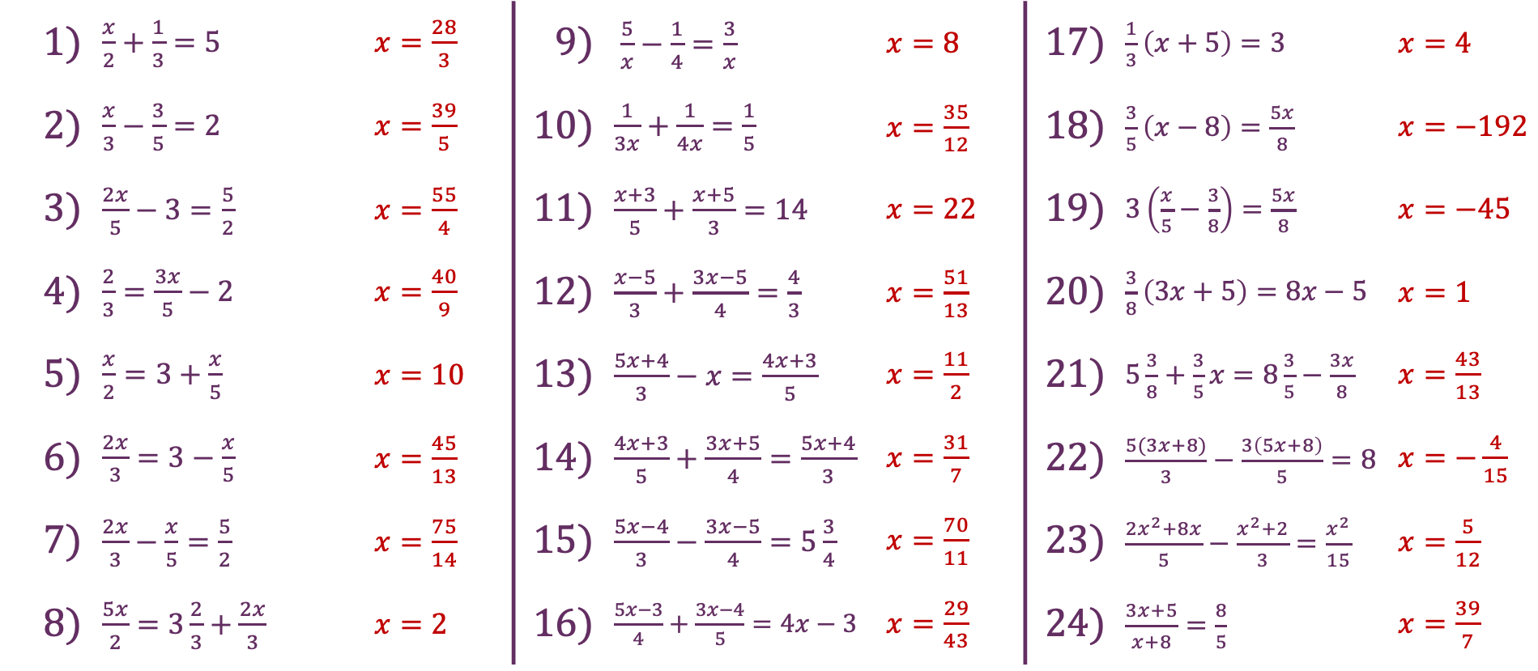
Fractions
1) | $\frac{x}{2}+\frac{1}{3}=5$ | $x=\frac{28}{3}$ | 9) | $\frac{5}{x}−\frac{1}{4}=\frac{3}{x}$ | $x=8$ | 17) | $\frac{1}{3}\left(x+5\right)=3$ | $x=4$
2) | $\frac{x}{3}−\frac{3}{5}=2$ | $x=\frac{39}{5}$ | 10) | $\frac{1}{3x}+\frac{1}{4x}=\frac{1}{5}$ | $x=\frac{35}{12}$ | 18) | $\frac{3}{5}\left(x−8\right)=\frac{5x}{8}$ | $x=−192$
3) | $\frac{2x}{5}−3=\frac{5}{2}$ | $x=\frac{55}{4}$ | 11) | $\frac{x+3}{5}+\frac{x+5}{3}=14$ | $x=22$ | 19) | $3\left(\frac{x}{5}−\frac{3}{8}\right)=\frac{5x}{8}$ | $x=−45$
4) | $\frac{2}{3}=\frac{3x}{5}−2$ | $x=\frac{40}{9}$ | 12) | $\frac{x−5}{3}+\frac{3x−5}{4}=\frac{4}{3}$ | $x=\frac{51}{13}$ | 20) | $\frac{3}{8}\left(3x+5\right)=8x−5$ | $x=1$
5) | $\frac{x}{2}=3+\frac{x}{5}$ | $x=10$ | 13) | $\frac{5x+4}{3}−x=\frac{4x+3}{5}$ | $x=\frac{11}{2}$ | 21) | $5\frac{3}{8}+\frac{3}{5}x=8\frac{3}{5}−\frac{3x}{8}$ | $x=\frac{43}{13}$
6) | $\frac{2x}{3}=3−\frac{x}{5}$ | $x=\frac{45}{13}$ | 14) | $\frac{4x+3}{5}+\frac{3x+5}{4}=\frac{5x+4}{3}$ | $x=\frac{31}{7}$ | 22) | $\frac{5(3x+8)}{3}−\frac{3\left(5x+8\right)}{5}=8$ | $x=−\frac{4}{15}$
7) | $\frac{2x}{3}−\frac{x}{5}=\frac{5}{2}$ | $x=\frac{75}{14}$ | 15) | $\frac{5x−4}{3}−\frac{3x−5}{4}=5\frac{3}{4}$ | $x=\frac{70}{11}$ | 23) | $\frac{{2x}^{2}+8x}{5}−\frac{x^{2}+2}{3}=\frac{x^{2}}{15}$ | $x=\frac{5}{12}$
8) | $\frac{5x}{2}=3\frac{2}{3}+\frac{2x}{3}$ | $x=2$ | 16) | $\frac{5x−3}{4}+\frac{3x−4}{5}=4x−3$ | $x=\frac{29}{43}$ | 24) | $\frac{3x+5}{x+8}=\frac{8}{5}$ | $x=\frac{39}{7}$

