Slide 1
InterwovenMaths.com
Bounds
Frequency Diagrams with…
$30$ students have their heights measured to the nearest foot. Draw a cumulative frequency diagram for these data.
The heights of $30$ sunflowers are truncated to a whole number of metres. Draw a histogram for these data.
Height (to nearest foot) | Height (inequality) | Frequency
4 | $≤h<$ | 12
5 |  | 14
6 |  | 4
Height (truncated) | Height (inequality) | Frequency
0 | $≤h<$ | 3
1 |  | 17
2 |  | 10
$100$ random numbers between $0$ and $10$ are rounded to the nearest prime. Draw a histogram for these data.
The side lengths of 30 cubes are measured to the nearest cm. Draw a frequency polygon for the volumes of these cubes.
Number (to nearest prime) | Number (inequality) | Frequency
2 | $≤n<$ | 15
3 |  | 24
5 |  | 24
7 |  | 30
11 |  | 7
Side Length (to nearest cm) | Volume (inequality) | Frequency
1 | $≤V<$ | 11
2 |  | 9
3 |  | 10
@MansbridgeMaths

Slide 2
InterwovenMaths.com
Bounds
Frequency Diagrams with…
$30$ students have their heights measured to the nearest foot. Draw a cumulative frequency diagram for these data.
The heights of $30$ sunflowers are truncated to a whole number of metres. Draw a histogram for these data.
Height (to nearest foot) | Height (inequality) | Frequency | Cumulative Frequency
4 | $$3.5≤h<4.5$$ | 12 | 12
5 | $$4.5≤h<5.5$$ | 14 | 26
6 | $$5.5≤h<6.5$$ | 4 | 30
Height (truncated) | Height (inequality) | Frequency | Frequency Density
0 | $$0≤h<1$$ | 3 | 3
1 | $$1≤h<2$$ | 17 | 17
2 | $$2≤h<3$$ | 10 | 10
$100$ random numbers between $0$ and $10$ are rounded to the nearest prime. Draw a histogram for these data.
The side lengths of 30 cubes are measured to the nearest cm. Draw a frequency polygon for the volumes of these cubes.
Number (to nearest prime) | Number (inequality) | Frequency | Frequency Density
2 | $$0<n<2.5$$ | 15 | 6
3 | $$2.5≤n<4$$ | 24 | 16
5 | $$4≤n<6$$ | 24 | 12
7 | $$6≤n<9$$ | 30 | 10
11 | $$9≤n<10$$ | 7 | 7
Side Length (to nearest cm) | Volume (inequality) | Frequency | Midpoint
1 | $$0.25≤V<2.25$$ | 11 | 1.25
2 | $$2.25≤V<6.25$$ | 9 | 4.25
3 | $$6.25≤V<12.25$$ | 10 | 9.25
@MansbridgeMaths

Slide 3
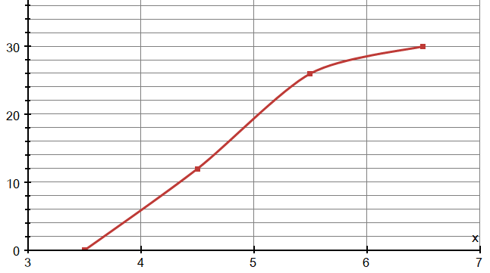
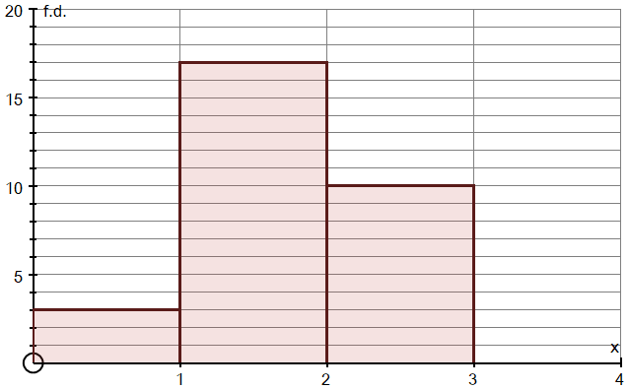
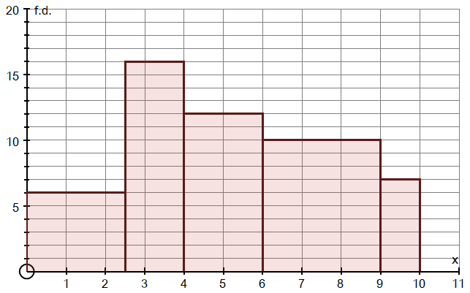
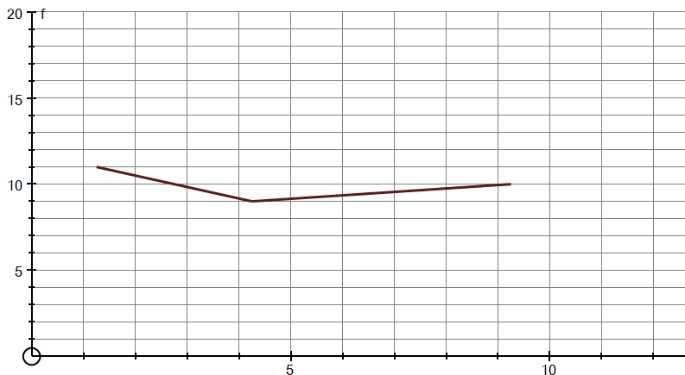
InterwovenMaths.com
Bounds
Frequency Diagrams with…
Solutions
$30$ students have their heights measured to the nearest foot. Draw a cumulative frequency diagram for these data.
The heights of $30$ sunflowers are truncated to a whole number of metres. Draw a histogram for these data.
Height (to nearest foot) | Height (inequality) | Frequency | Cumulative Frequency
4 | $$3.5≤h<4.5$$ | 12 | 12
5 | $$4.5≤h<5.5$$ | 14 | 26
6 | $$5.5≤h<6.5$$ | 4 | 30
Height (truncated) | Height (inequality) | Frequency | Frequency Density
0 | $$0≤h<1$$ | 3 | 3
1 | $$1≤h<2$$ | 17 | 17
2 | $$2≤h<3$$ | 10 | 10
$100$ random numbers between $0$ and $10$ are rounded to the nearest prime. Draw a histogram for these data.
The side lengths of 30 cubes are measured to the nearest cm. Draw a frequency polygon for the volumes of these cubes.
Number (to nearest prime) | Number (inequality) | Frequency | Frequency Density
2 | $$0<n<2.5$$ | 15 | 6
3 | $$2.5≤n<4$$ | 24 | 16
5 | $$4≤n<6$$ | 24 | 12
7 | $$6≤n<9$$ | 30 | 10
11 | $$9≤n<10$$ | 7 | 7
Side Length (to nearest cm) | Volume (inequality) | Frequency | Midpoint
1 | $$0.25≤V<2.25$$ | 11 | 1.25
2 | $$2.25≤V<6.25$$ | 9 | 4.25
3 | $$6.25≤V<12.25$$ | 10 | 9.25
@MansbridgeMaths

