Slide 1
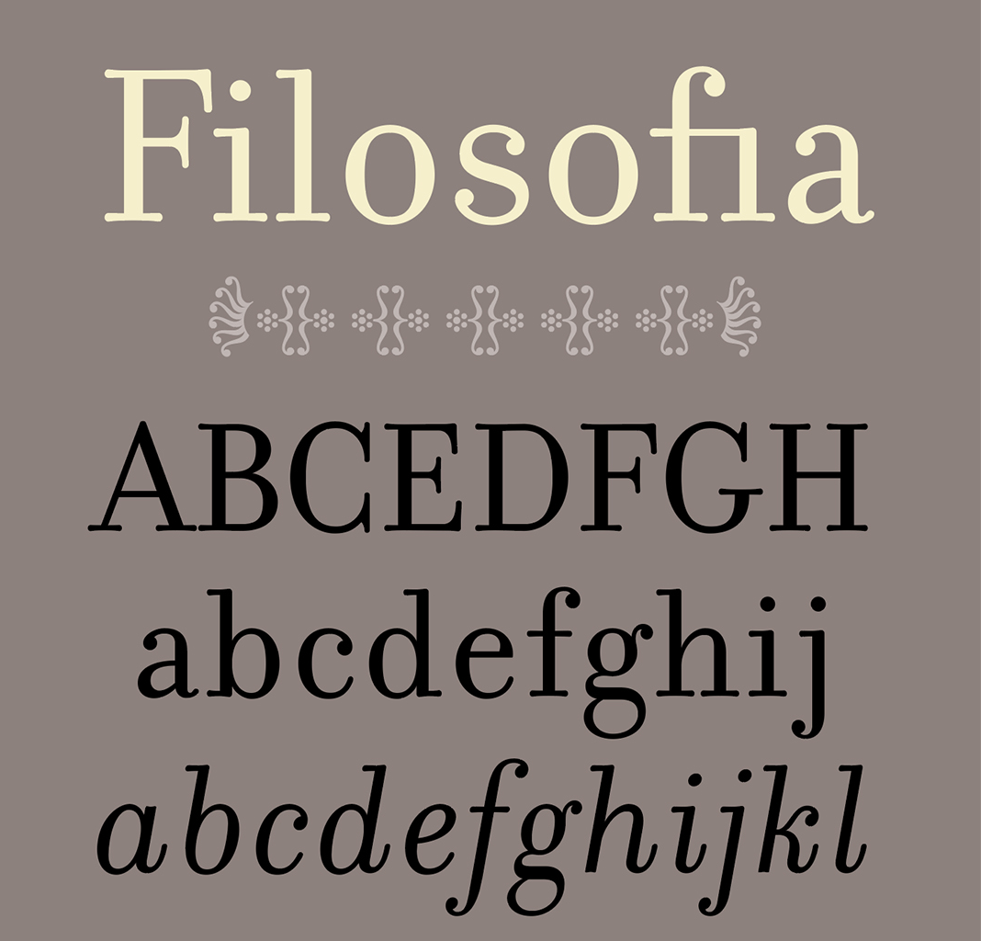
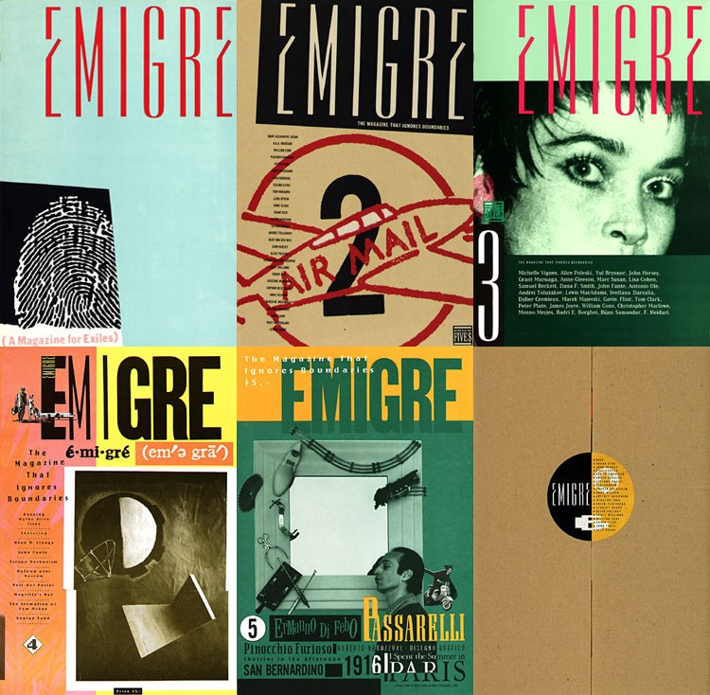
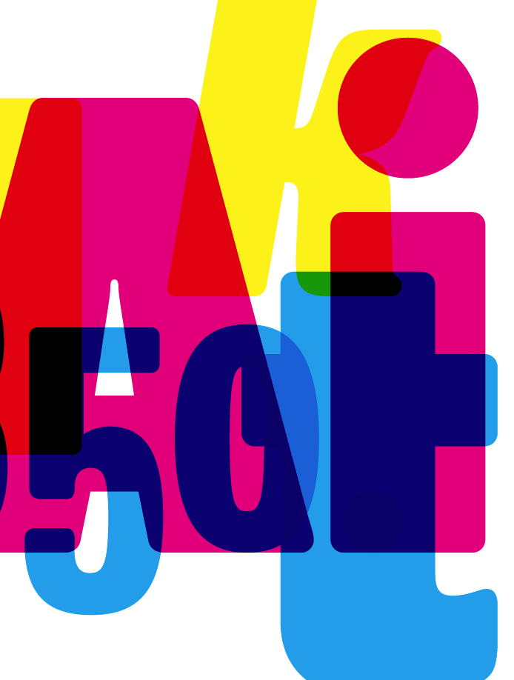
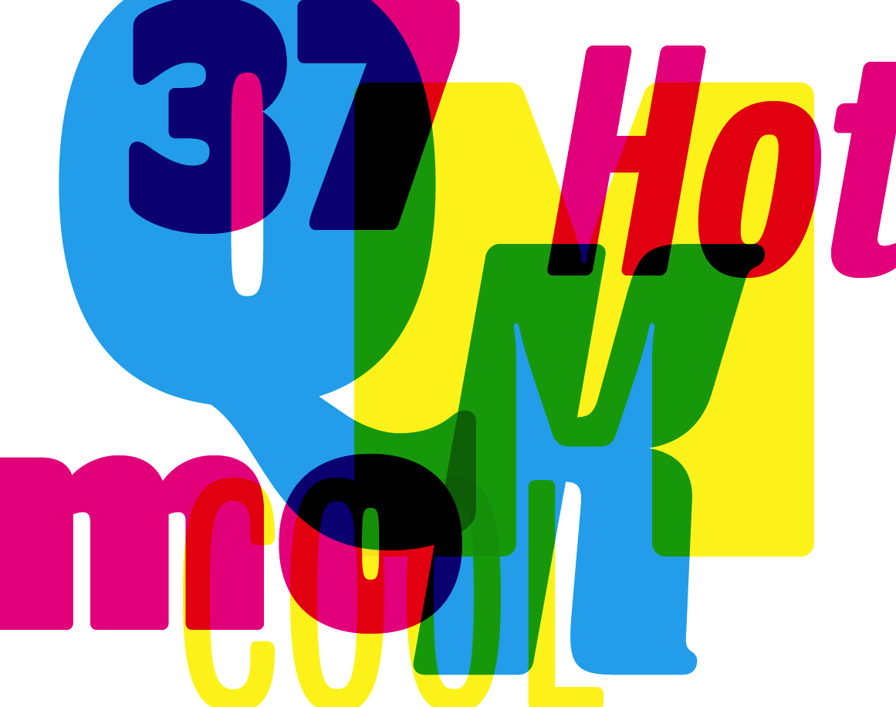
Zuzana Licko
Hai Nguyen

Slide 2
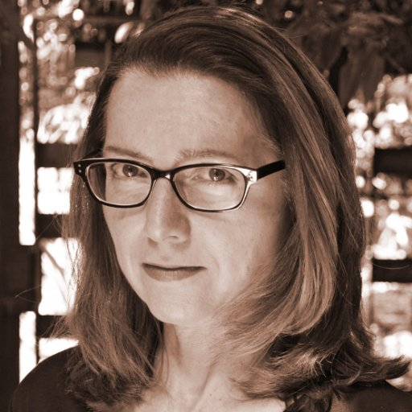
About
Zuzana Licko was born in 1961 in Bratislava, Czechoslovakia.
She emigrated with her parents to the U.S. in 1968.
She graduated from UC Berkeley in 1984, with a degree in Graphic Communications.
In 1984, Licko and her husband Rudy VanderLans started Emigre Graphics. The design company became world renowned for its self-published, award-winning magazine Emigre.

Slide 3
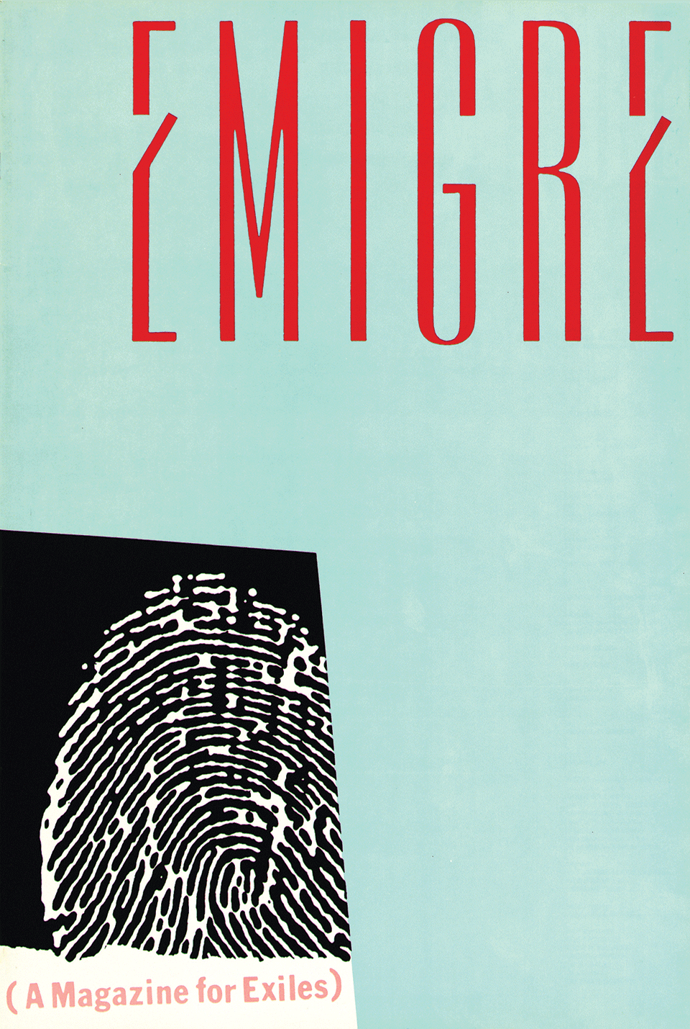
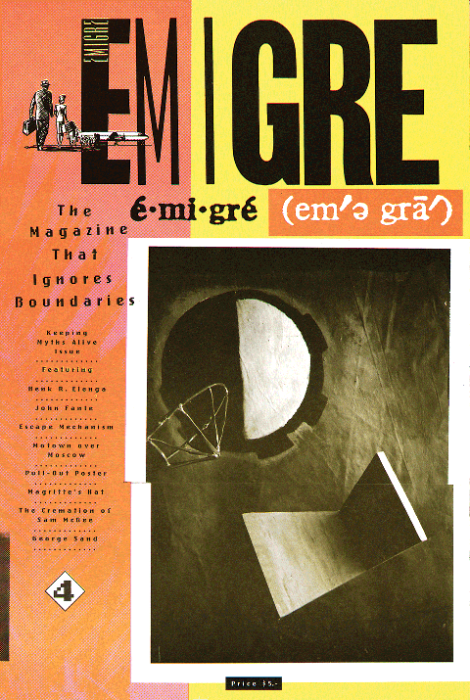
Emigre Magazine
The magazine was inspired by the new technical possibilities offered by the introduction of the Macintosh computer.
Licko and VanderLans became early adopters and used the computer to experiment and created some of the very first typeface designs and digital page layouts.
Emigre #1
Emigre #4

Slide 4
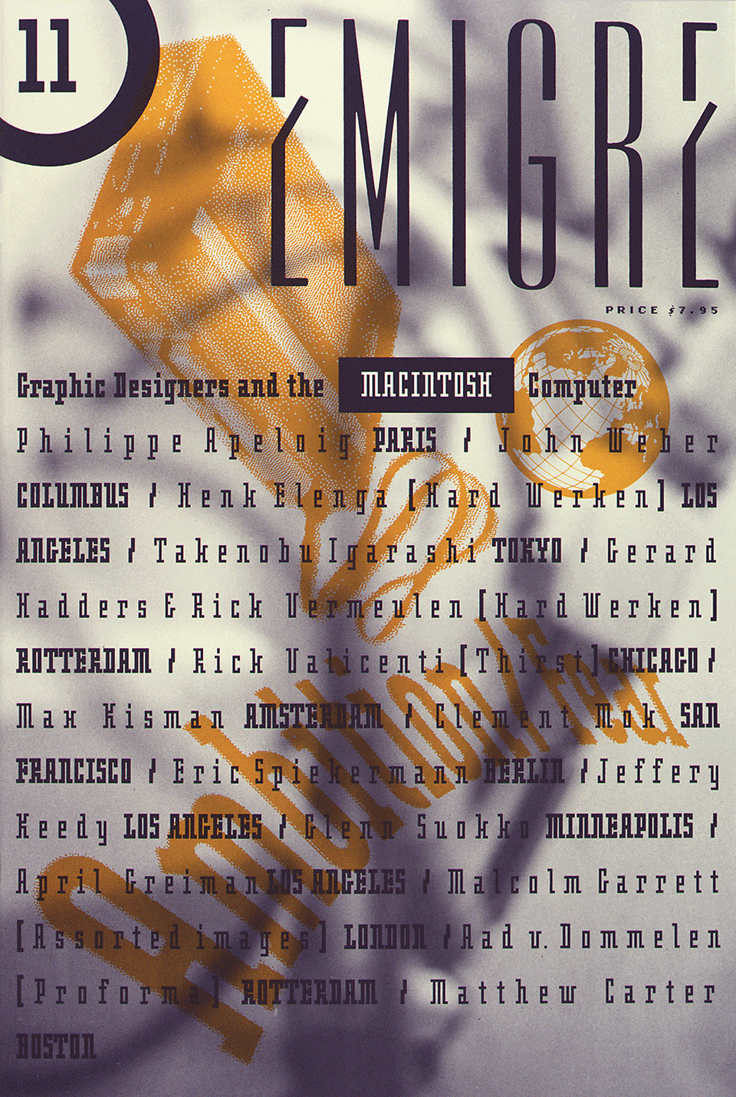
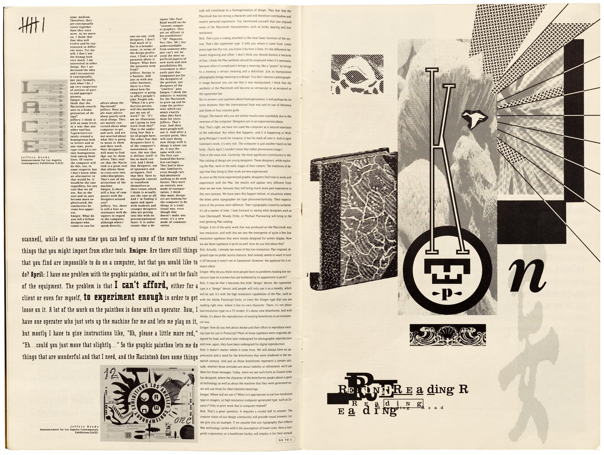
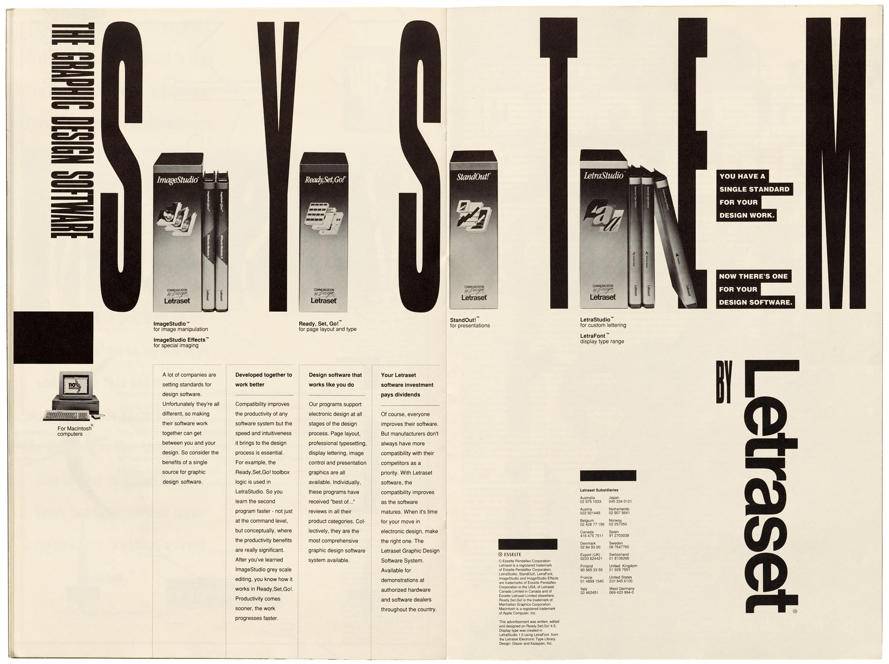
Emigre Fonts
Emigre #11
Licko's experimental type designs became a prominent feature of the magazine for its entire run.
Exposure to her typefaces through the magazine lead to the creation of Emigre Fonts in 1985.

Slide 5
Emigre Fonts
As a team, Emigre has been honored with numerous awards:
- 1994 Chrysler Award for Innovation in Design
- 1998 Charles Nypels Award for excellence in the field of typography
- Recipient of the 1997 American Institute of Graphic Arts Gold Medal Award

Slide 6
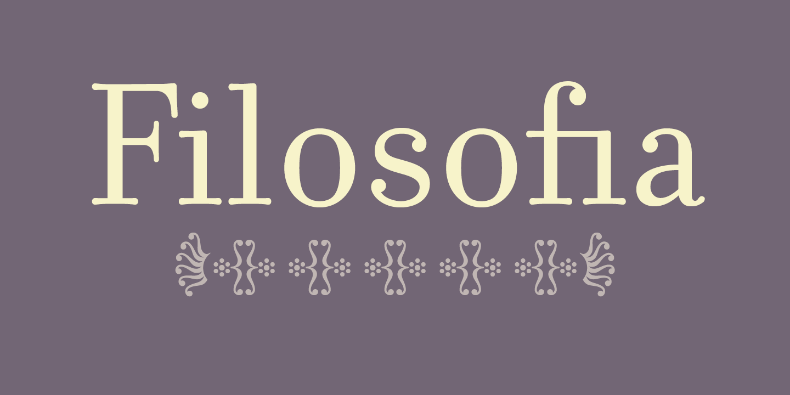
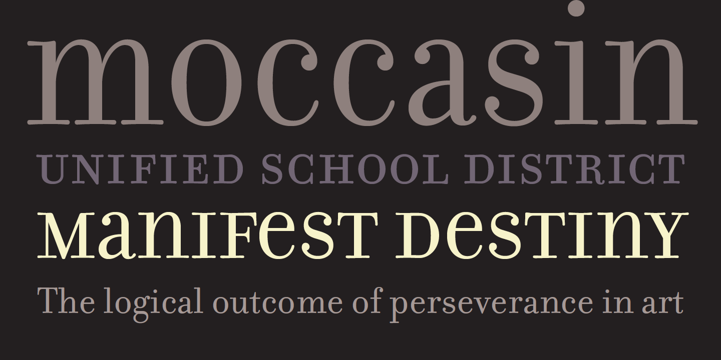

Slide 7
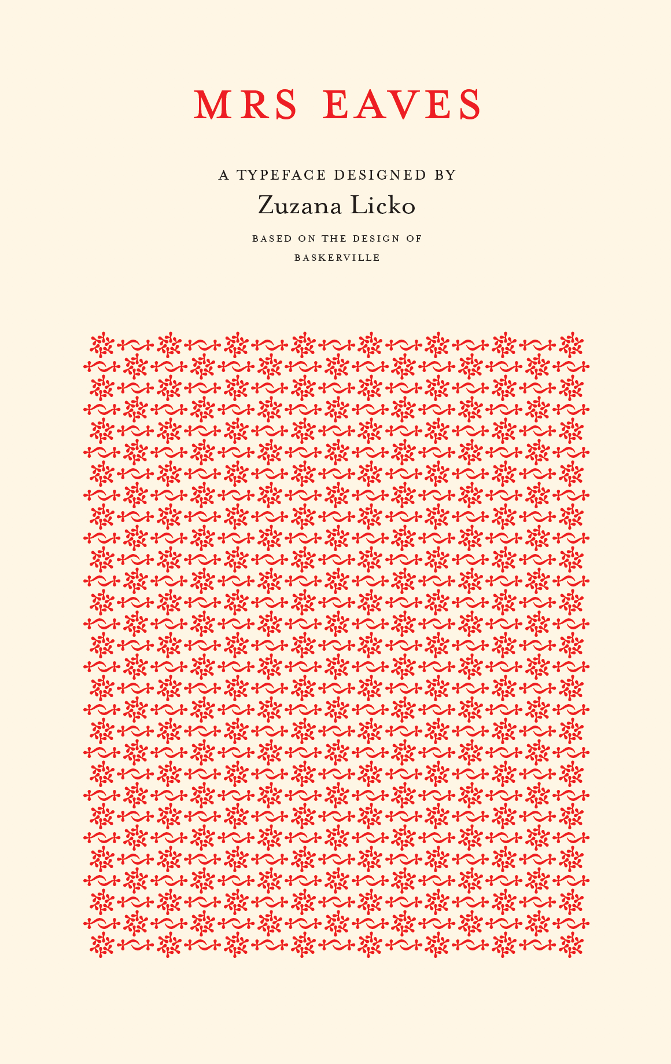

Slide 8
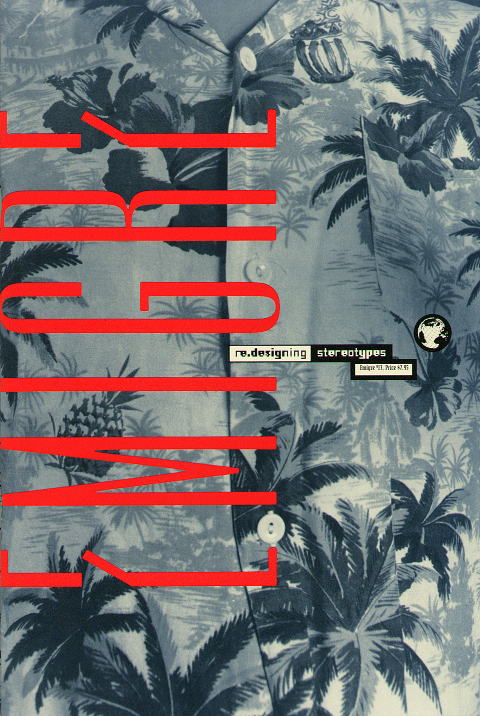
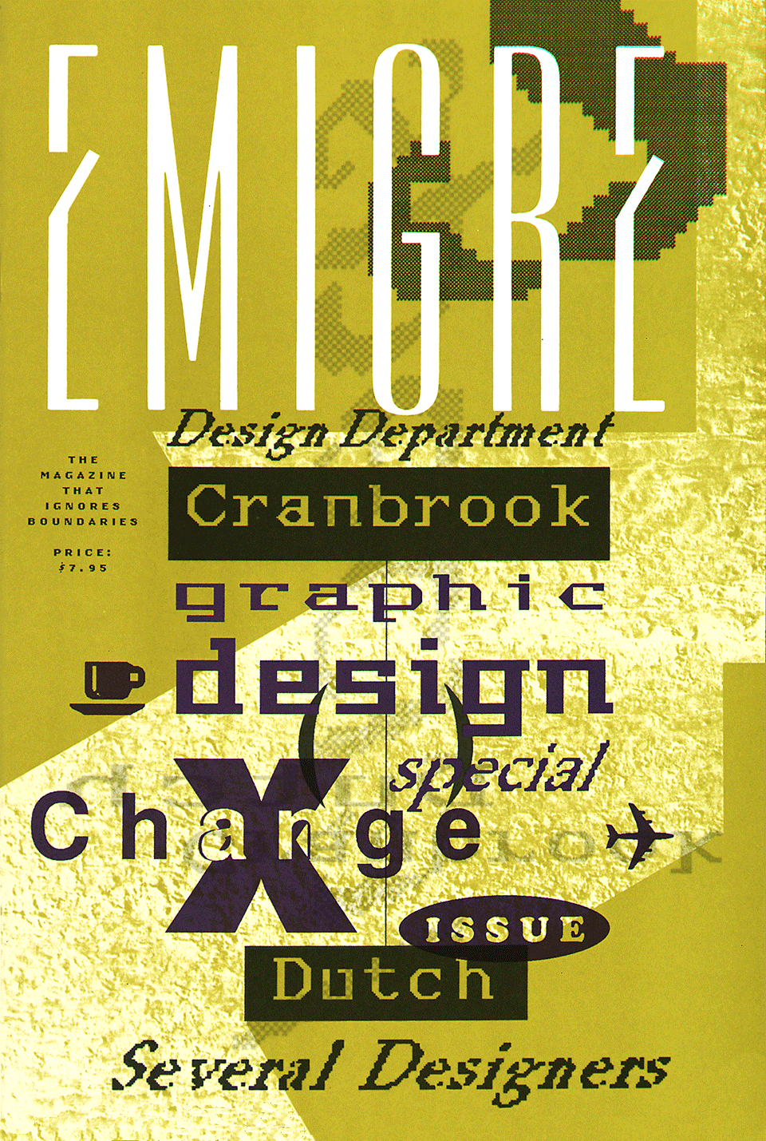
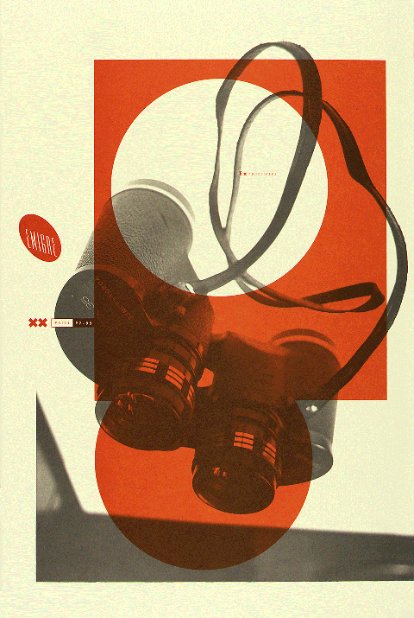
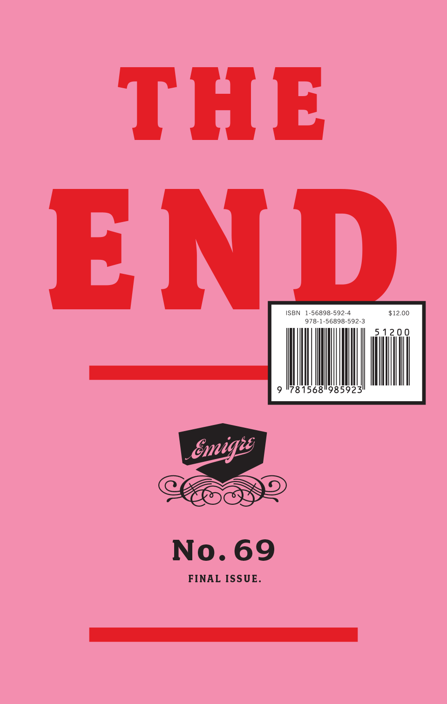
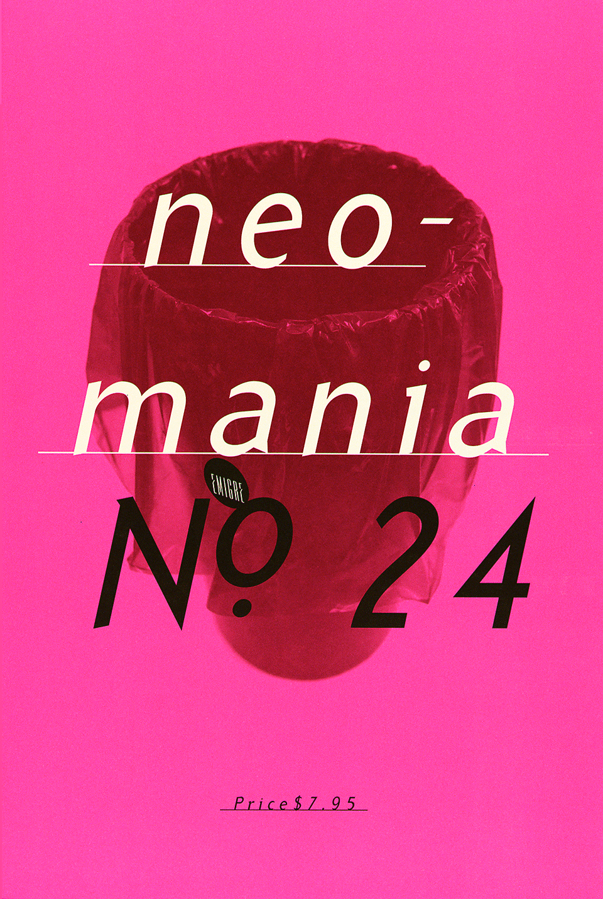
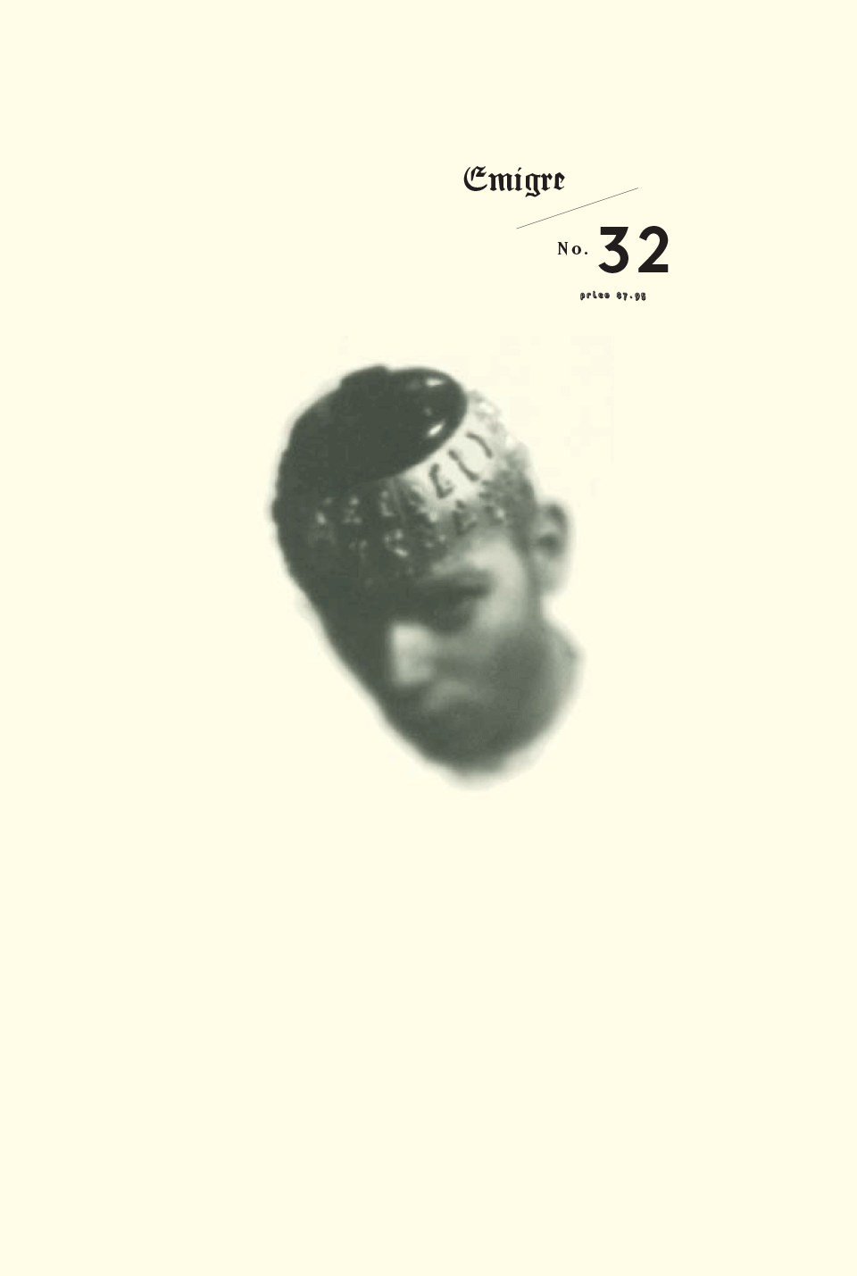
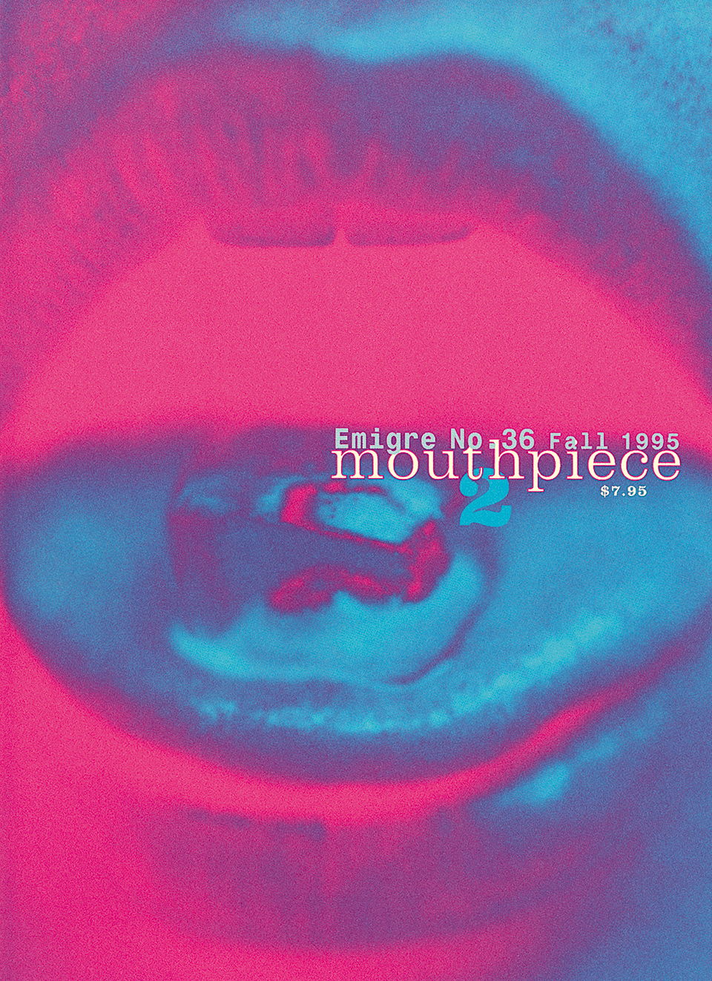
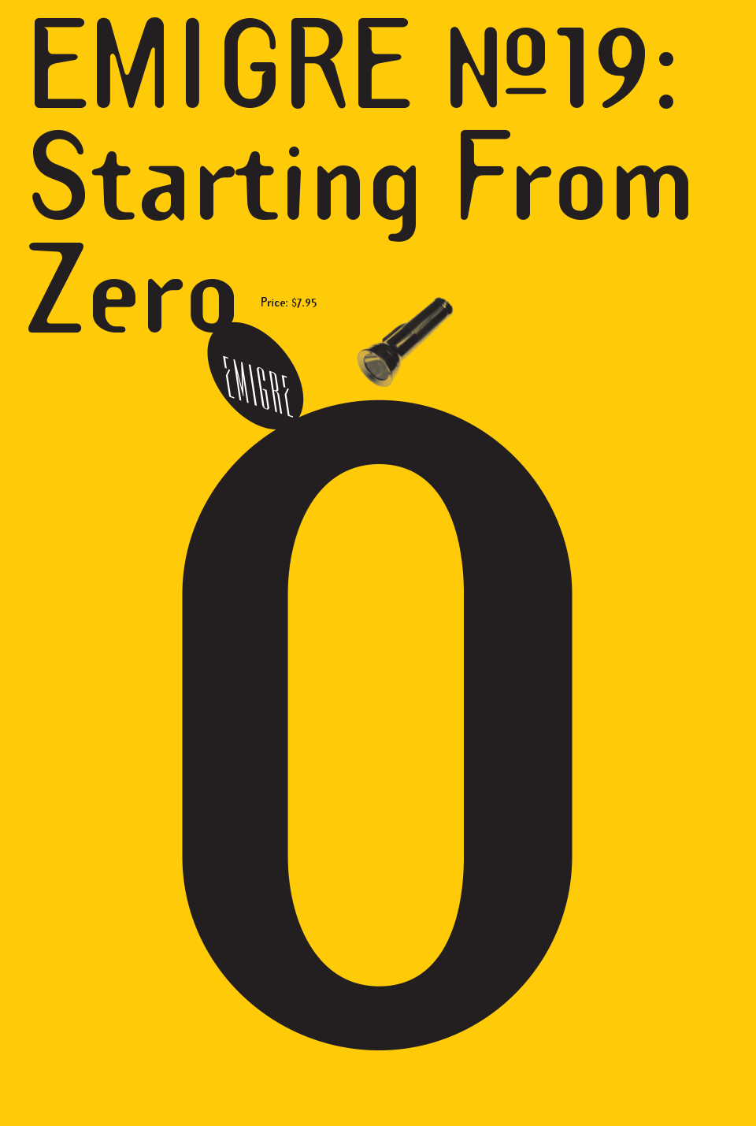

Slide 9
Why I think this Designer is inspiring
Licko’s works showcase very extensive typographic experimentation, as well as her great range and versatility in graphics.
Establishing and developing Emigre have shown her commitment and passion for typography throughout her career.
Her mindset of adopting and exploring with novel creative mediums, embracing them over more traditional design methods and practices, is especially relevant and helpful for creatives of our time.

