Slide 1
Introductions
Making Connections
The Power of Interweaving
@nathanday314

Slide 2
What is Interweaving?
Interweaving
Using questions and tasks that bring together multiple different topics from across mathematics.

Slide 3
What is Interweaving?
Interweaving
It’s not interleaving!

Slide 4
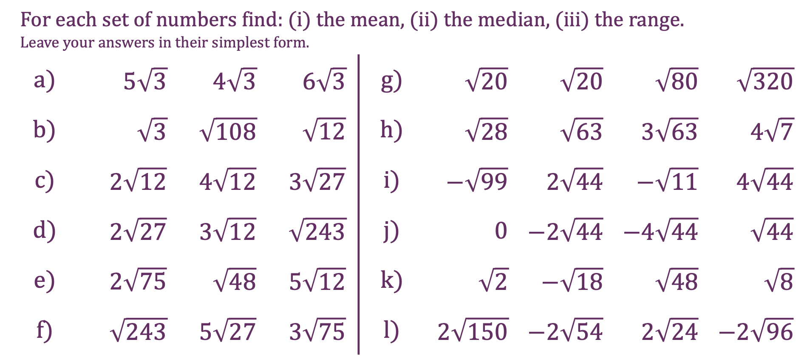
Surds
For each set of numbers find: (i) the mean, (ii) the median, (iii) the range. Leave your answers in their simplest form.
a) | $5\sqrt{3}$ | $4\sqrt{3}$ | $6\sqrt{3}$ | g) | $\sqrt{20}$ | $\sqrt{20}$ | $\sqrt{80}$ | $\sqrt{320}$
b) | $\sqrt{3}$ | $\sqrt{108}$ | $\sqrt{12}$ | h) | $\sqrt{28}$ | $\sqrt{63}$ | $3\sqrt{63}$ | $4\sqrt{7}$
c) | $2\sqrt{12}$ | $4\sqrt{12}$ | $3\sqrt{27}$ | i) | $−\sqrt{99}$ | $2\sqrt{44}$ | $−\sqrt{11}$ | $4\sqrt{44}$
d) | $2\sqrt{27}$ | $3\sqrt{12}$ | $\sqrt{243}$ | j) | $0$ | $−2\sqrt{44}$ | $−4\sqrt{44}$ | $\sqrt{44}$
e) | $2\sqrt{75}$ | $\sqrt{48}$ | $5\sqrt{12}$ | k) | $\sqrt{2}$ | $−\sqrt{18}$ | $\sqrt{48}$ | $\sqrt{8}$
f) | $\sqrt{243}$ | $5\sqrt{27}$ | $3\sqrt{75}$ | l) | $2\sqrt{150}$ | $−2\sqrt{54}$ | $2\sqrt{24}$ | $−2\sqrt{96}$

Slide 5
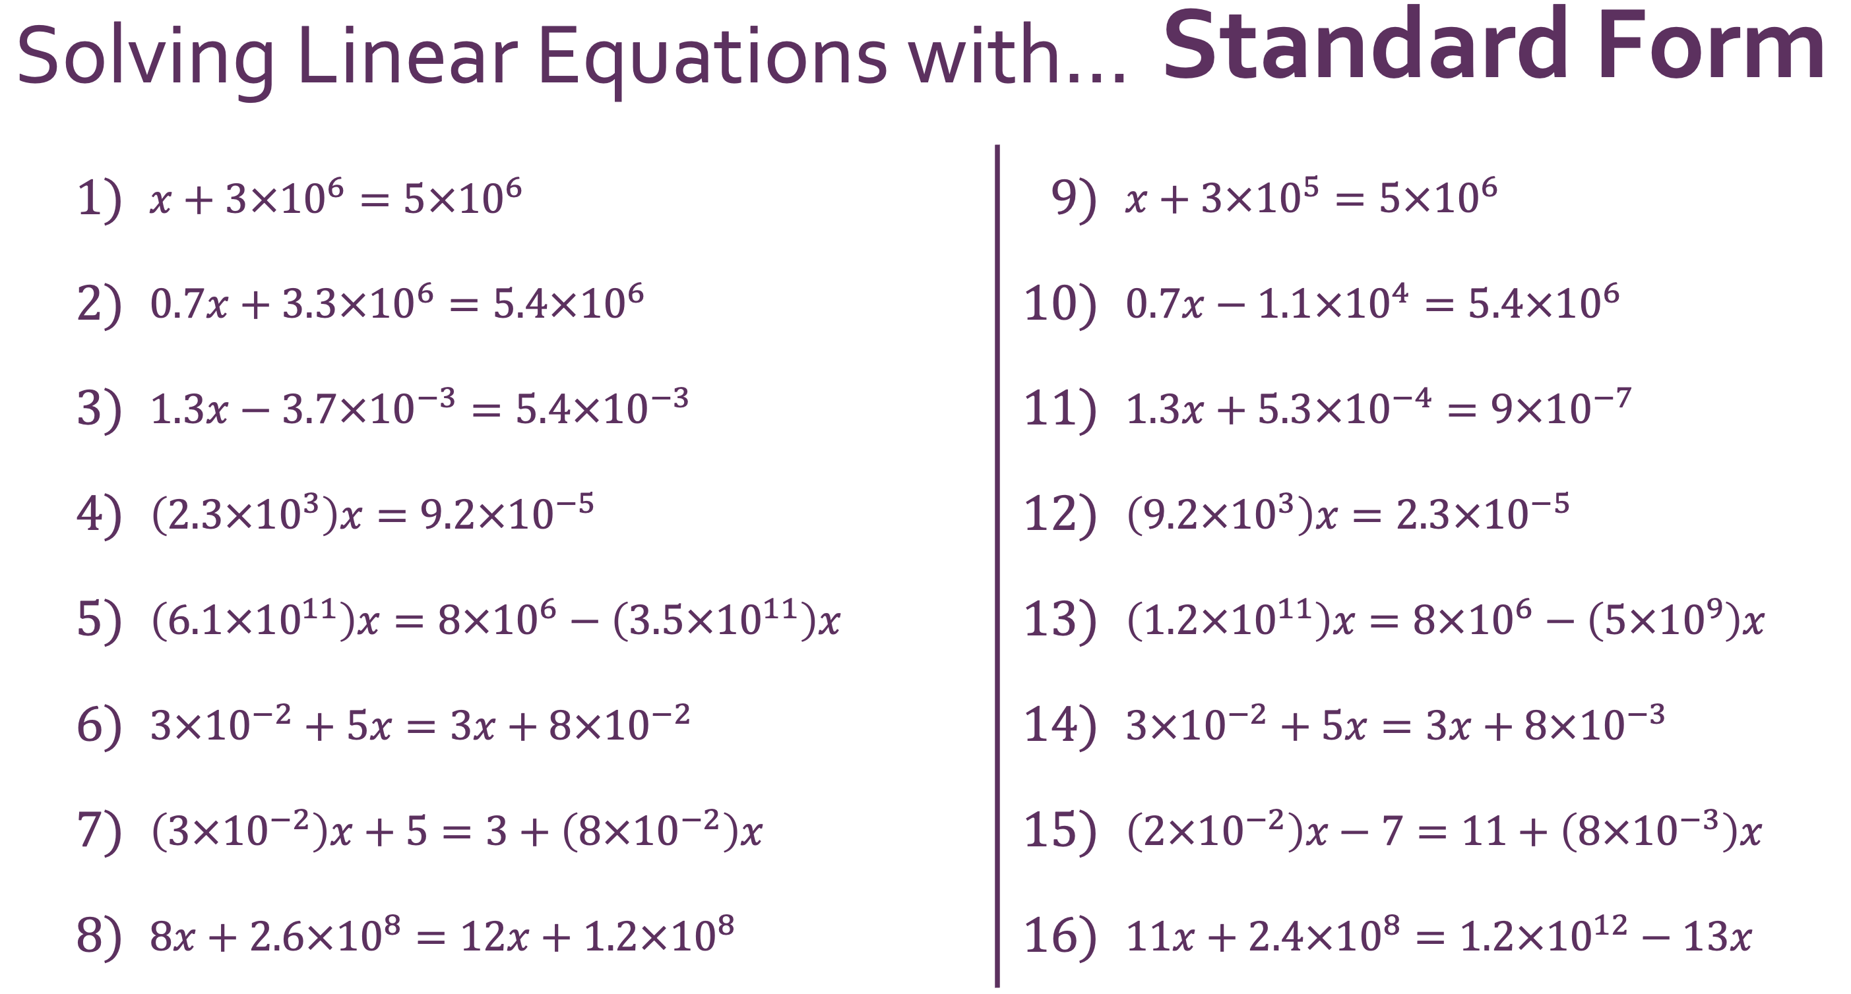
InterwovenMaths.com

Slide 6
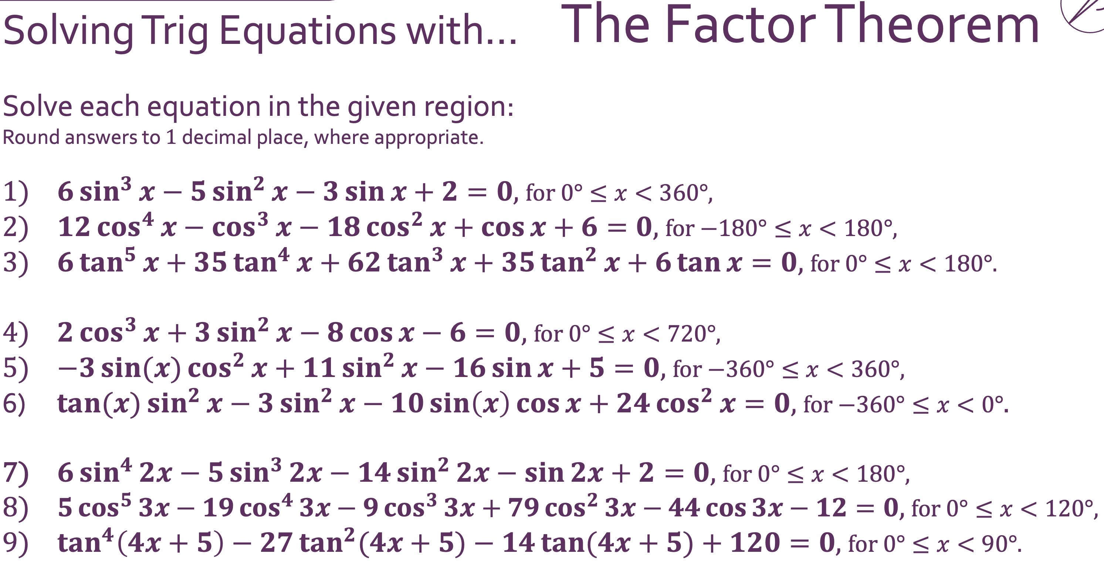
InterwovenMaths.com

Slide 7
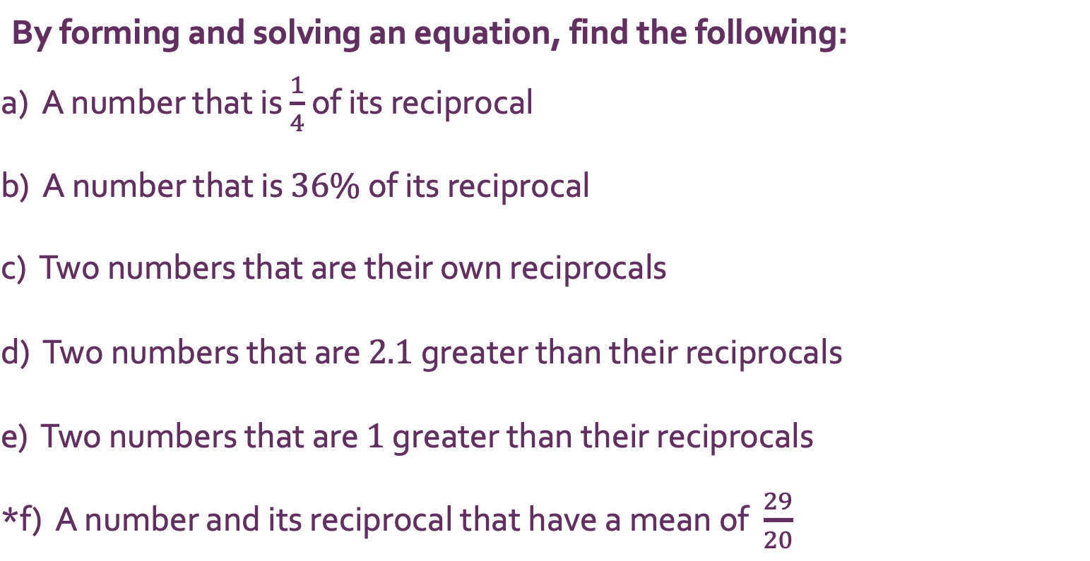
InterwovenMaths.com
Reciprocals with… Equations
By forming and solving an equation, find the following:
a) A number that is $\frac{1}{4}$ of its reciprocal
b) A number that is $36\%$ of its reciprocal
c) Two numbers that are their own reciprocals
d) Two numbers that are $2.1$ greater than their reciprocals
e) Two numbers that are $1$ greater than their reciprocals
*f) A number and its reciprocal that have a mean of $\frac{29}{20}$

Slide 8
What is Interweaving?
Why do Interweaving?
1 – Making Connections
2 – Retrieval
3 – Depth
4 – Challenge
5 – Purpose

Slide 9


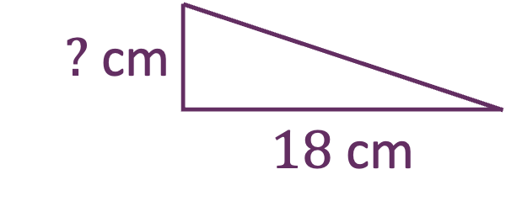
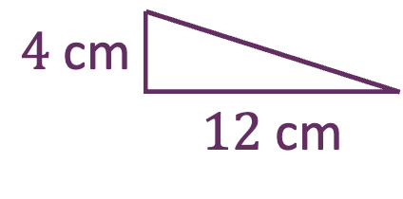

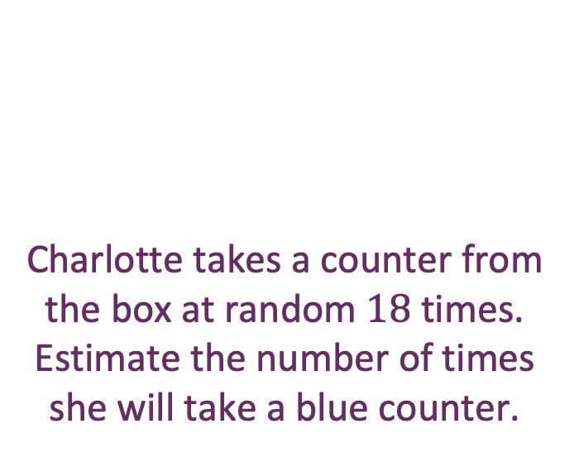


Proportional Reasoning
Charlotte takes a counter from the box at random $18$ times.
Estimate the number of times she will take a blue counter.
$12\%$ of a number is $4$.
What is $18\%$ of that number?
B
B
G
R
$$\frac{4}{12}=\frac{?}{18}$$
G
G
G
R
B
R
B
G
Which is the odd one out?
$4$ cm
 | $12$ cm
Jonny walks $12$ miles in $4$ hours.
How far does he walk in $18$ hours?
$$(?, 18)$$
$?$ cm
 | $18$ cm
$$(4, 12)$$

Slide 10
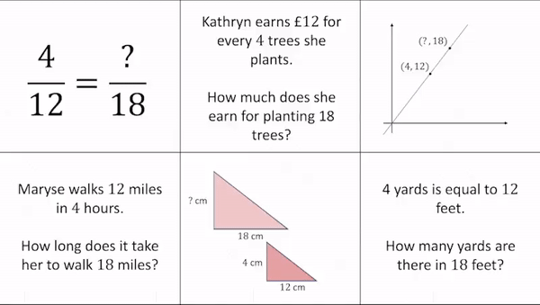
Proportional Reasoning

Slide 11
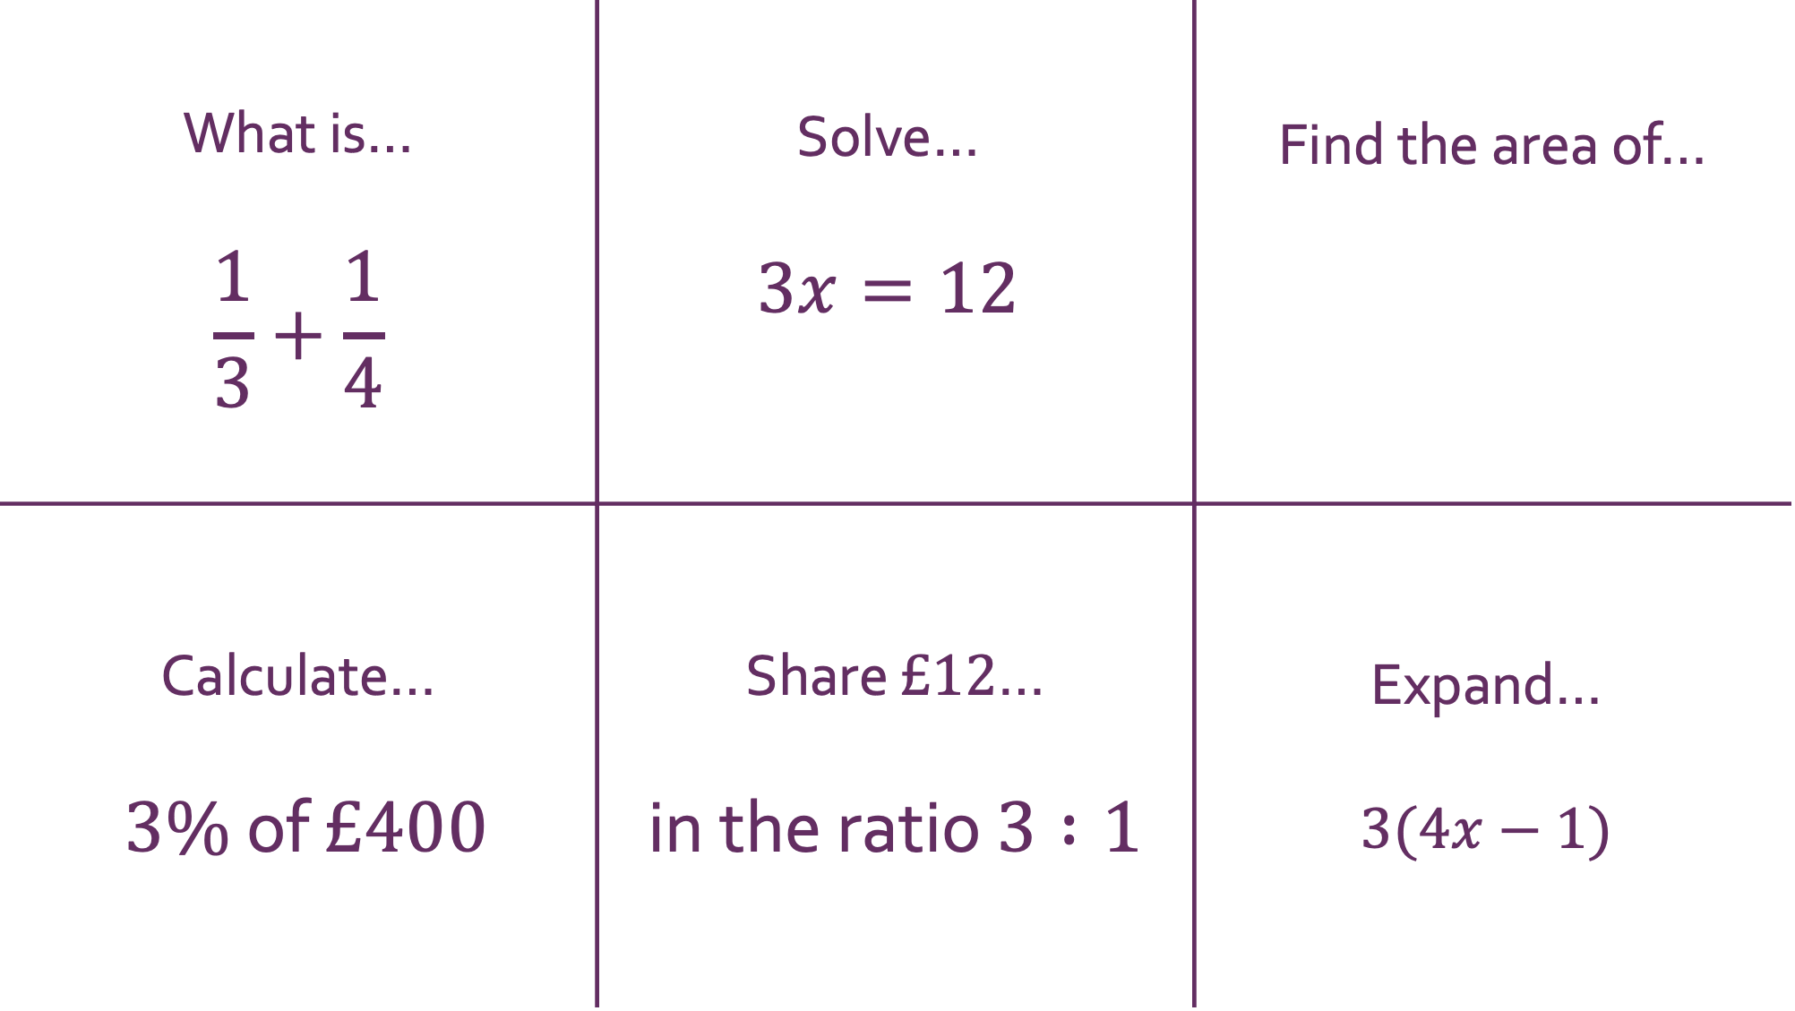

What is… $$\frac{1}{3}+\frac{1}{4}$$ | Solve… $$3x=12$$ | Find the area of…
Calculate… $3\%$ of $£400$ | Share $£12$… in the ratio $3 :1$ | Expand… $$3(4x−1)$$
Multiplication
3 m
 | 4 m
$$3×4=12$$

Slide 12
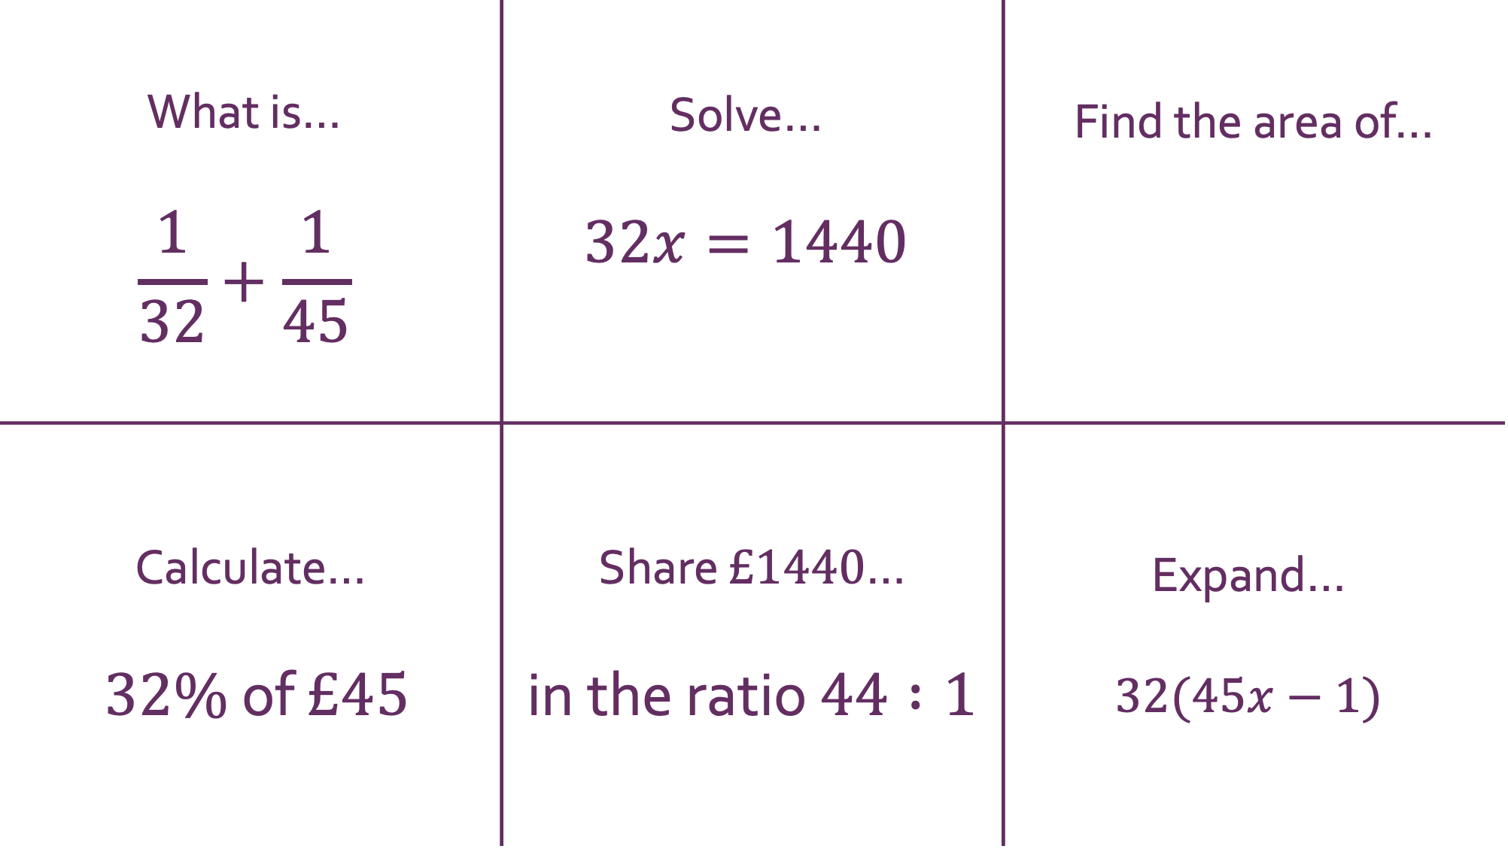

What is… $$\frac{1}{32}+\frac{1}{45}$$ | Solve… $$32x=1440$$ | Find the area of…
Calculate… $32\%$ of $£45$ | Share $£1440$… in the ratio $44 :1$ | Expand… $$32(45x−1)$$
Multiplication
45 m
 | 32 m
Given that $32×45=1440$…

Slide 13
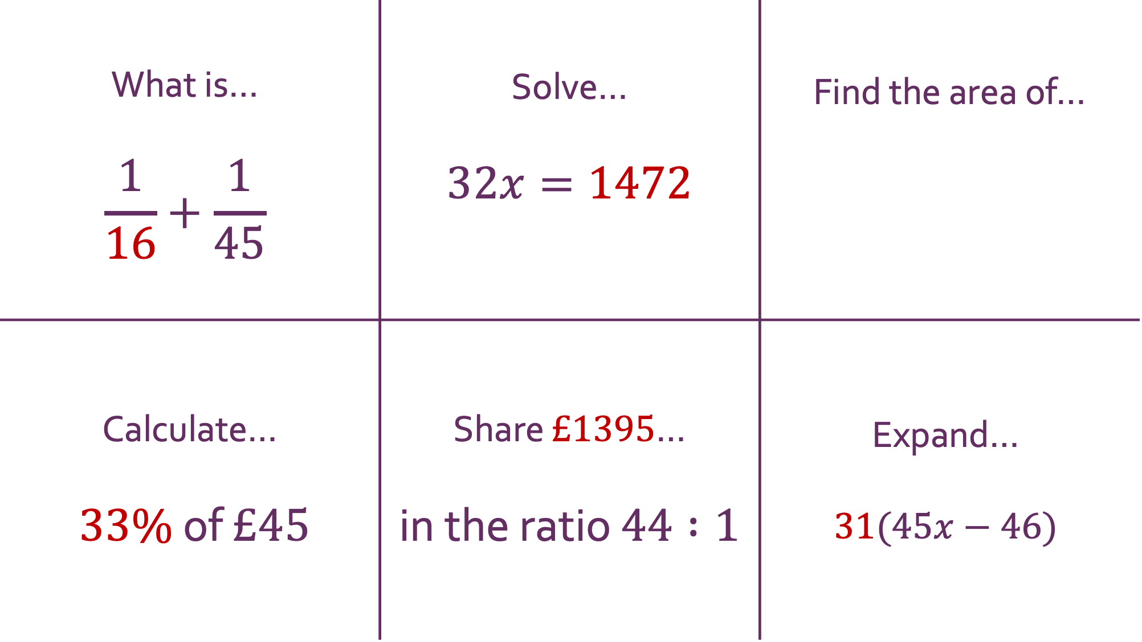
What is… $$\frac{1}{16}+\frac{1}{45}$$ | Solve… $$32x=1472$$ | Find the area of…
Calculate… $33\%$ of $£45$ | Share $£1395$… in the ratio $44 :1$ | Expand… $$31(45x−46)$$
Multiplication
4.5 m
 | 32 m
Given that $32×45=1440$…

Slide 14
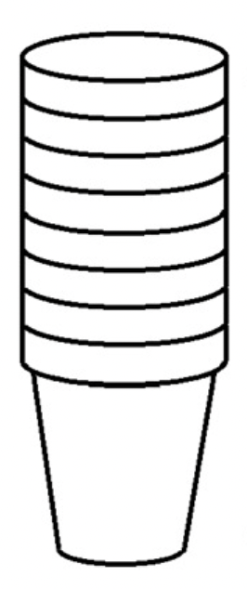
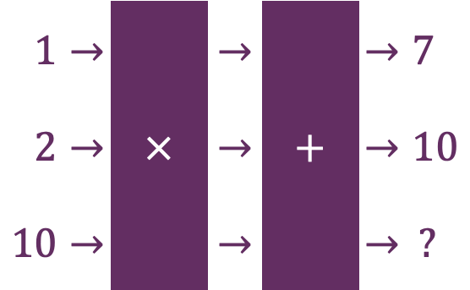








Find the $10$^{th} term of the sequence $$7, 10,…$$ |  | A taxi fare includes a call-out fee and a price per mile driven. $1$ mile $→£7$ total $2$ miles $→£10$ total $10$ miles $→ ?$
 | $$△⧠=7$$ $$△△⧠=10$$ $$△△△△△△△△△△⧠= ?$$
Linear Relationships
$$(10, ?)$$
$$(2, 10)$$
$$(1, 7)$$
Change each question to make the answer $43$
$1→$ |  | $→$ |  | $→7$
$2→$ | $×$ | $→$ | $+$ | $→10$
$10→$ |  | $→$ |  | $→ ?$
$7$ cm
$?$ cm
$10$ cm

Slide 15
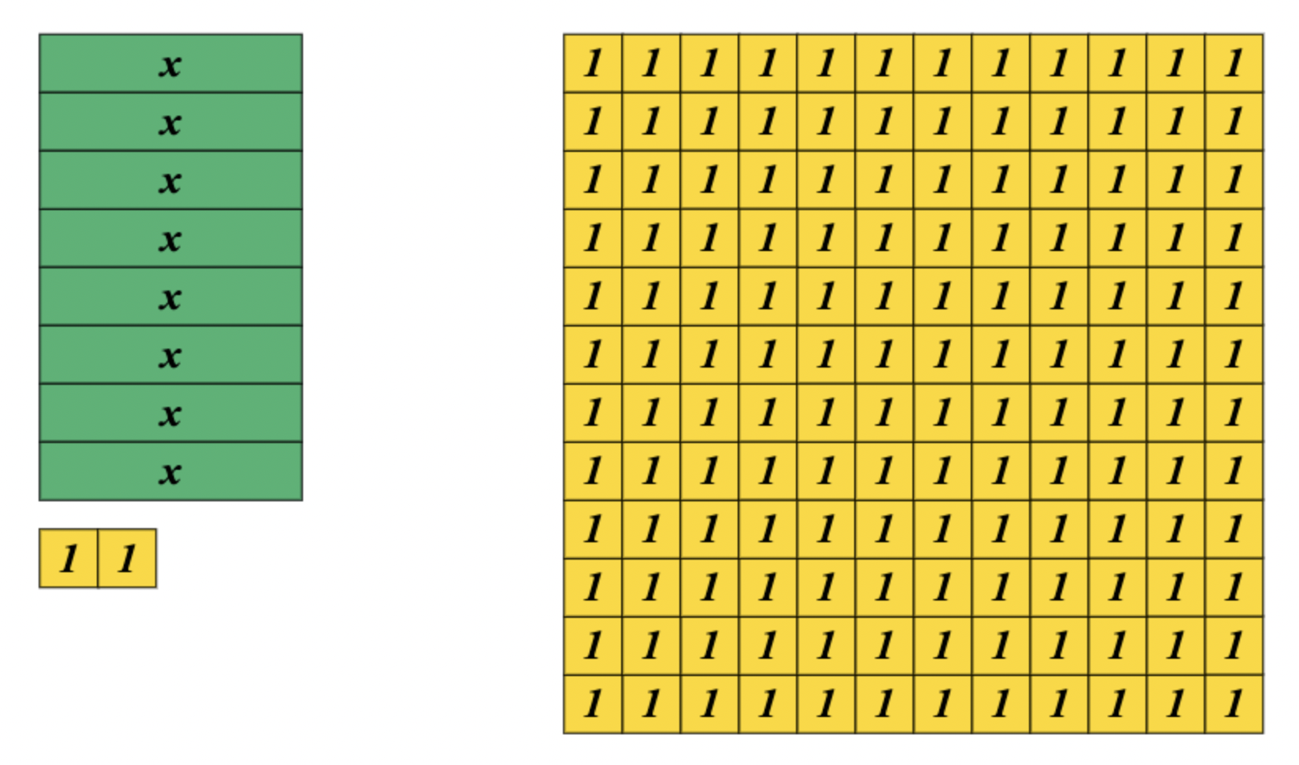

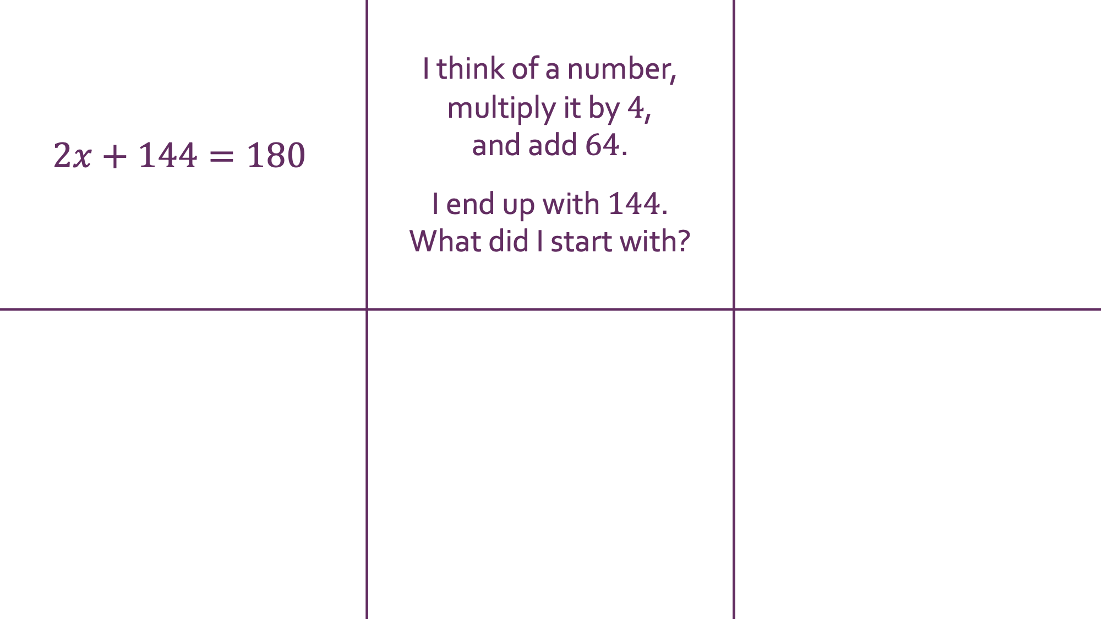
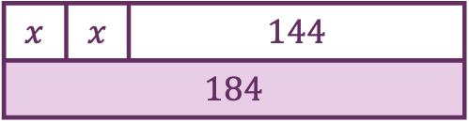
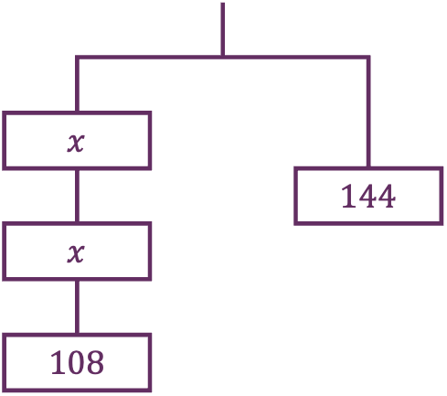
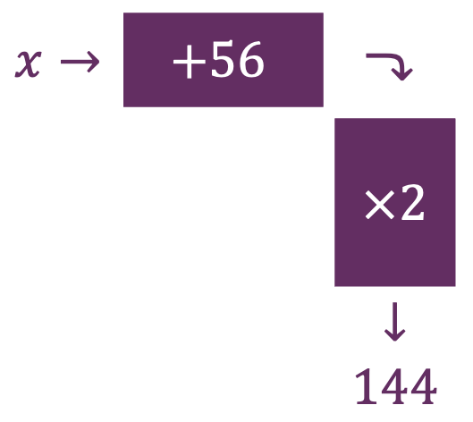
$$2x+144=180$$ | I think of a number, multiply it by $4$, and add $64$. I end up with $144$. What did I start with?
Different Presentations
$x→$ | $$+56$$ | $⤵$
 |  | $×2$
 |  | $↓$ $144$
Pair them up
$x$
 |  |  |  | $144$
$x$
$108$
$x$ | $x$ | $144$
$184$
$=$

Slide 16
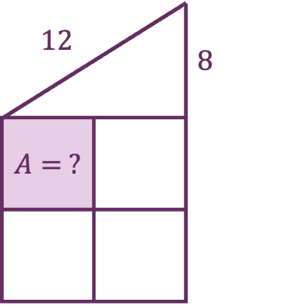
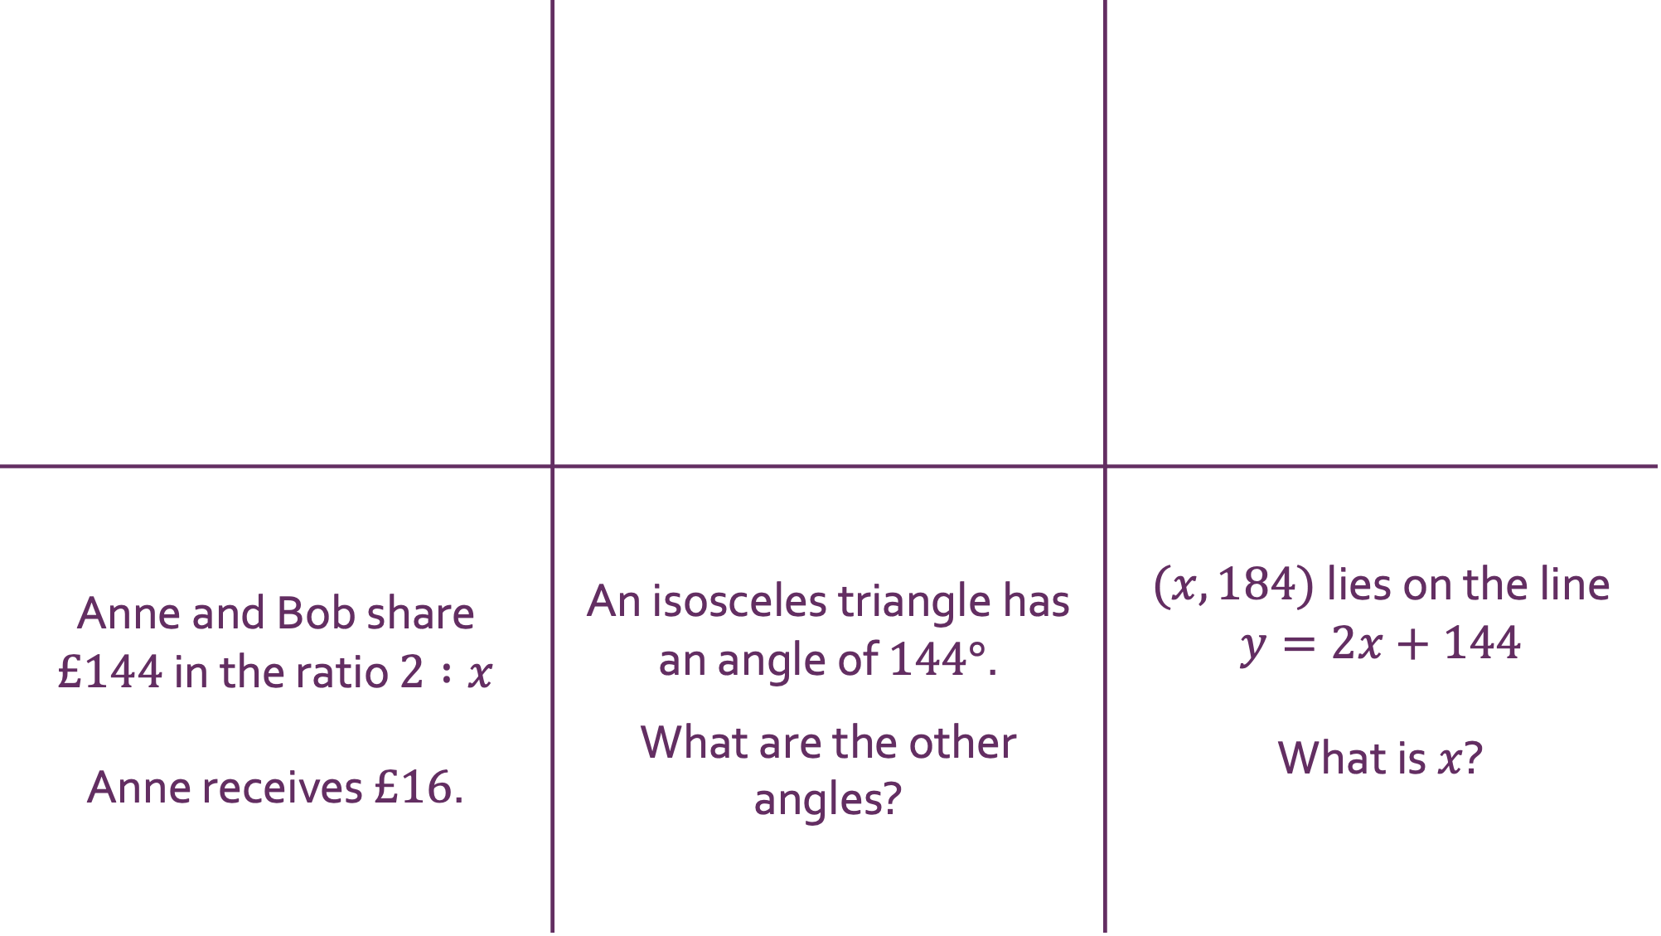
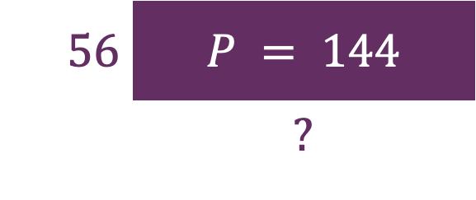



Anne and Bob share $£144$ in the ratio $2 :x$ Anne receives $£16$. | An isosceles triangle has an angle of $144°$. What are the other angles? | $(x, 184)$ lies on the line $y=2x+144$ What is $x$?
Different Topics
Right angled triangle
$12$ |  | $8$
$A= ?$
$56$ | $P = 144$
 | $?$
Four congruent
squares
$144°$
$x$
$x$
Pair them up

Slide 17
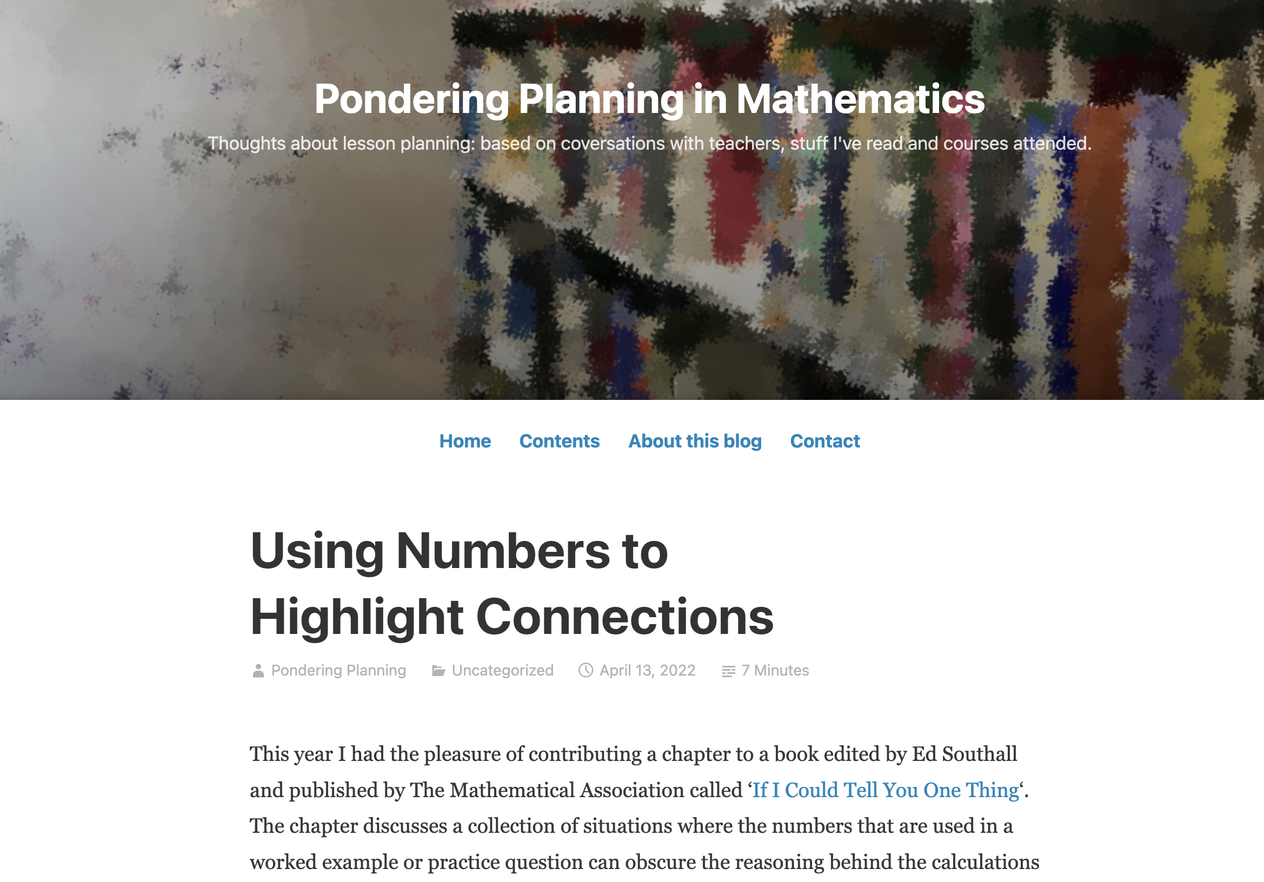
https://ponderingplanning.wordpress.com/2022/04/13/using-numbers-to-highlight-connections/

Slide 18
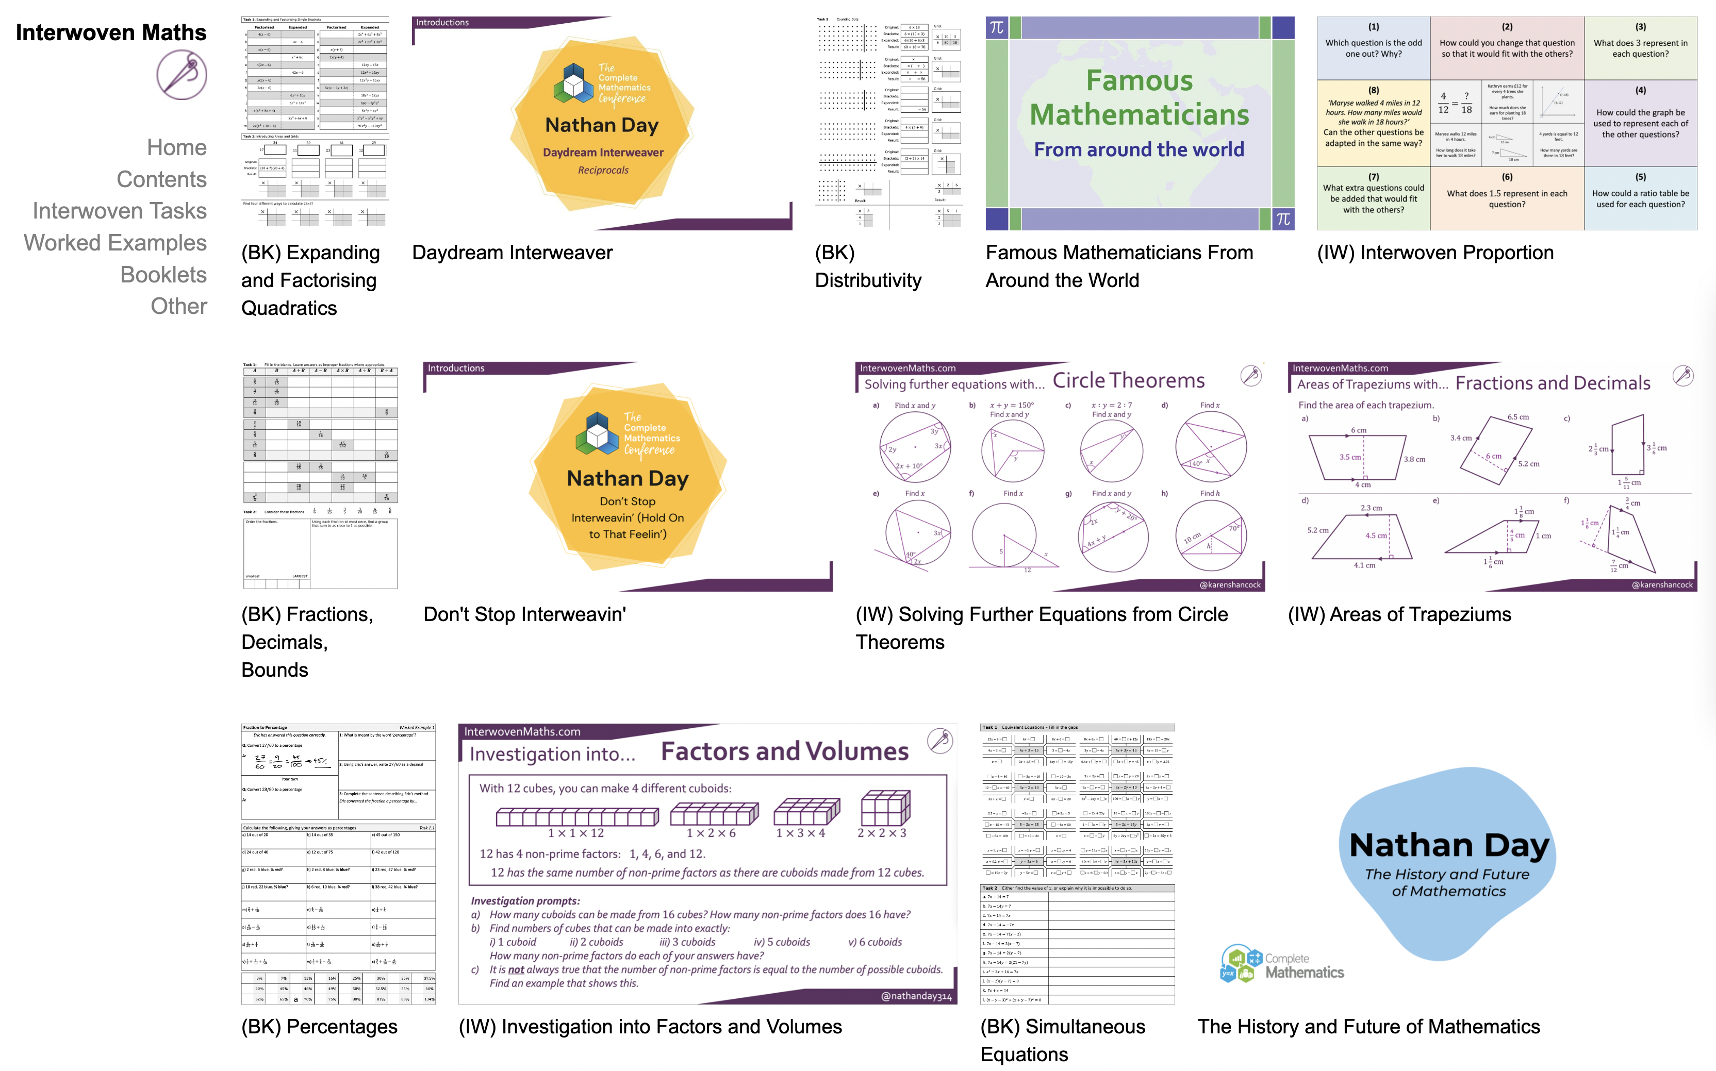
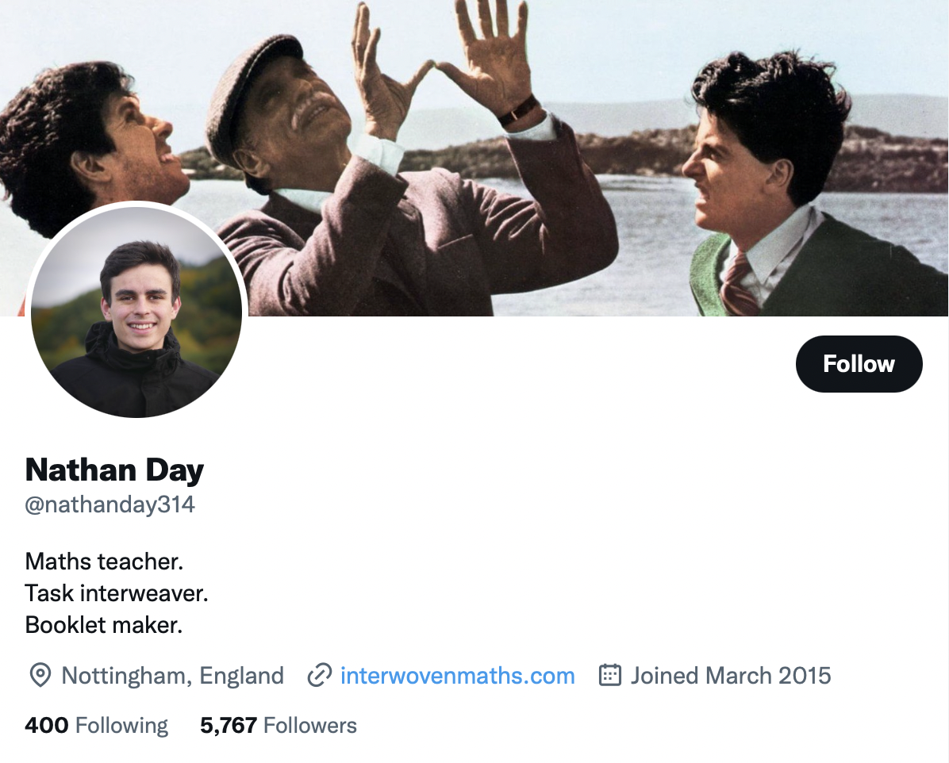
Wrapping up
Thank you!

