Slide 1
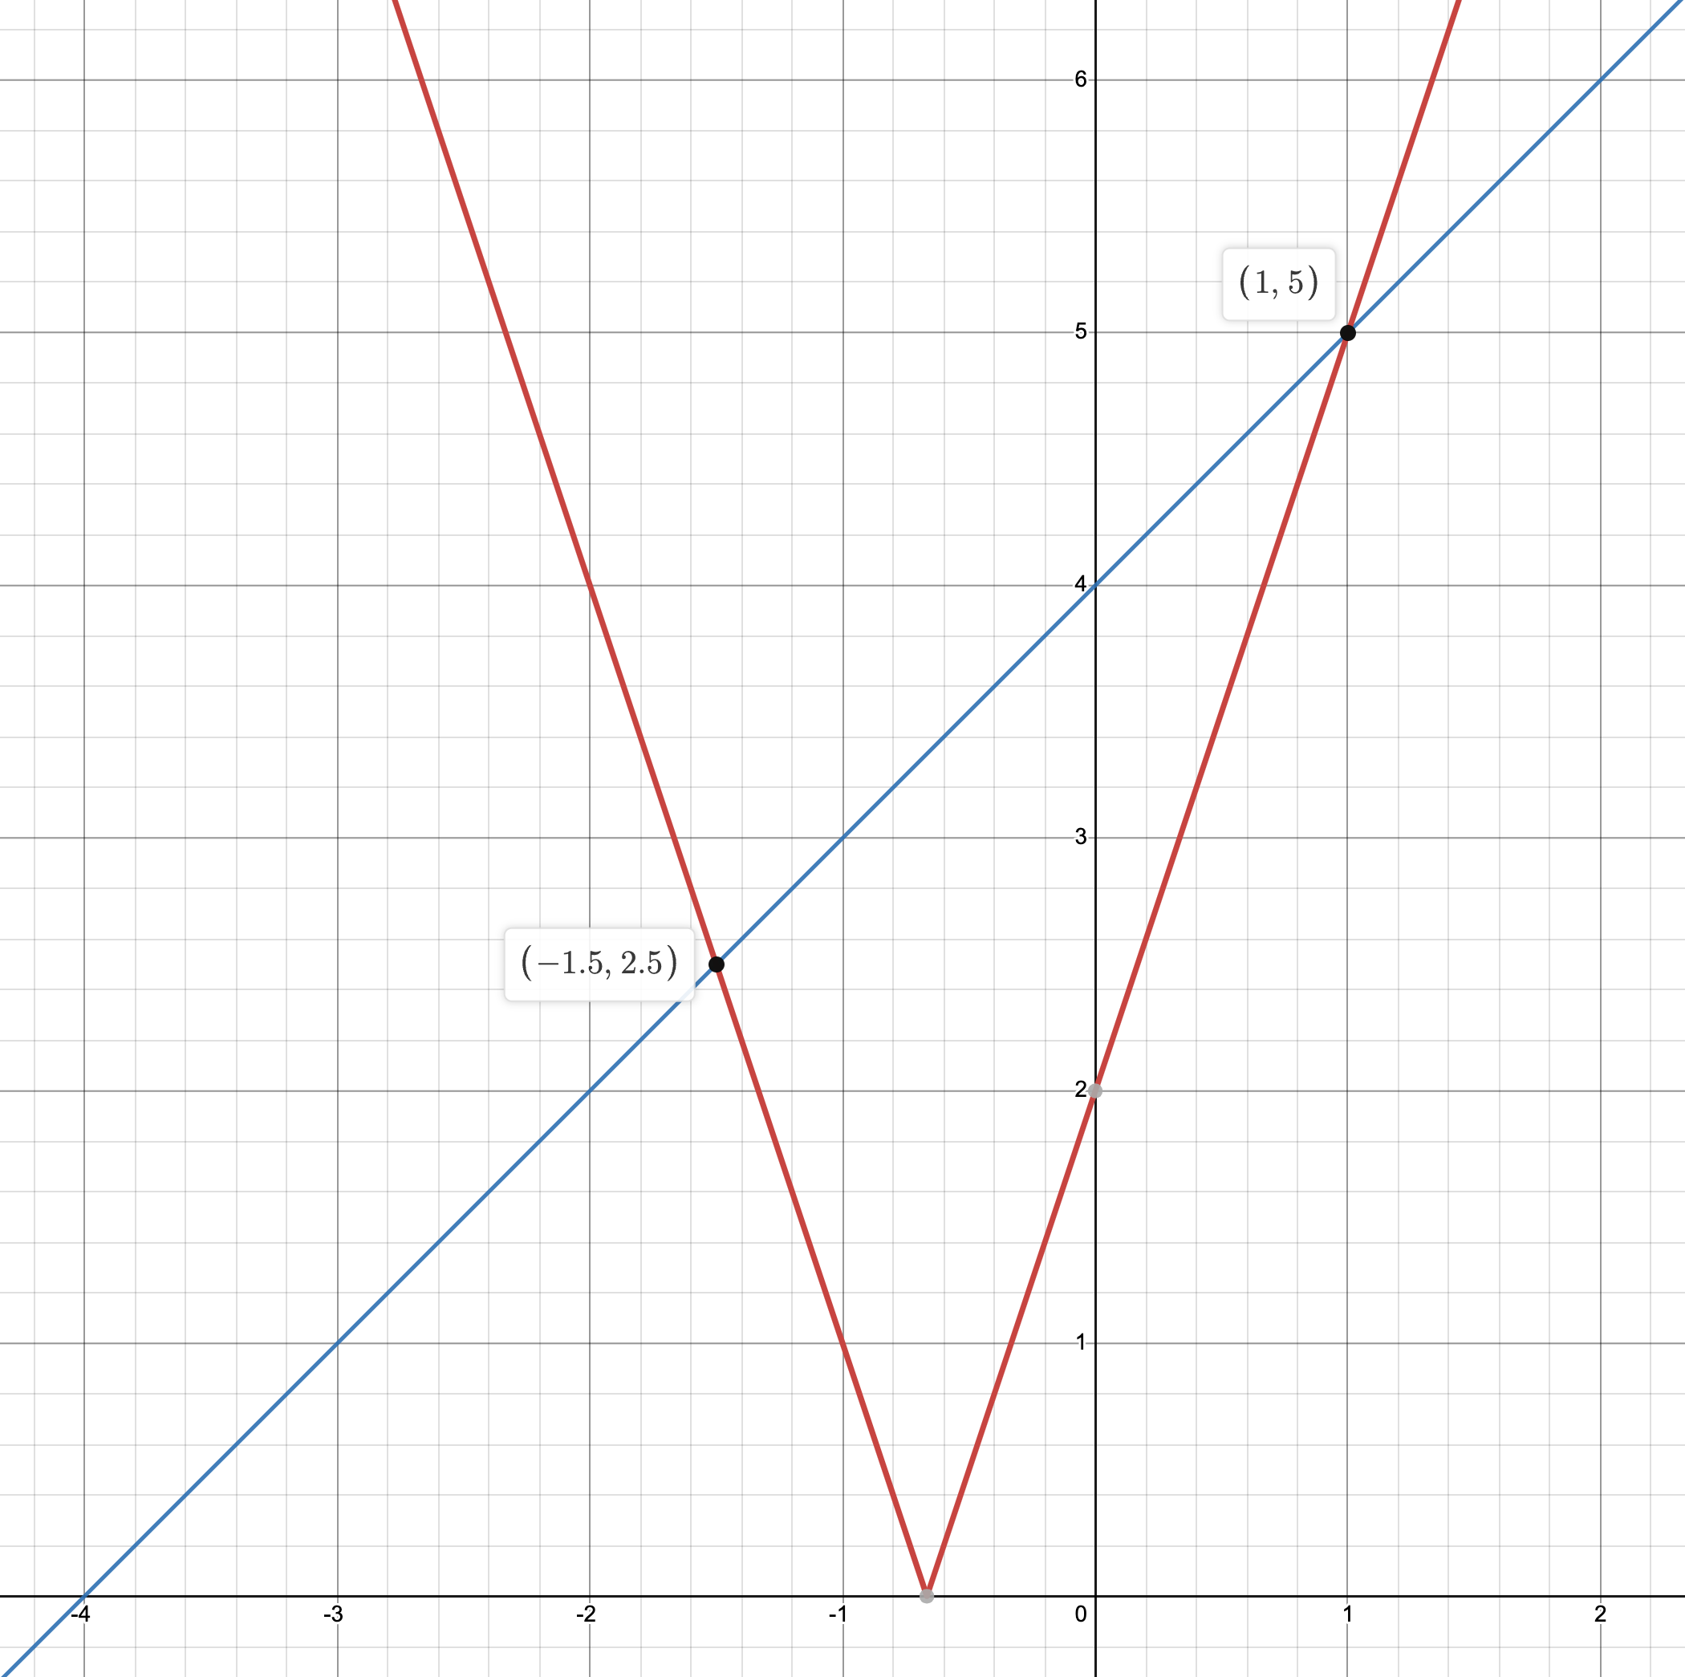
Modulus Functions - 1 | Study the solutions carefully and answer these questions.
Ben has answered this question correctly. Q: Solve $\left|3x+2\right|=x+4$. A: | 1: Substitute $x=1$ and $x=−1.5$ into the equation to verify the solutions. 2: Draw a graph showing $y=\left|3x+2\right|$ and $y=x+4$. Label any intersections of the lines with each other and with the axes. 3: Using either method, solve $\left|3x+2\right|=4x+5$. E: Find the area of the triangle between the lines $y=\left|3x+2\right|$ and $y=x+4$.
Evie has also answered the question correctly. Evie has used a different method to Ben. Q: Solve $\left|3x+2\right|=x+4$. A:

Slide 2
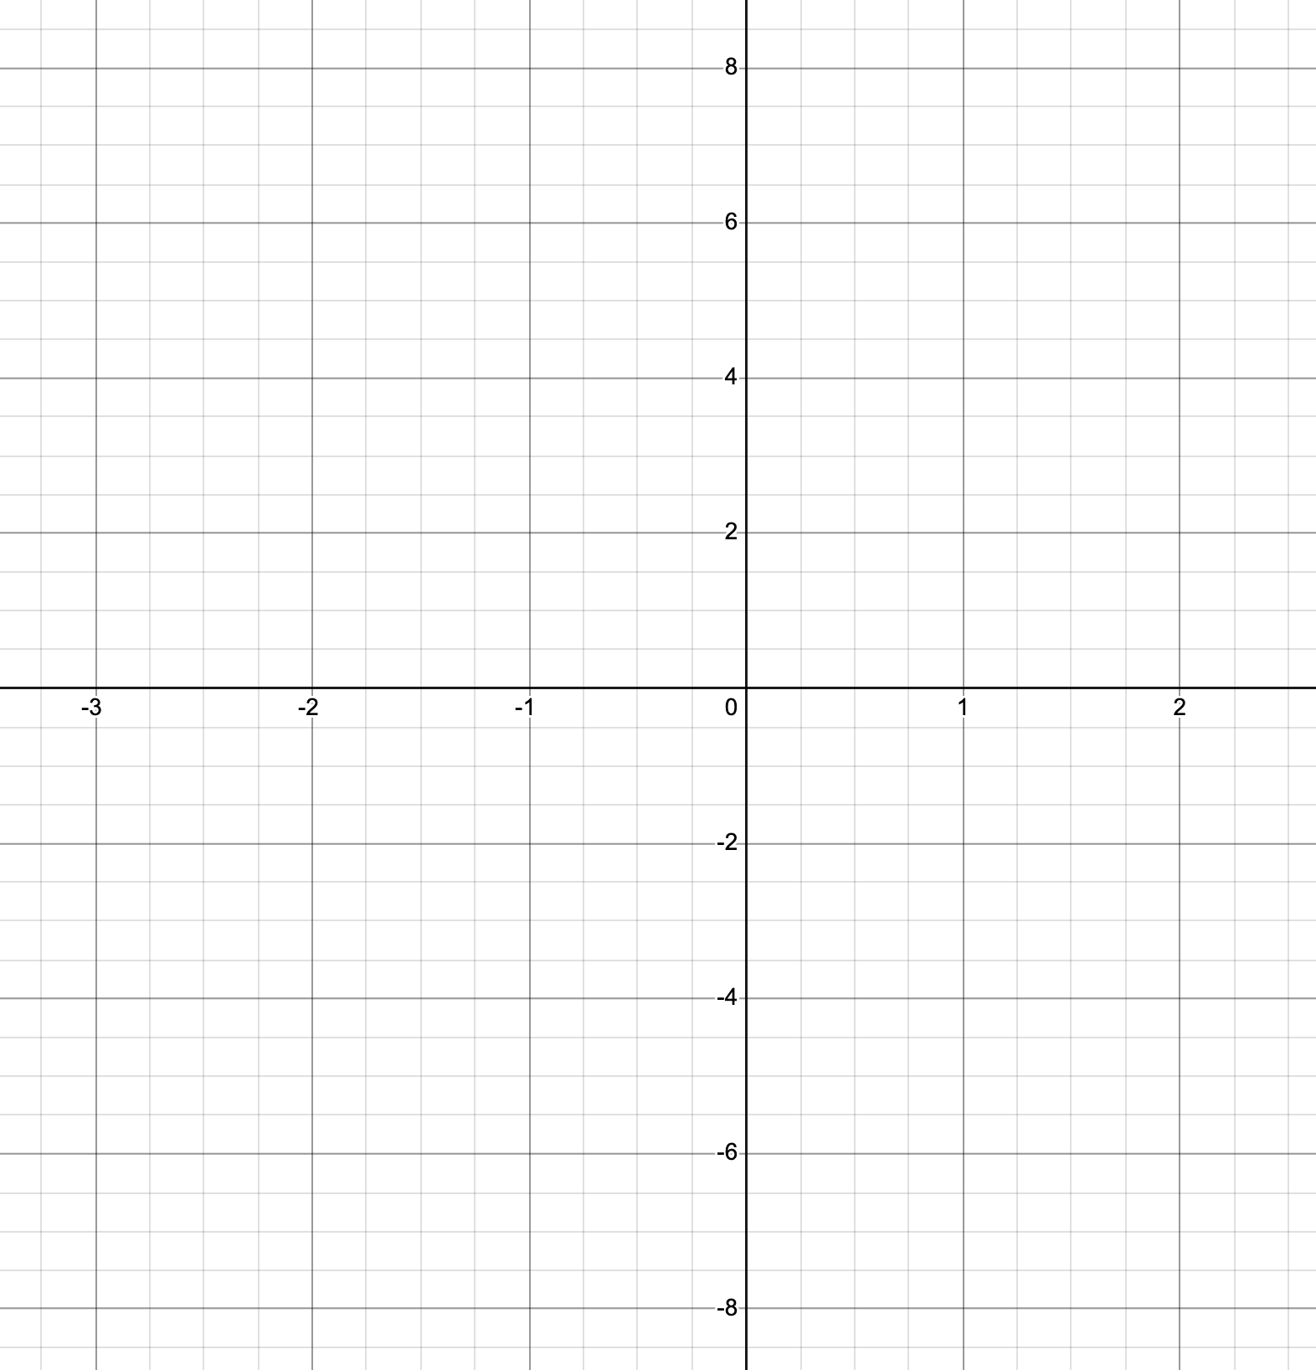
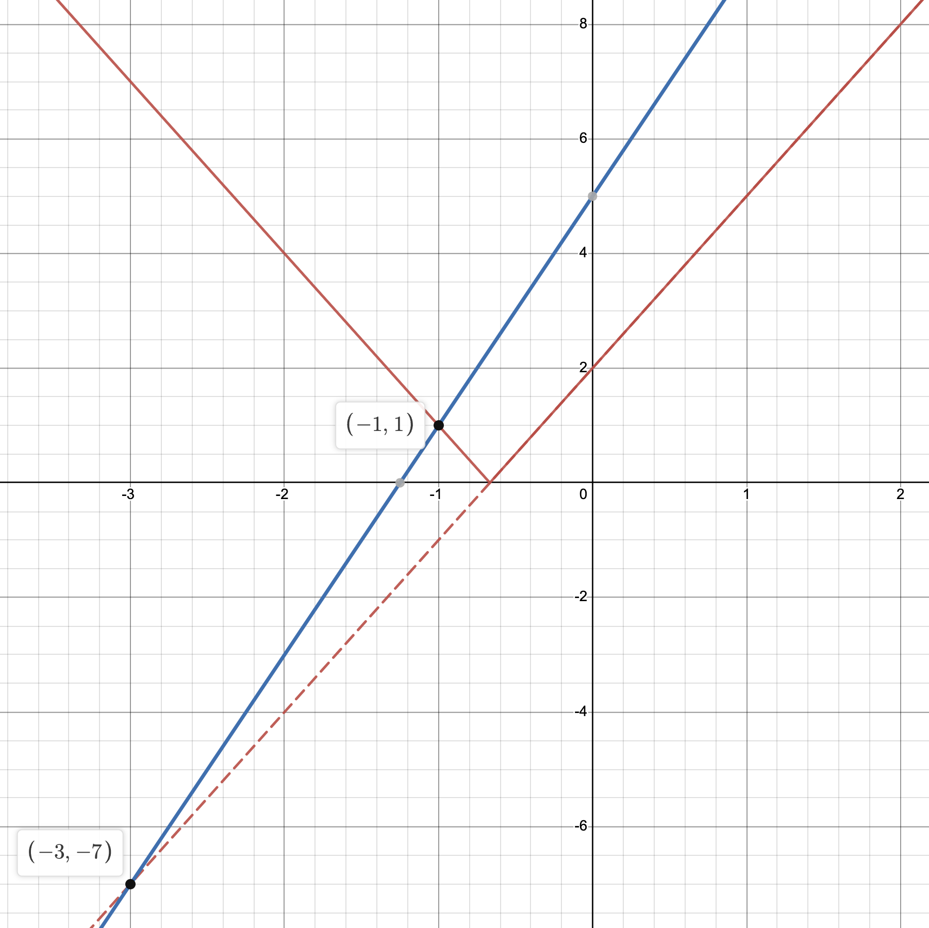
Modulus Functions - 2 | Study the solutions carefully and answer these questions.
Ben has answered this question correctly. Q: Solve $\left|3x+2\right|=4x+5$. A: | 1: By substituting into the equation, show that $x=−3$ is not a solution. 2: Draw a graph showing $y=\left|3x+2\right|$ and $y=4x+5$. Show on the graph both the correct solution and the ‘phantom solution’. 3: How did Ben know to reject the $x=−3$ solution? 4: What should Evie have done to avoid making the error?
Evie has answered the question incorrectly. Evie has used a different method to Ben. Q: Solve $\left|3x+2\right|=4x+5$. A:

